Slide 1
Webinar Training Series
Auto Reporting

Slide 2
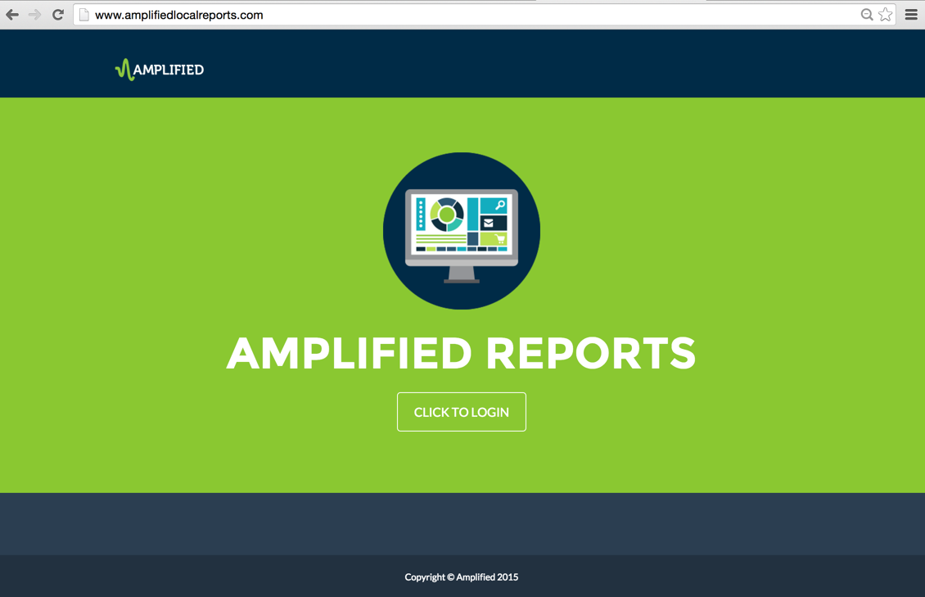
Notes:
The focus of this training session is the Auto report in the Amplified Analytics dashboard.

Slide 3
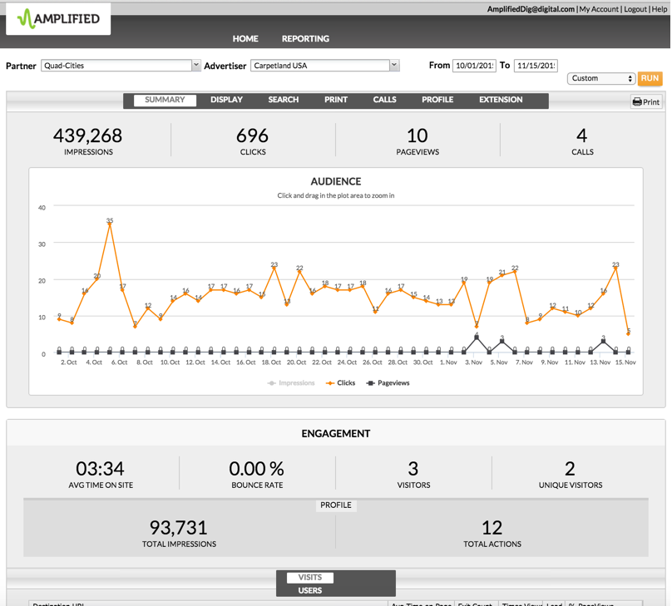
Notes:
The auto report is uniquely set up to present the performance metrics specifically for the automotive inventory solution, Wheels For You. It emphasizes the audience reached, and the car buyers engagement, and actions taken on a dealerships vehicle listings.
To drill down into the data, select the Auto tab from the performance summary page. The summary page also includes a glimpse of the overall performance including total vehicle detail page views, actions and leads generated from the Wheels For You platform.

Slide 4
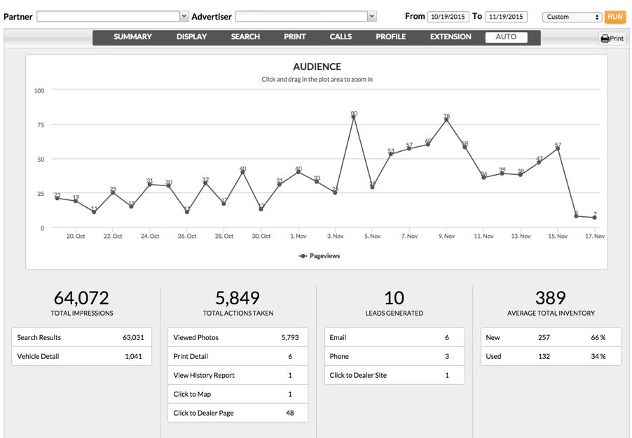
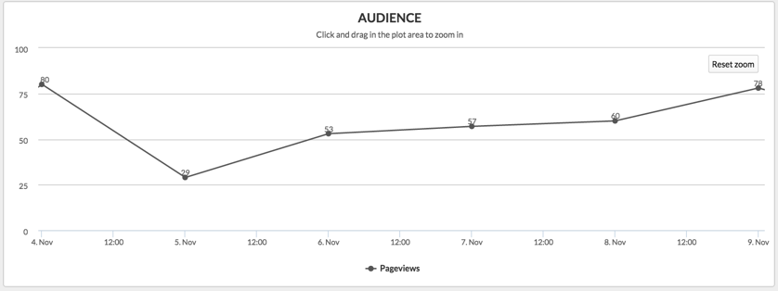
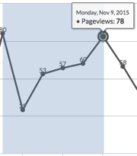
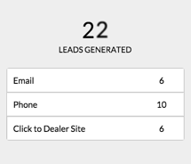
Notes:
Upon entering the Auto report, starting at the top of the page, you will see an audience graph showcasing total vehicle detail page views. You can take a closer look at a particular timeframe by clicking and dragging a plot area. Returning to full-view by clicking the reset button. Additional audience metrics are presented within the total impressions area, which is made up of the total search results and vehicle details page impressions. Search results are made up of the number of times your dealer’s inventory shows up in a Wheels for You search. Vehicle detail is the number of times the audience has click thru to view the vehicle detail page. The vehicle detail page is often sited in the automotive industry as the most valuable metric to measure consumer engagement and return on investment.
The next sections showcase the car buyers engagement and activities on the site. These actions show how you are effectively promoting visitors toward the dealership’s inventory, which helps get the shopper into the front door to check out the vehicle in-person, and also is a jump-start to close a sale. You are able to see the total number of photos viewed, how many times vehicle details were printed, vehicle history reports viewed, click-thrus to view the map of the dealership location, and how many times car buyers click thru to view the dealers profile page.
Actions result in leads, which all help to close new sales. Leads are displayed within the leads generated section. Not only are you able to see the emails, and phone calls delivered, but also show how many potential car buyers you pushed directly to a dealerships website, all from the Wheels For You platform.
When a call tracking number is used, you'll find the details of the calls under the specific calls report, which you can access via the Calls tab at the top of the page.
The average total inventory gives you a sense of the dealers volume and inventory mix over the course of the report. These numbers are valuable in discussing the context of the performance. In this example, the dealership inventory skews toward new but still shows healthy engagement on used, suggesting that the dealer’s inventory is priced and composed well for the market.

Slide 5
Notes:
Digging deeper into the inventory, Dealers have the ability to evaluate how specific inventory is performing, based on total search results and vehicle detail page views.
Within the VIN Detail section, you can filter and view the report by year, make and model, as well as specific VIN and stock number. You can also download this data into an Excel document, by clicking on export.
Let’s now take a closer look at the call metrics within the dashboard. When a call tracking number is used, you'll find the details of the calls under the specific calls report, which you can access via the Calls tab at the top of the page.

Slide 6
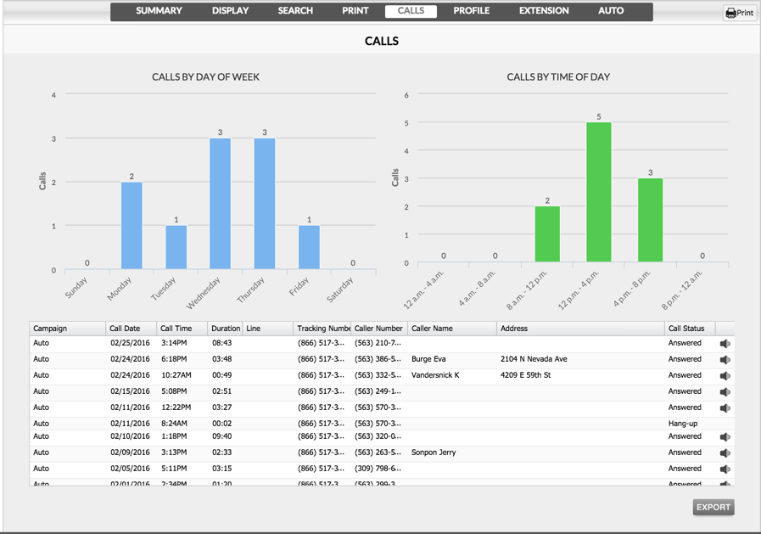
Notes:
The report starts with calls by day of the week and time of the day. This can be very eye-opening to a dealership and can provide data that can, in some cases, uncover issues that may be affecting their business. They can determine if their business is set up adequately to make sure they aren't missing any calls. Are there certain days or times they're understaffed or do they need more phone lines? This detailed call information can be very powerful and can be an indirect way to increase business as a result of the information you are giving them as a marketing consultant.
This section lets you drill down deeper into the details on the actual calls made. Filtering options on all the tabs allow you to sort the data to find exactly what you're looking for, whether it be all the calls from a specific campaign, calls from one particular day, or even all the calls from a particular caller. By knowing the name of the caller, you can see if it is a current customer or a potential new lead.
In addition to proving the ROI of your automotive platform, the call status and ability to listen to the calls is a great tool to help your dealership in the customer service arena. You have the ability to see how many calls were answered, as well as how many were missed.
Listening to the calls within the dashboard provides another insight into their business, as you can hear how the phones are being answered and how customers are being treated. As a business owner, you trust the front lines answering the phones are professional and courteous to your customers. Listening can be very enlightening to a dealership and can greatly help them with sales efforts. Not only knowing their phones are being answered but how they're being answered, how their customers are being treated and maybe services callers are asking for, comes from the data you provided as a marketing consultant. Call recordings are available for 90 days after the call was received. You can also export the call details into an Excel document by selecting the export button – the audio does not export into the Excel doc.

Slide 7
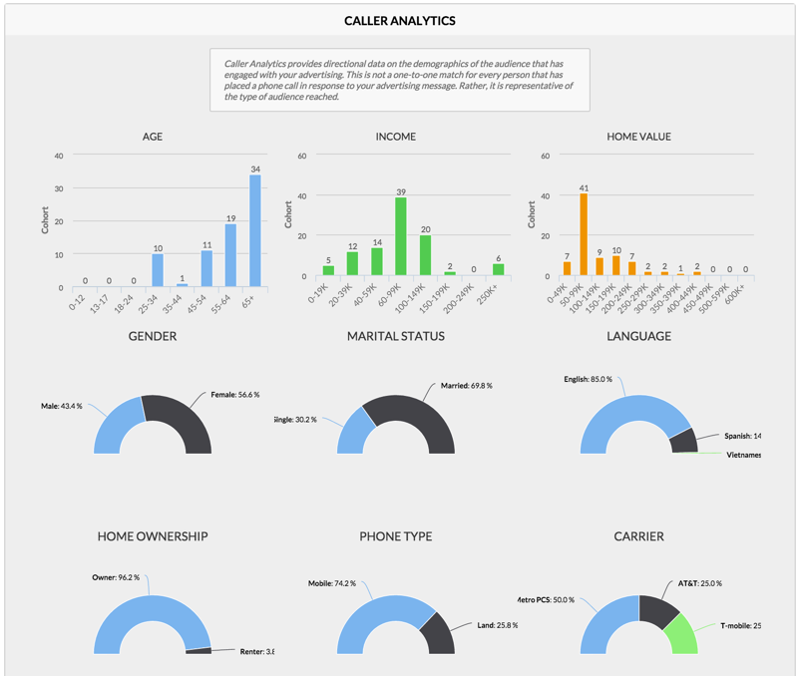
Notes:
The caller analytics section really digs into the demographics of the callers. It's a representation of the audience reached. For advertisers who want to know more about who they're reaching, this section provides about everything they would want to know: Age, income, home value, gender, marital status, the caller's language, home ownership, phone type and phone carrier. It's a lot of information that some dealerships may be interested in knowing and vet against leads and sales.

Slide 8
Notes:
This concludes the Auto data page training, within the Amplified Analytics dashboard.

