Slide 1
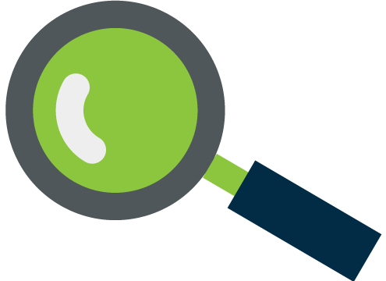
importance of search
Why?
Google, Bing and Yahoo! dominate search, over 95% combined share.
Your company’s appearance at the top of the Search Engine Result Page (SERP)
Paid search lifts organic search
Paid search is an essential part of your marketing strategy
Almost 60% of US adults use a search engine
each day.
When?
When your website needs help with SEO
When promoting a time-sensitive offer
If you have a new website, product or service
Highly targeted traffic is sought
Searches Done Per Searcher in the US Per Month
121
Think about the words users would type to find your pages,
and make sure that your site actually includes those words within it.

Slide 2
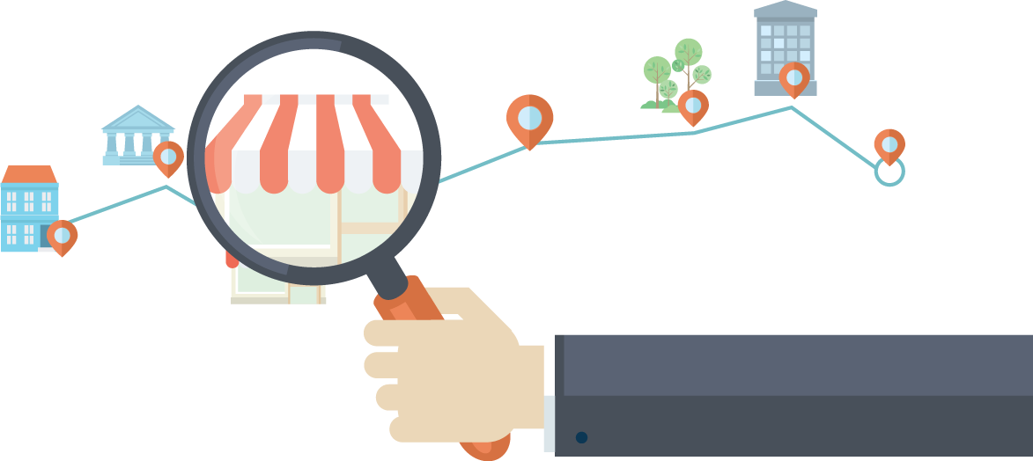
benefits of SEM
Increase brand awareness
Increase web traffic
Reach an audience that's interested in you
Increase in targeted leads.
Target your ads to users in a specific location
Drive ROI with those actively seeking you

Slide 3
Why Work With Amplified Digital?
BECAUSE HERE’S WHAT IT TAKES TO BUY DIRECT FROM GOOGLE
Set up an account in Google
Deposit money into your account
Design your ad
Select your geo-targeting
Bid on your keywords
Set your daily spend amount
Review your results (reports)
Adjust your buy-based on click analytics
Repeat
Notes:
Do you change your own oil for your car?
You could…why don’t you?
Search is the same way. We’ll talk more today about handling objections. But this is the easiest one to combat.

Slide 4
SEM as part of Amplified Digital
Complete Solution
“We do it all for you.” This includes:
Setting up targeted SEM campaigns on Google, Yahoo, and Bing
Creating the mirror site or landing pages to track results
Call tracking with local or 800 numbers
Ongoing campaign management and optimization
Results will be reported in the Amplified Digital dashboard
$63,537
Notes:
One-stop Shopping – We can now offer a complete digital advertising solution
Results Driven – Engagement Dashboard designed to show measurable results
Nimble – Includes ability to add or remove products based on changing market
Competitive advantage – Local sales force with best-of-breed national vendors.

Slide 5
How We’re Different Than Our Competitors
It all starts with you.
Learn the focus areas of your customer’s business (pre-call planning and needs analysis)
In the case of an electrician, we will set up a campaign with ad groups for:
residential electrical services (specialty lighting, upgrades and improvement, safety, etc.)
commercial, outdoor and landscape lighting
energy saving solutions
electrical safety inspections
Many competitors, like Reachlocal, set up campaigns using 1 or 2 high-level generic ad groups or categories (like electrical services). Results in higher CPCs (cost per click), less qualified traffic, and lower conversions.
$63,537

Slide 6
Why Amplified SEM is Different
Automated bid management = Always on campaign monitoring
Bids are adjusted on an hourly basis to minimize CPC
Maximize ROI
Delivering qualified traffic (clicks and calls) evenly over the duration of the contract.
Complete transparency includes:
Sharing all campaign set-up information and performance data
Many competitors do not share campaign set-up information
Most national players (like Reachlocal) provide access to an online dashboard
$63,537

