Slide 1
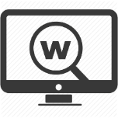
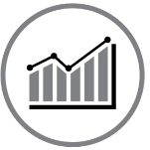
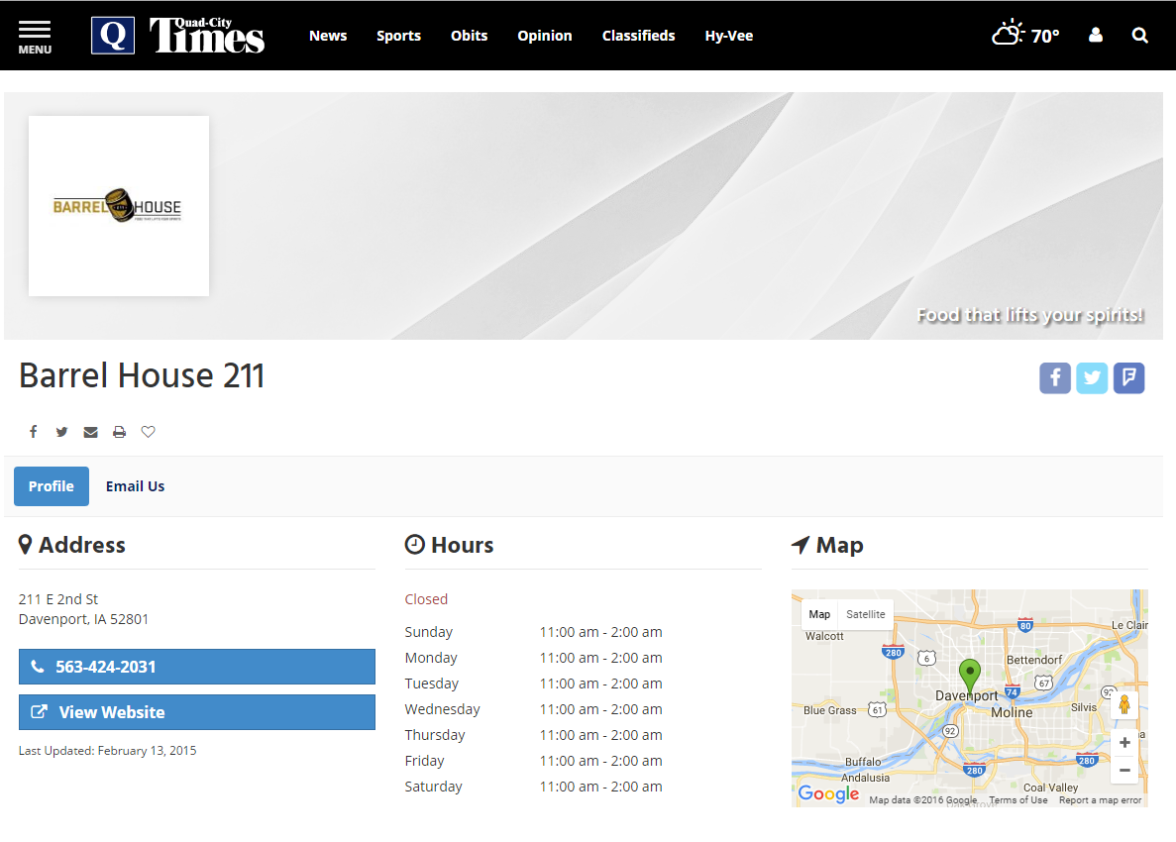
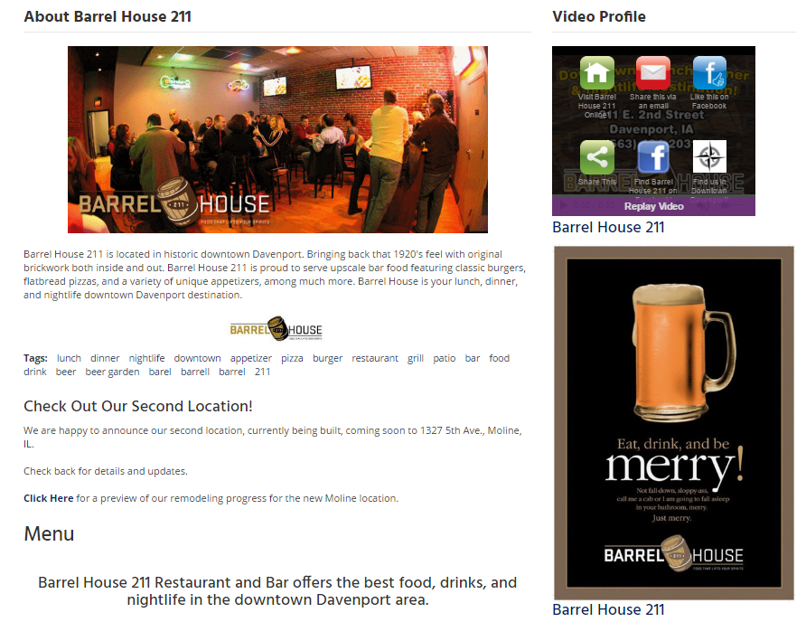
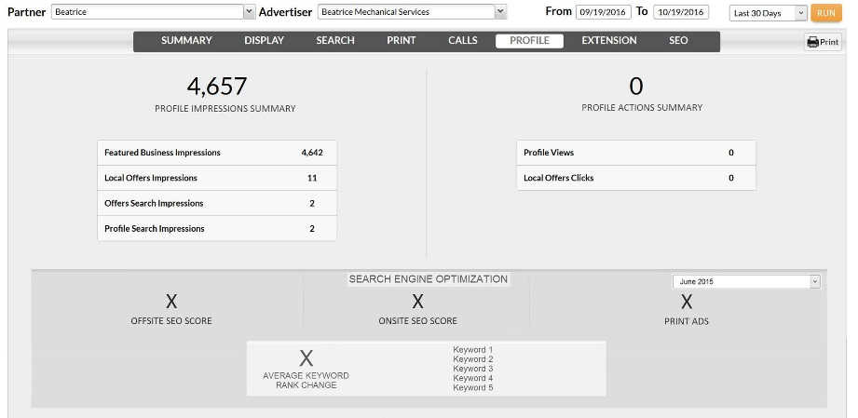
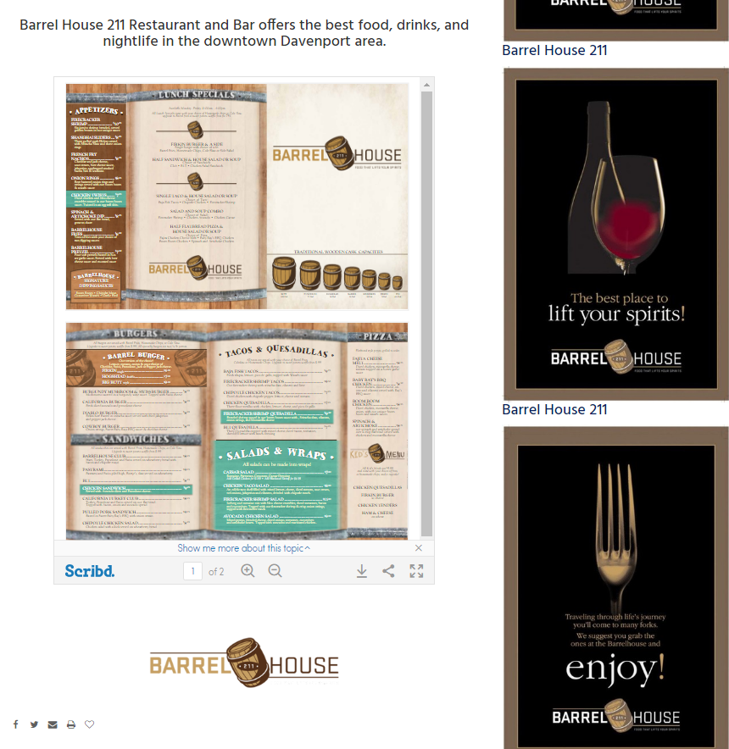
Digital
Connect
Connect with Largest Local Audience: By having a business profile on our site you will reach an ever expanding digital audience on Northwest Indiana’s #1 local website. The Times reaches over 75% percent of all adults in the local market weekly.
Powerful Digital Presence: With Digital Connect we provide greater visibility of your business with preferred placement on our site allowing you to leverage our high PageRank and authority with search engines, thereby improving your website search rankings.
Enhanced Print Advertising: We convert your print ads into powerful digital content. This fresh and relevant content gives your business an SEO boost. Run more print ads to improve the search performance of your website and in return be found more easily by potential customers.
Robust Analytics: With Digital Connect you are able to measure the performance of your print and digital strategy by tracking keyword performance and the improvement over time.
Business Profile
Robust Analytics

Slide 2
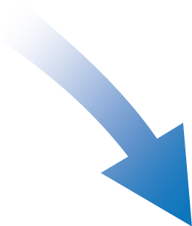
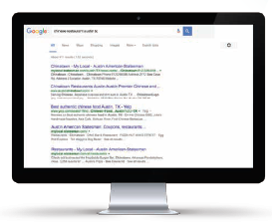
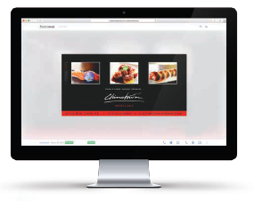
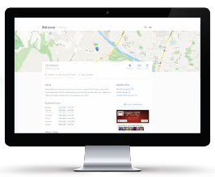
Digital
Connect
Digital
Connect
Digital Connect aligns your print advertising with your digital strategy by converting your existing print ads into powerful digital content. This SEO enhancement ad platform is fully responsive for desktop, mobile, and tablet. All of this is designed to not only give you a better digital presence, but also to strengthen and extend the lifespan of your print advertisements.
How it works
1
Your print advertisements are uploaded to our directory database.
4
The more print ads you run, the more fresh and relevant content is indexed online, the better digital presence you build to be found online.
2
A landing page is automatically created, turning your ad into fresh and relevant online content that is indexed by search engines in order to be found by consumers searching online.
3
The landing page is hosted on our news site, the #1 most visited site locally, and links back to your website, proving a powerful digital presence and SEO enhancement.

