Slide 1
Search Engine Optimization
If you have a website or business on the internet, then you are no doubt looking to expand your presence in the search engines. Let Amplified help you be seen by consumers as they navigate the web with SEO services.

Slide 2
What is Search Engine Optimization?
SEO is the work that goes in to showing the search engines that you are the absolute best answer to queries related to your product or service.

Slide 3
Why is SEO Important
70% Search Online Before Buying
Prospective buyers begin their search online. By the time they visit your site, 60% of the purchasing process is already complete.
70

Slide 4
How Does Search Engine Optimization Work?
ON-SITE OPTIMIZATION
OFF-SITE OPTIMIZATION
Indexability
SEO
Trust
User Experience
Relevance
Authority

Slide 5
HOW DOES SEARCH ENGINE OPTIMIZATION WORK?
Indexability
Are your individual pages able to be viewed and categorized by the search engines? Are there certain elements of your website that disallow Google from understanding the content?
Relevance
Does the information on your website accurately describe exactly what you do? Can the search engines clearly understand your content?
SEO
Authority
Are other websites linking to your site, essentially referring their unique traffic to your website? Are the search engines able to see others out there are talking about your products or services?
User Experience
Once someone has visited your website, are there defined elements that entice them into taking the next step? Is your phone number prominently advertised? Do you have a clear “Contact us!” procedure laid out?

Slide 6
Onsite Optimization: HOW DOES RELEVANCE WORK?
EXISTING CONTENT
META INFORMATION
KEYWORDS
<title tag>
</a>
What people can read
on your site
Title tags, meta descriptions
Placing the right
keywords within your
content

Slide 7
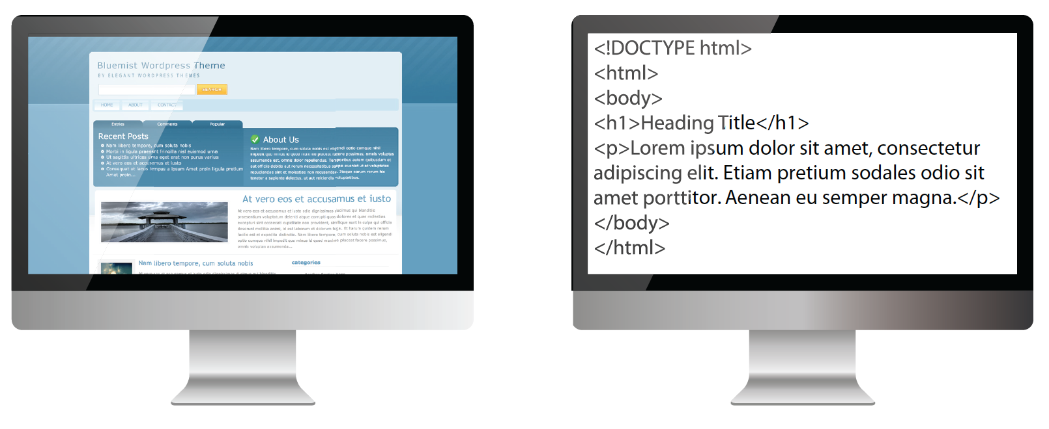
Onsite Optimization: Indexing
How You see your website:
How Google sees your website:

Slide 8
Onsite Optimization
Indexability refers to the search engines ability to crawl and categorize your site’s individual pages. If the search engines are unable to categorize your site, they won’t be able to list your business in their search results.
HOW DO WE MAKE YOUR SITE INDEXABLE?
Analyze existing site architecture elements including, but not limited to:
XML sitemap
robots.txt file
related follow / nofollow alt attributes

Slide 9
Onsite Optimization: Ensuring a great user experience
WHAT IS USER EXPERIENCE?
The overall experience of an individual interacting with a website. A set path from the initial site visit all the way through to your checkout process can be tailored with the user in mind.
HOW DO WE PROMOTE USER EXPERIENCE?
Present concise, relevant information that highlights your products or services.
Prominently display your business phone number in an easy to spot area (typically the far right side at the very top).
Create lead capture forms that require only the most pertinent information to be filled out. Example: If your sales team contacts prospects via phone, users filling out their street address is unnecessary. Fewer Steps = Higher Conversion

Slide 10
Offsite Optimization Strategy
Industry-Specific Links
Linking Super Mario Bros. Pizza to an HVAC contractor makes no sense. Google penalizes such unnatural link behavior.
Dedicated Content Team
Quality content created by a dedicated content team.
Blogs
Algorithm-Friendly Content
No cutting corners. Only the highest quality content is posted on your behalf.
Extensive relationships with blogs all over the country – hours of your budget aren’t being spent on researching where to post content.

Slide 11
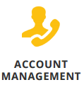
Why choose us?
At Amplified, we believe in absolute transparency. We have 100% confidence in all of the actions that will be completed for your website so we have built a custom fulfillment dashboard where you will be able to see every work item finished for your campaign in real-time. You will also be able to track the daily progress made on your keywords, and sync Google Analytics in order to see traffic and bounce rates all in one place!
Our SEO Team is made up of some of the most experienced analysts in the industry and all of our work is done in-house. Your dedicated account management team will strategize to provide a successful and efficient marketing plan for you and your business. By only managing a handful of accounts, each management team is able to dedicate their full attention to your business goals, familiarize themselves with your industry, and come up with a customized plan that will produce the most value for your investment.
Your Account Manager will keep you up to date on the progress of your campaign and what can be done for further improvement. We make it our first priority to maintain top-level customer support, which is why more small businesses trust Amplified with their SEO budgets. We manage thousands of SMB customers on our enterprise level small business SEO platform and because of our proven results, we maintain one of the highest customer retention rates in the industry.

Slide 12
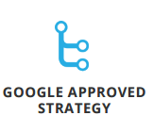
Why choose us?
Search engines are constantly improving their algorithms in order to provide the best search results for their visitors. This means that SEO practices and standards frequently change and it is important to hire an SEO firm, like Amplfieid that can roll with the punches and re-direct focus when needed.
At Amplified, we are always learning and familiarizing ourselves with the latest search engine updates and practices. We will never use ‘black hat’ or unethical techniques to cheat or manipulate rankings. All of the work that we do will always align with current SEO standards to ensure that you rank naturally and show continual organic growth

Slide 13
SEO Roadmap of Work
THE FOLLOWING IS A LIST OF ACTIONS THAT WILL BE PERFORMED FOR YOUR WEBSITE:
GOOGLE ANALYTICS & WEBMASTER TOOLS: Installation and analysis of Google Analytics and Google Webmaster Tools.
WEBSITE SEO ONSITE OPTIMIZATION: Including Title Tags, Meta data, H1 Tags and Image Tags.
WEBSITE OFFSITE OPTIMIZATION: Link building to targeted landing pages CONTENT OPTIMIZATION: Creating or optimizing for keyword rich content for website landing pages
OPTIMIZE SITEMAP AND ROBOTS.TXT FILES: Informing search engines how to interact when indexing your website. The SEO team will optimize these documents using best SEO practices. \
OPTIMIZE BUSINESS LOCATIONS FOR GOOGLE PLACES AND MAPS: Be found locally with the most up to date information about your business.
OPTIMIZE WEBSITE URL STRUCTURE: A clean and optimized URL is important for a successful SEO campaign. ANALYSIS OF TOP ONLINE COMPETITORS: A study of online competitors to track trends and strategies to stay one step ahead.
CUSTOM MONTHLY PERFORMANCE REPORTING: Each month your Campaign Manager and SEO Consultant will review the previous month with you, and discuss ways to improve.

Slide 14
Why pay for SEO?
Google and other search engines have little “bots” or “spiders” that constantly crawl the Internet and look at every website to determine the value of each site. The spiders send information back to their search engines, which then run the collected information through complex algorithms to determine a website’s rank on a search engine results page (SERP).
The frequency of these spider-crawls depends largely on how often you update your site. If Google et al. notice that you’re doing a lot of SEO work, they will crawl your site more frequently, which will lead to better results for you.

Slide 15
Why pay for SEO?
SEO, or search engine optimization, is not a get-rich-quick scheme, nor does good SEO ever promise immediate results. The effects of SEO efforts vary depending on the SEO activities, the duration of the campaign, the industry, the type of site, and the site’s history. Since SEO involves many factors, there is no hard and fast answer to how long SEO will take. Think of SEO as cultivating a garden. You can’t plant a seed and expect it to grow without any attention or care to it. SEO is an ongoing process – it does not end once you reach a certain goal. Without consistent upkeep, those results will slide away. You must constantly adapt and refine your SEO tactics in order to reach and maintain the results you want.
It is important to remember that real white-hat, Internet-legal SEO tactics are the only SEO tactics that you should use. Some illegal SEO tactics promise to deliver quick results. Do NOT use these illegal tactics, as search engines heavily punish those sites found employing these methods and may even remove a site from search results.
Specific examples of illegal SEO practices include stuffing keywords and meta tags, publishing duplicate content, cloaking or re-directing to a page you do not own, and inking from irrelevant sites. At the end of the day, illegal SEO tactics are not worth the quick and brief spike in traffic; search engines can easily track the traffic spike (and the illegal efforts that caused it), and your site will be penalized.

Slide 16
How Long to See Results?
There is no hard and fast answer to the question “How long does SEO take?” However, generally speaking, SEO efforts take between six and nine months to produce visible results. This does not mean that after exactly six months your customer will be on the first page of the search engine results, nor does it mean that your customer should quit their SEO efforts after nine months if they have not seen a noticeable difference. This is a guideline that your customer can use to measure their results. Monitoring progress over several months will also highlight the small changes that add up over time.
Keep in mind that the longer your customer maintains their SEO efforts, the more effective the results they will see as time goes on. Good SEO has a powerful and lasting impact on website traffic and rankings, which, in turn, leads to more business for the customer. Rankings on search engine results pages are achieved through several tasks that take time to implement. There are no shortcuts or tricks to make results happen faster if your customer wants true, durable results. Depending on the competitiveness of the keywords, the budget, and the current search trends; initial results take a few months to really see.

Slide 17
Pricing
Minimum monthly spend is $400
Campaign results for SEO need minimum of 6 months
All proposals will be sent back with retail pricing
Proposals include 50% markup
Negotiated rate with vendor is competitive in markets.
50% mark up should be minimum in all Lee markets.
Booked (sold) SEO campaigns auto renew monthly until cancellation notification is requested.
Make sure this matches up with APT billing.
Close Ratio Goal 30%
For every 10 proposals created, goal is to close 3

Slide 18
Fulfillment
Reporting &
Analytics

Slide 19
SEO: Reporting & Analytics
Showing all of the work that goes in to the campaign with the allocated hourly budget.
Real time tracking of keyword rankings.
See HOW marketing dollars are being spent.
Before phone calls and sales come in, you can see how your rankings are positively increasing.

Slide 20
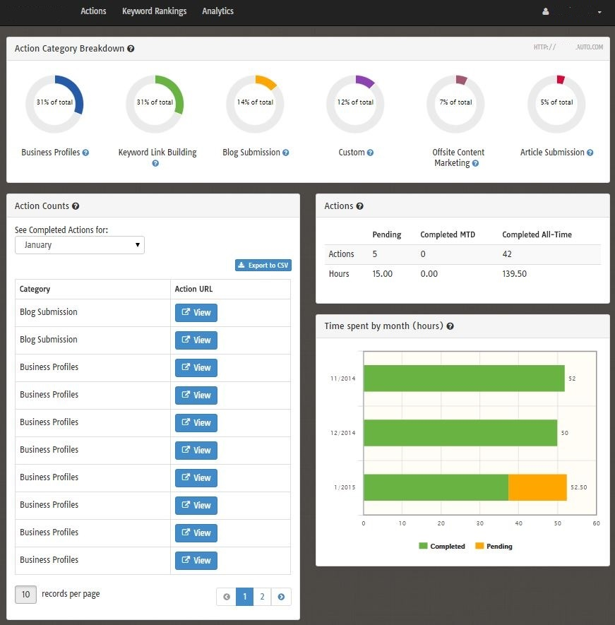
SEO Analytics: Actions
Category Breakdown
Percentage of time spent on different actions
Completed Actions
Click on “View” and see exactly what was completed
Time spent by month
Green is completed actions
Yellow is pending actions

Slide 21
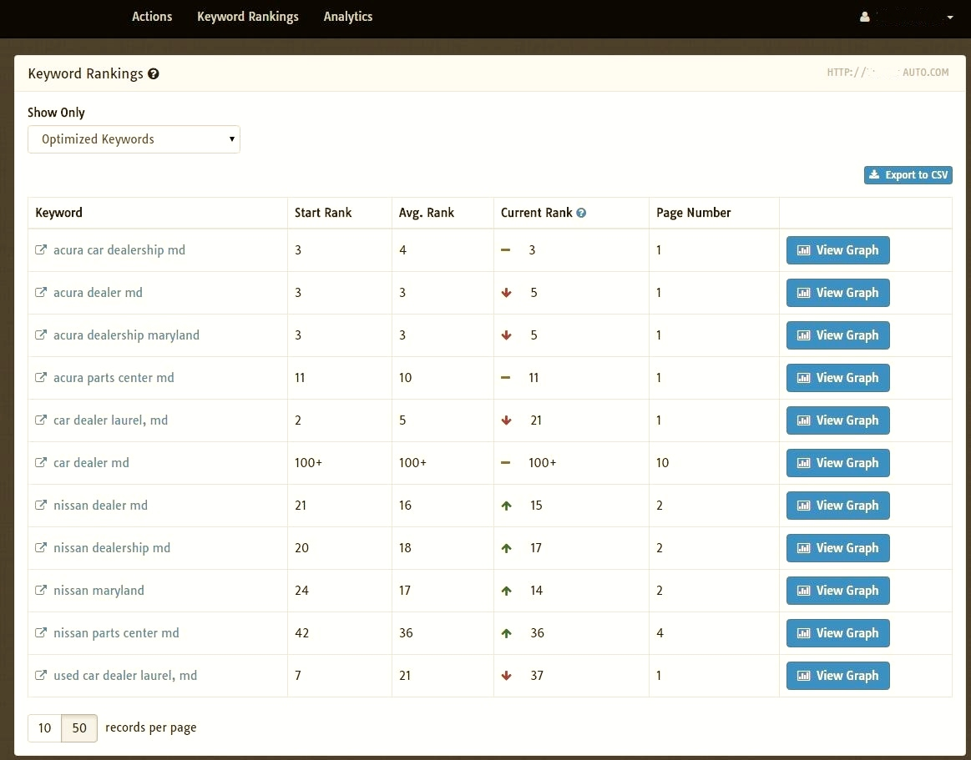
SEO Analytics: Keywords
Optimized Keywords
Keywords that are actively is determined by budget worked on
“View Graph” shows the history of where the keyword has ranked since the campaign
Click on the keyword to see where keyword is ranking in real time
Number of Optimized keywords
Tracking Keywords
Keywords aren’t actively worked on
Simply to monitor natural ranking
Used to help campaign strategy
Number of Tracked keywords is determined by budget

Slide 22
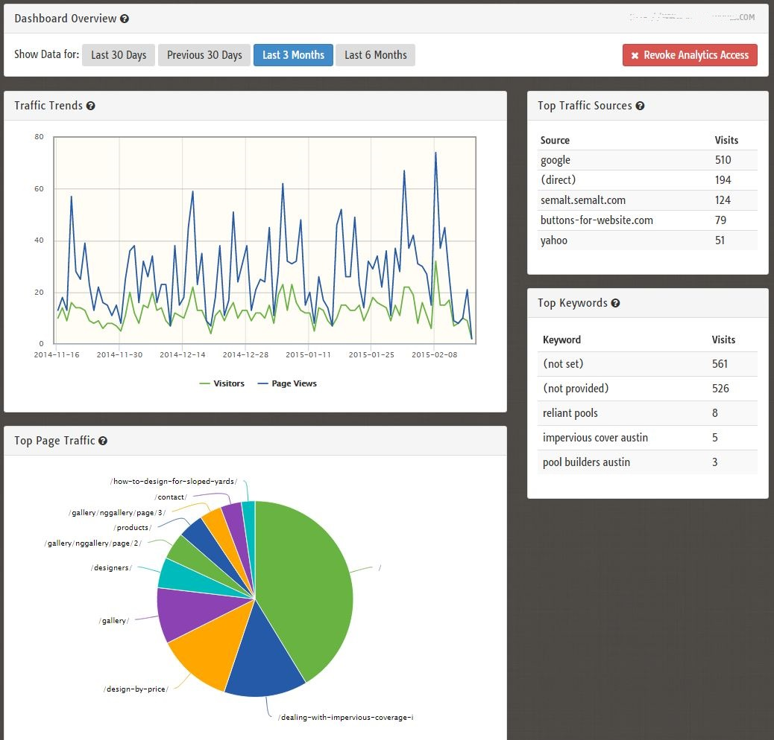
SEO in Google Analytics
Dashboard Overview
Connected to Google Analytics
GA code must be added to website in order to monitor
Allows you to see overall traffic of website
Used to plan and execute SEO campaign
It is not mandatory to gain access to the client’s Google Analytics
But we will try as it is an important resource

Slide 23
Fulfillment
Fulfillment

Slide 24
Fulfillment Process Overview - Support Forms
Proposal Request Form routes directly to Boostability
Sold orders are entered directly into Boostability’s system Launchpad
http://intranet.lee.net/online/other/html_2a6fcb16-403f-11e0-870b-001cc4c03286.html

Slide 25
Campaign Fulfillment Overview
1
1. Verify interest and submit request for proposal
2
2. Proposal returned within 24 hours
3
3. Sale Closed and order entered into Launchpad
4
4. Welcome Call Scheduled with Client
3
5
5. Ongoing monthly check-in call with Client

Slide 26
The Process after a Campaign is Sold
1
1. Set Up Welcome Call
After creating an account with Boostability, you will have an initial consultation with your dedicated account manager. They will go more in depth in to the business itself and the ways in which you want to appear online.
2
2. Preliminary Audit
Account manager conducts a standard audit. The purpose of the audit is to gain an understanding of how the site is currently performing. This gives us insight as to how the budgeted hours can be best spent.
3
3. Keyword Research
The account manager, based on your input, will determine the most lucrative keywords to target within the budget. Search volumes and competitiveness of keywords will be taken into consideration. We want to find keywords that will rank within 3-6 months of the campaign.
4
4. Maximize Budget
Using data derived during the audit, in tandem with proprietary keyword research, your account manager selects keywords that are realistic to rank for within the budget in a reasonable amount of time.

Slide 27
Questions?
Thank you!

