Slide 1
SOCIAL MEDIA & REPUTATION MANAGEMENT
Engage with customers and build relationships with Amplified’s help

Slide 2
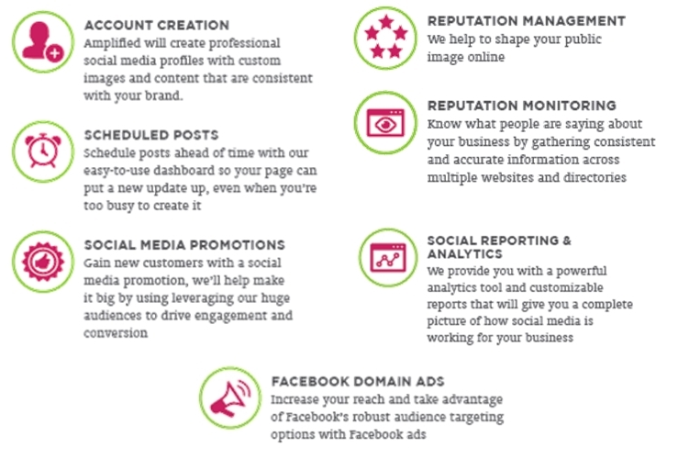
WHAT WE CAN DO

Slide 3
Social Media Management
PUTTING IT TO USE FOR OUR ADVERTISERS

Slide 4
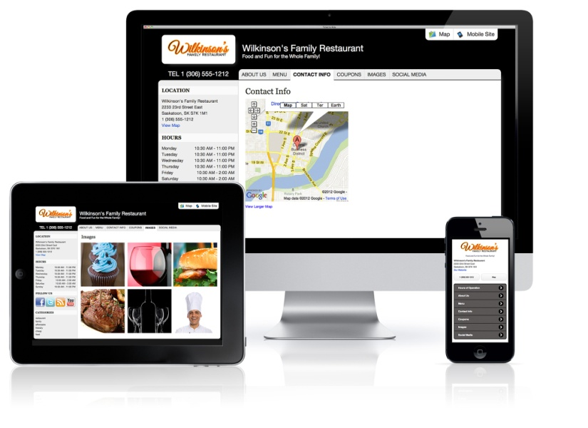
A Business’s Virtual Doorway is on the Web

Slide 5
SOCIAL MEDIA
Strategy & Execution
Measuring the Reach & Frequency of Social Media is much more important than counting number of fans.
GET FANS who are they?
BRAND MESSAGES REACH FANS via news feed
FANS “TALK ABOUT” CONTENT
CONTENT SPREADS TO FRIENDS
GOAL: REACH MAXIMUM ROI
Drive & Create Engagement
Cut Through the Crowd
Amplify Your Message
Notes:
The greatest potential for new fan growth is to reach the FRIENDS OF YOUR FANS!

Slide 6
SOCIAL drive audience
Notes:
Stella and Dot does a great job of driving traffic to their Facebook page by offering different ways to wear their accessories.(necklace and scarf example). They have a weekly blog they post of Facebook called “style sessions” with details on their weekly outfit inspiration with lots of great pictures and ideas. They also post inspiring quotes, video and promotions to keep people coming back. They encourage customers to post pictures of themselves wearing products on their social media with a hash tag to Stella & Dot to twitter and Instagram. Stella and Dot is a direct sales (accessory) business that provides a business platform for women to work from home.

Slide 7
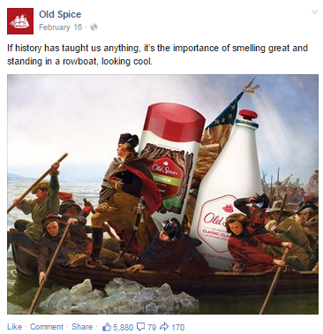
SOCIAL drive engagement
Notes:
Old Spice drives engagement on their page by posting humorous ads, videos, photos and post that get people to like share and comment.
History ad = 5,880 likes, 79 comments and 170 shares
Leap weekend = 97 likes, 6 comments and 1 share
Video = 3,706,133 views, 39,144 likes, 1,421 comments and ,739 shares

Slide 8
SOCIAL MEDIA
goals and benefits
Ability to generate leads and turn prospects into customers
Professional social media accounts set you apart from the competition
Builds and enhances your online reputation and digital footprint
Sophisticated lead capture campaigns to gain contact information
Increased levels of customer engagement on social channels
Access to our robust dashboard to make managing your social networks simple and convenient

Slide 9
SOCIAL MARKETING
(previously called Socialize)
Social Marketing dashboard is a posting platform that allows you to post, schedule and manage your posts; all in one place
We can create and Schedule Posts to your Facebook, Twitter, Google+, LinkedIn and Blog
Get a detailed look at the Engagement, Post Reach and Fan Demographics with the Stats
Not sure what to post? Find content tailored to your business with the Library.
Find potential connections and new clients on Twitter with the Keyword Search

Slide 10
Social Quarterly Contests
Contests are a great way to bring in new likes, re-connect with your current fans, build awareness around your brand and gather social data for future marketing campaigns.
What are your goals for this contest?
More likes
Boost awareness of a product
Gathering data
Prizes
What is your budget for this contest?
What will the prize be?
Will there be runner-up prizes as well?
What kind of contest will this be?
Sweepstakes
Photo or video entries
Hashtag contests
Essay submission
Competition or Brackets (Fans can vote on their favorite image or product)
Design requests?
Your contest tab can be customized to fit your needs.
Rules, Terms and Conditions
We provide you with a basic template for the rules for your contest. Please look over this with your legal representative and feel free to make any changes.

Slide 11
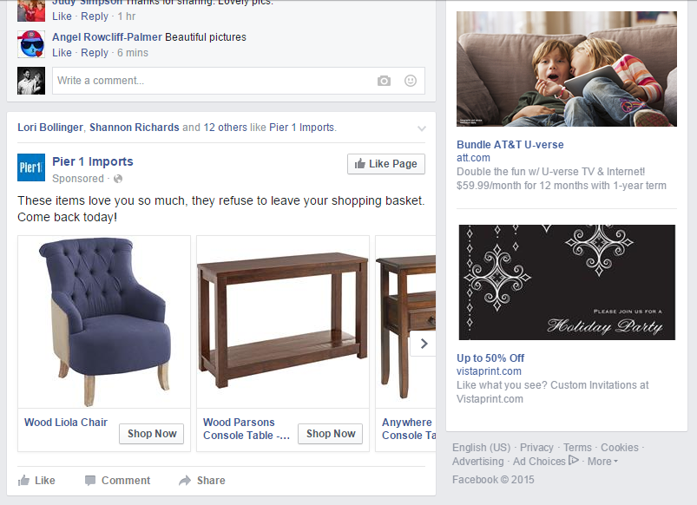
SOCIAL MEDIA MARKETING
FACEBOOK ADS

Slide 12
FB Advertising with Amplified
Monitoring & Tracking
Campaigns are tracked continuously from start to finish ensuring your budget is being spent fairly and that your ads are targeting the right results.
Saves business owner time which equates to money
Ad Group Testing & Optimization
Each ad group contains multiple ads which are tested against each other to provide a better understanding of what customers are responsive to. We will set up multiple ad groups to run along-side or to alternate if you have more than one goal for your ads.
Reporting
We can provide in-depth reporting to show you how many people your ad is reaching, who is interacting with it and how often people are seeing them. This is all included with your monthly reporting.

Slide 13
Social Media Management
Social Site Management
Facebook
Twitter
Foursquare
Google+
Pinterest
YouTube
List Building
411.com
Bing Local
Citysearch
Angie's List
MerchantCircle
Superpages
Yellow Book
Yellow Bot
YellowPages
Yelp
OpenTable
TripAdvisor
Urbanspoon

Slide 14
Why Amplified for Social Media Management
Amplified is dedicated to expanding a customer’s brand online so they can be found
Around 85-90% of posts on business' Facebook pages are not responded to.
Amplified fulfillment will respond and engage with your customers/clients for you and relationships will be built. Social media is called SOCIAL media, right?
Amplified with take the think-work over for the business.
Amplified will create quality content that prompts response. With some direction from the business owner or not, they will shoulder the majority the work.
We do see it as a partnership, so do expect for your customer to participate in some manner.
Multiple social networks require individual approaches
Amplified team remains up-to-date with technological developments in the social world
Analytics with proven results
Most importantly...
It will free up the business owner’s time to do what they need to do - run a business!

Slide 15
Social Media Management

Slide 16
Reputation Monitoring & Management
PUTTING IT TO USE FOR OUR ADVERTISERS

Slide 17
Online Reviews = $$$
70%
Customers who read consumer reviews to ensure they are purchasing the right product or service.
U.S. customers who say their buying decisions are influenced by online reviews.
The amount of new business companies with positive reviews can convert when compared to companies with ZERO or negative reviews.
Consumers who consider user generated reviews important or extremely important.
90%
183%
82%

Slide 18
Online Reputation

Slide 19
Why Manage Your Online Reputation
Reputation is a perception of value or distinctiveness
Reputation builds a competitive advantage
Every organization will have a reputation…organizations that do not manage their reputation will have it managed for them by competitors, critics, and/or others
Reputation management is a process, not an event.

Slide 20
Why Choose Us for Reputation
No robots or canned responses – we have real social media experts handling your online reputation, ready to work with you to come up with the best solutions
Build your own package – our pricing allows reputation management to be affordable for all business sizes
Pricing by location – the more locations you have, the less you pay per location
We’ve got you covered – we use the most state-of-the-art dashboards to stay on top of every online aspect of your reputation
Transparency – we train and teach our customers on how to use their reputation dashboards so they can see everything we see, what we’ve done, where they’re at, plus more.

Slide 21
Reputation
Snapshot Report – At a glance look at a business’s current web presence
Listings Management – Proactive management of web presence, related to business listings
Reputation Monitoring – Monitoring, with ability to “Self Service”
Reputation Management – Proactive management, “Do It For Me”

Slide 22
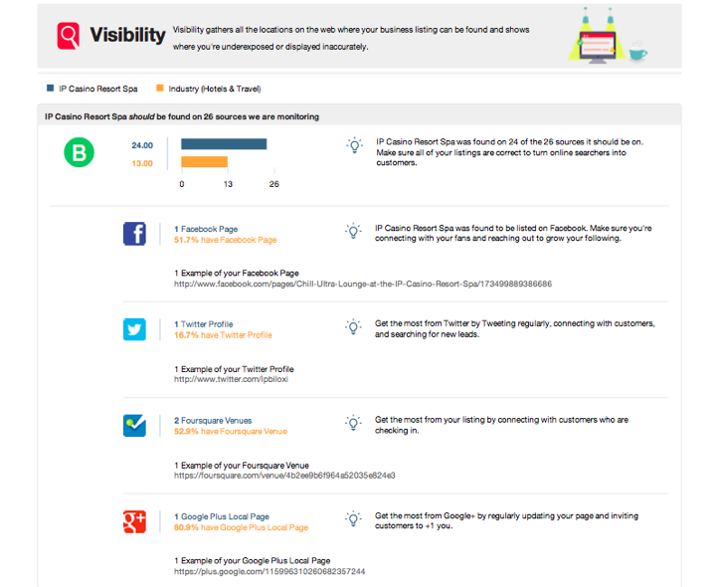
How many directories they are listed on
versus the industry average

Slide 23
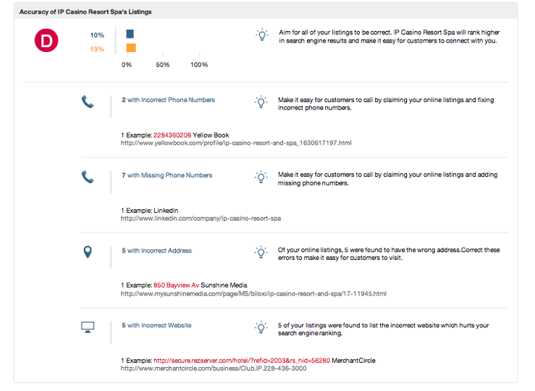
Inaccuracies of those listings
versus the industry average

Slide 24
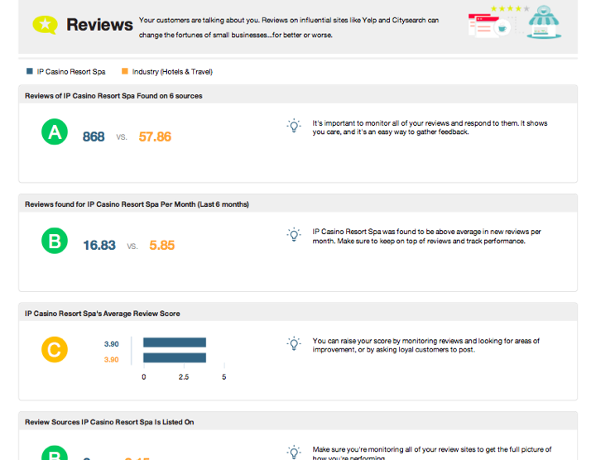
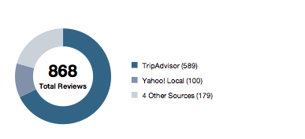
# of reviews
versus the industry average

Slide 25
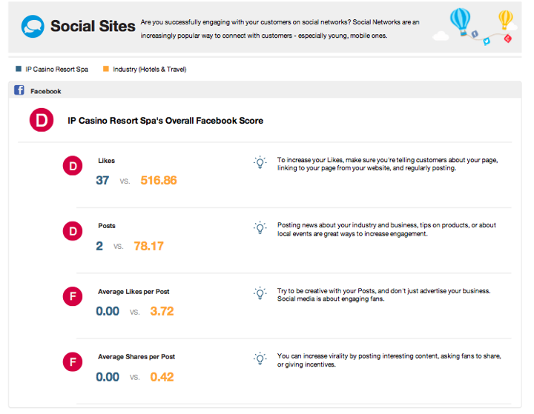
Likes and posts
versus the industry average

Slide 26
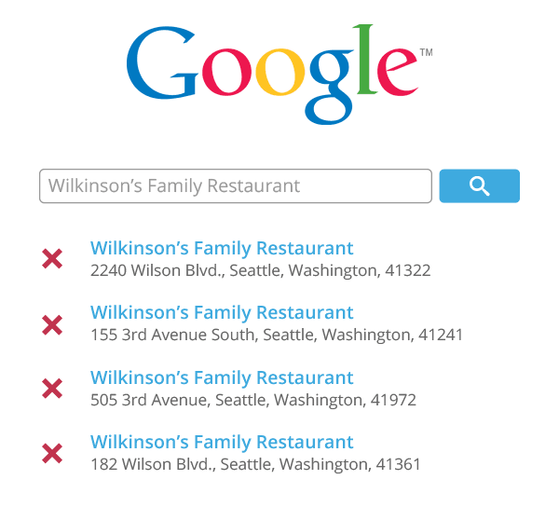
There's Nothing Worse Than Four Different Listings with the Wrong Contact Info

Slide 27
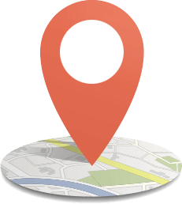
Automated Listing Distribution
Pushes accurate business information out to
Big 4 every week to improve listings
Business Name
Street Address
Zip Code
State
Phone Number
Website
Business Category
“Do It For Me”

Slide 28
Automated Listing Distribution
Set Expectations
Directory listings will update over time. It is an ongoing process. Review monthly reports with your advertiser to assess progress and receive feedback.
- Some may update daily
- Some may only update once a year
- Be patient – Minimum 12-month commitment
- Track Visibility progress through the dashboard

Slide 29
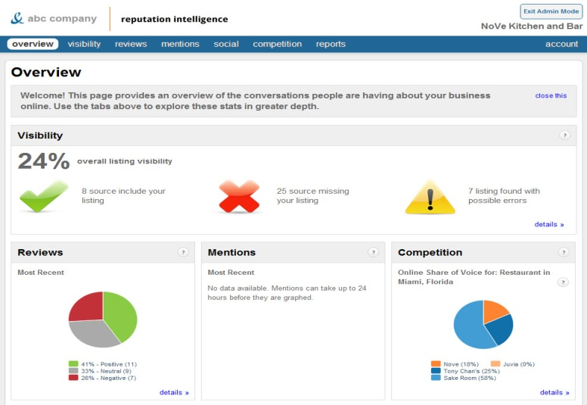
Reputation Intelligence (formally monitoring – Self Service)
Monitors your brand and reputation 24/7
Receive instant notification when a review is posted about your business
Monitor listings for accuracy
Track share of voice against competition
Track social followers
Monthly reports emailed
Reputation

Slide 30
Reputation Management
Respond to all reviews
The Service
Claim and correct listings on *included review sites
Monitor and respond to negative and positive reviews
The response is written and sent to the advertiser for approval
“Do It For Me”
Does not include response to historical reviews
–only those going forward

Slide 31
Review Response
Review Sites Included Based on Category
Automotive
•Cars.com
•DealerRater (*paid site)
•Edmunds
Service
•Kudzu
Restaurants
•OpenTable (*paid site)
•Urbanspoon
Travel
•TripAdvisor
Medical
•Vitals
All Categories
•CitySearch
•Yelp
Google Plus
YellowPages
Facebook
Yahoo
Bing
Real Estate
•Apartment Reviews
Attorney
•Avvo
*paid site – advertiser must pay to be listed on these sites first

Slide 32
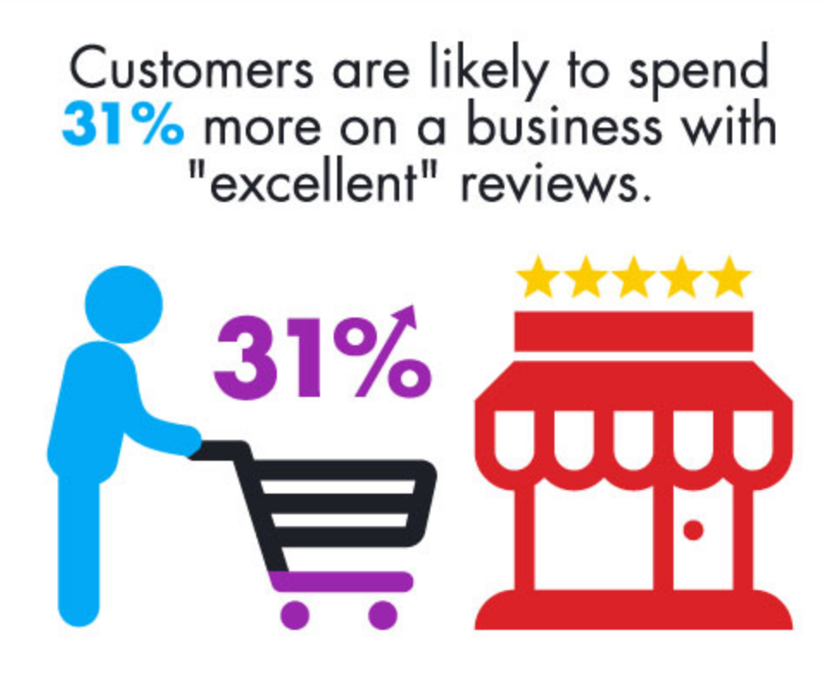
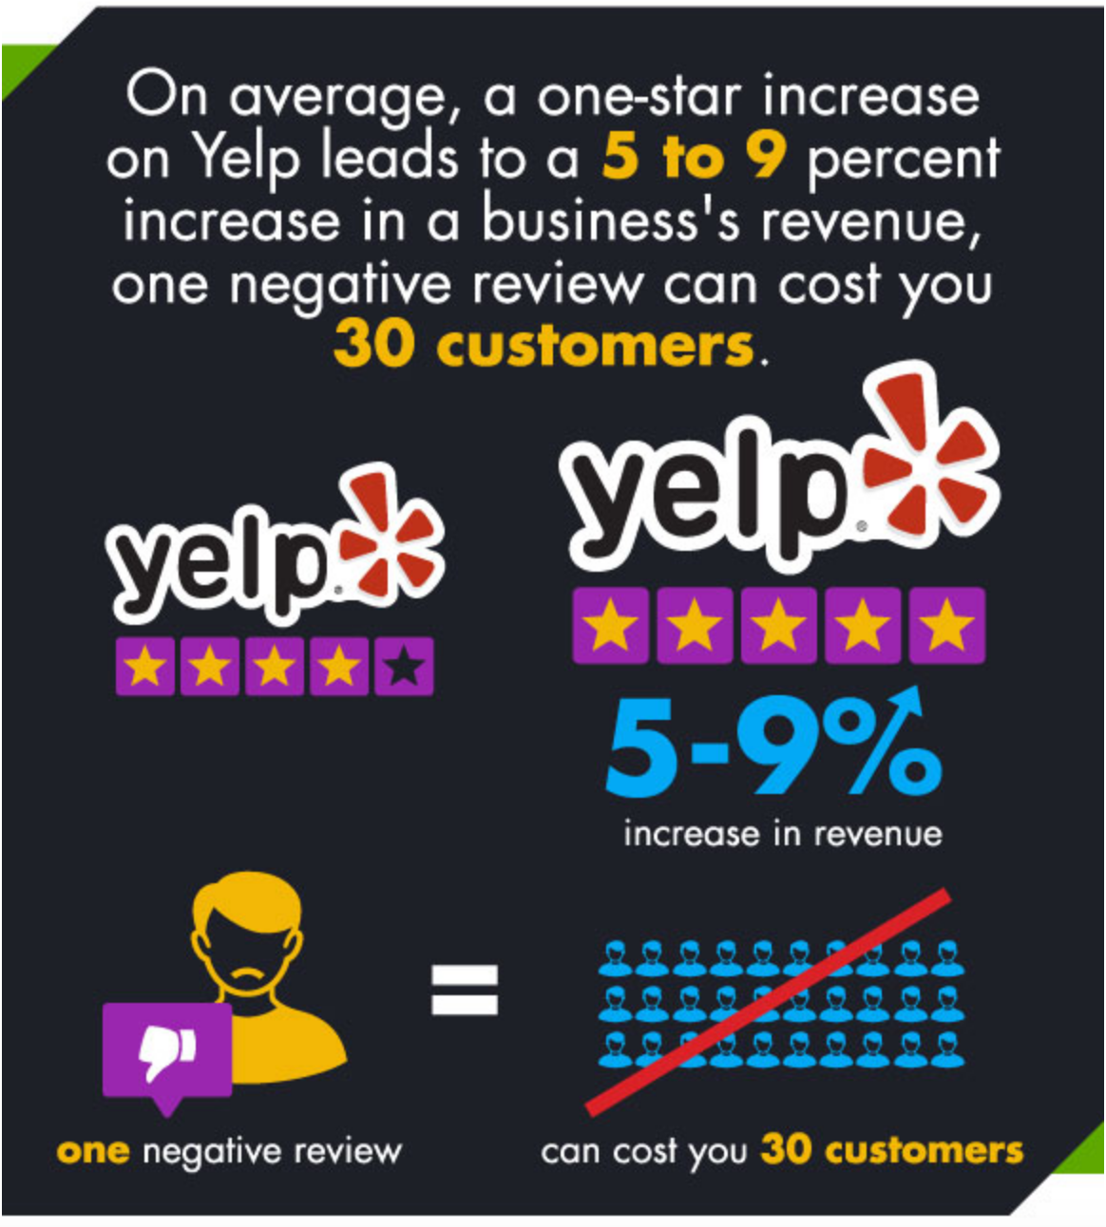
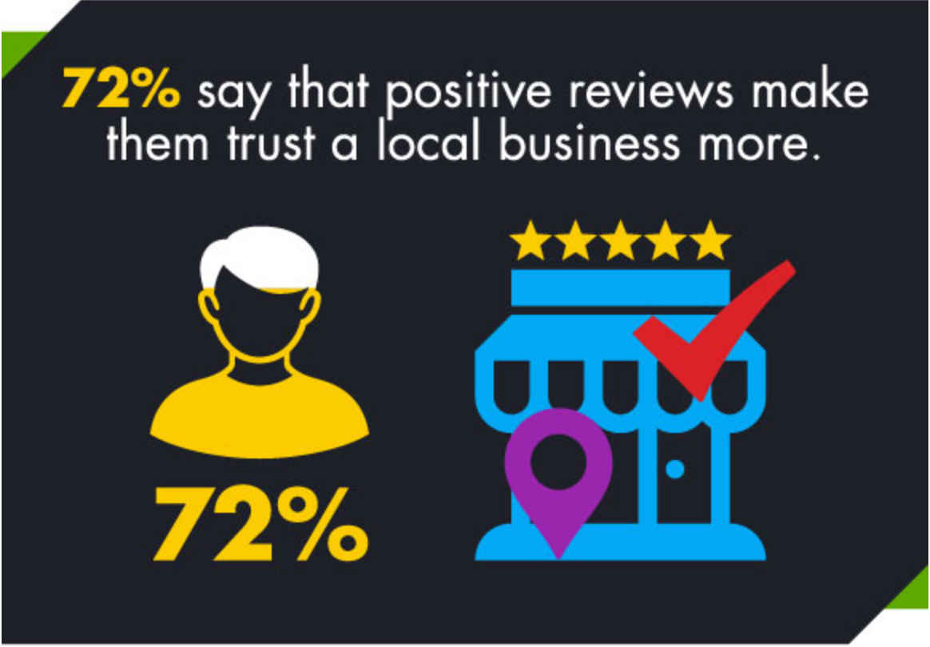
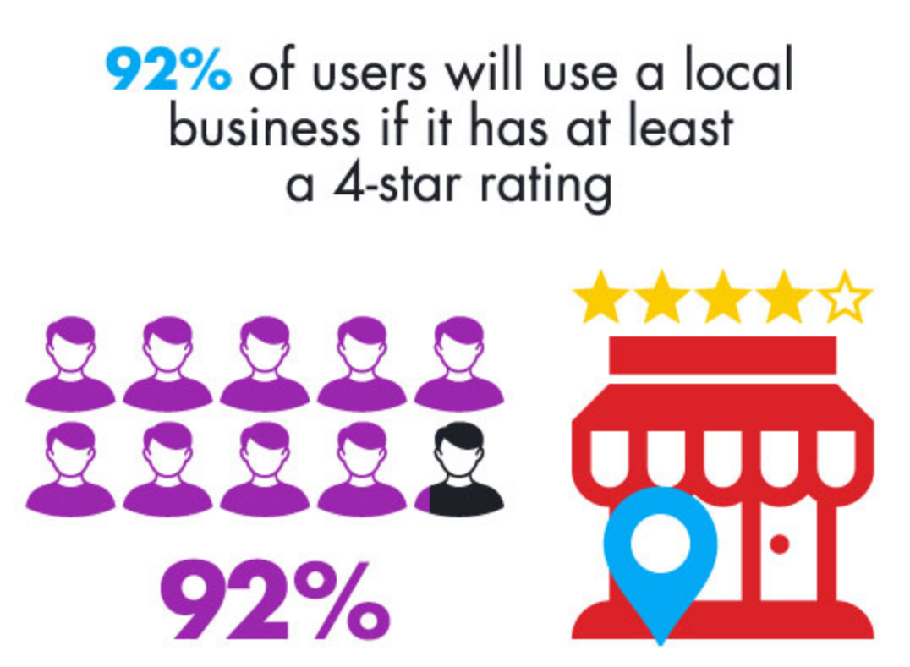
Online Reviews = $$$
http://www.business2community.com/infographics/impact-online-reviews-customers-buying-decisions-infographic-01280945?mc_cid=b7abcae3ce&mc_eid=0cb41f1a61

Slide 33
Post to Social Channels
Do It For Me
Regular posting helps build brands to followers
The Service
Facebook
Twitter
Google +
Foursquare
1x Offer a Month
Must provide graphic
and details of the offer
2x week
4x week

Slide 34
Post to Social Channels
Set Expectations
Onboarding call with a Fulfillment Specialist will help that person understand the client’s business
Posts will be discussed and selected relevant to the business
Regular posts build brands to followers by keeping the business name in front of them
Do not guarantee “Likes” or “Shares” – these are primarily built through custom offers

Slide 35
Successful Social Marketing is About Three Things
1
Customer
Service

Slide 36
#1 Customer Service
Having a social media channel you don't monitor is like having phone lines at your business that are never answered.

Slide 37
Successful Social Marketing is About Three Things
1
2
Customer
Service
Generating
Leads

Slide 38
#2 Generating Leads
Every day consumers are declaring their intentions on social media…
I need help planning my wedding.
I locked
my keys in the car...
I’m craving
Greek Ribs!

Slide 39
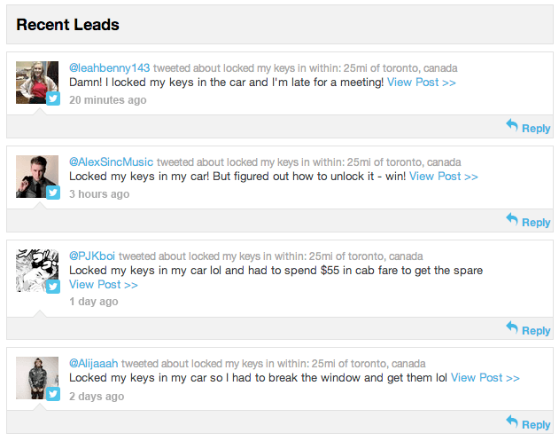
#2 Generating Leads
and those intentions are real-time leads.

Slide 40
Successful Social Marketing is About Three Things
1
2
3
Customer
Service
Generating
Leads
Building
Fans

Slide 42
Posting Interesting, Relevant Content is Key
And remember to vary your posts.
No one would watch a TV channel with 24/7 commercials, so why would they do that online?
Throw in some entertainment!

Slide 43
Awful & alarming but still a little funny social media fails.

Slide 44
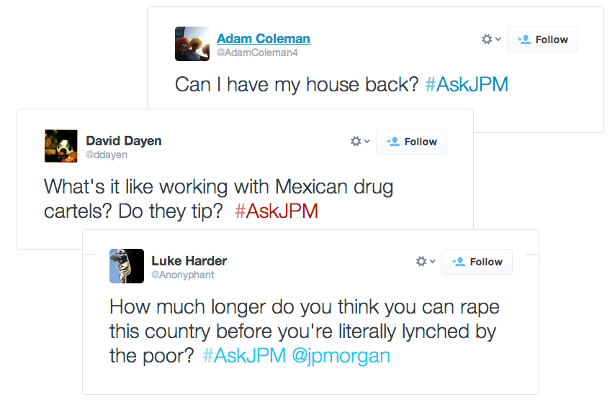
JP Morgan was clearly out of touch with public perception of their brand when they launched their #AskJPM Twitter campaign.

Slide 45
Know the way your company is perceived by the public and keep it in mind while marketing.

Slide 46
Fulfillment
Reporting &
Analytics

Slide 47
Respond to Reviews
Feature: Professional responses to your company’s online reviews and comments.
Advantage: Responding to reviews will show that your business cares about customer concerns and appreciates their feedback
Benefit: Potential consumer may be more likely to choose you based on this interaction

Slide 48
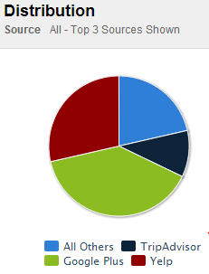
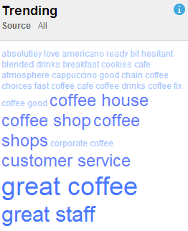
Gain Insight
Feature: Online reviews and trends
Advantage: Look at specific online trends regarding your company to better understand your customers, find out what they like or dislike and why. Look at negative feedback and find ways to improve on customer satisfaction.
Benefit: Increase customer satisfaction and gain repeat customers

Slide 49
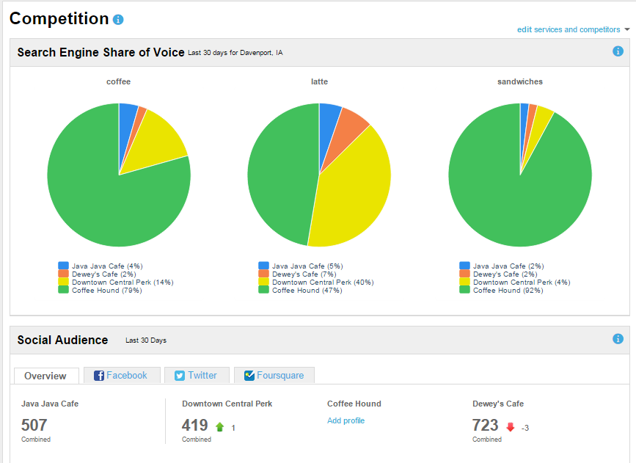
Monitor Competitors
Feature: Monitor competitors activity on the web
Advantage: You can see if a competitor is growing their social media audience rapidly and use that as insight into what appeals to your potential customer on social media.
Benefit: Look at your company compared to competitors on specific keyword searches, reviews and social media activity in order to improve your business and gain market share.

Slide 50
Fulfillment
Fulfillment

Slide 51
Pricing
Product Name Setup Monthly
Social Marketing $200
Reputation Intelligence $65
Socialbiz $350
Social Marketing + Socialbiz $425
Social Contests (per contest) $299 --
Pinterest Management $150 $49
Google+ Management $150 $49
Reputation & Social Management Custom Quoted

Slide 52
Pricing
Product Name Setup
YouTube Channel Setup Only $100/each
Listings Setup Only $200/each
Social Site Setup Only $175/each
Facebook Ad campaign Custom Quote

Slide 53
Which solution is best for your
customer?
REPUTATION MANAGEMENT
OR
REPUTATION INTELLIGENCE (DIY)

Slide 54
Reputation Management Services – (We do it for you)
Setup of Facebook, Twitter and Google+
Scheduled posts including emailed proof process and responding to Tweets or posts to your business Facebook and Google+ pages
Claim, correct, and verify specified listings.
Monitor the listings and social sites for reviews/responses, and work with your team to answer or address any customer feedback
Setup and training of Social and Reputation dashboards
Technical support via phone or email available with a turnaround time of up to 2 days during business hours
Quarterly Social Contests (per contest)
Pinterest Management
All reputation solutions are built around the customers needs

Slide 55
Reputation Intelligence (DIY)
What is reputation intelligence?
The Reputation Intelligence dashboard is a helpful tool for managing your brand around the web. Whether someone mentions you on Twitter or leaves a review on Yelp, you will know about it and you will be able to respond to it with the Reputation Intelligence dashboard

Slide 56
Reputation Intelligence (DIY)
Unified presence across online directories, social media sites and review sites
Ability to respond to online reviews and feedback with a professional response
Use online reviews and mentions to gain insight and improve customer satisfaction
Monitor competition to reveal online share of voice, social activity and competitive reach
Provides simple reports and alerts to allow advertiser to monitor online presence

Slide 57
Reputation Dashboard Features
Shows where business is listed and any listings that require updating
Allows advertiser to see what people are saying on all review sites where the business is listed.
Track mentions on advertiser specifically, or any keywords related to the business
Provides daily alerts and weekly reports to keep advertiser current on dashboard activity
Provides one location to track social media sites
Provides a barometer of how the advertiser’s business compares to the competition

Slide 58
How it is Done
In order to get you started, these questions will help us set up your dashboard
Business information, website and any social networks for the business?
What category does the business fall under? Which keywords relate to the business?
Which keywords best represent the business?
Is there a key person related to the business?
President, Owner or other Notable person
Are there any common business names or nicknames associated with the business?
Who are the competitors?
Who in the business would like to receive this report?

Slide 59
What We Do
Once the dashboard is created, we will do the following:
Enter business information, to pull in their listings from around the web.
Enter any keyword mentions they wish to get alerts about.
Enter competitor’s information so they can compare your business to theirs.
Training on the Reputation Intelligence Dashboard
Your brand is only as good as your reputation. Make sure you’re found and you know what your customers are saying about your business with our reputation intelligence dashboard!

Slide 60
Fulfillment Process Overview – Preparing for the Reputation Management sale
Step 1
Sales Expert’s Responsibilities
Complete a request for Reputation Management quote: http://www.formstack.com/forms/?1735558-c0uJrJf4lF
Please allow for 24-48 hours during the business week for a response
Review proposal with the customer and ensure that they understand the service offering and pricing

Slide 61
Fulfillment Process Overview – The Reputation Management Order is Sold!
Step 2
Digital Fulfillment Account Manager’s Responsibilities
Once the proposal is accepted, a CRM order will need to be submitted by your property’s CRM Admin.
Fulfillment Account Manager is assigned to the account
Customer will be contacted for a kick off call within 24-48 hours
The Fulfillment Account Manager will gather all of the information needed to start on the customer’s website
Fulfillment Account Manager manages project until final product is delivered

Slide 62
Fulfillment Process Overview – The Reputation Intelligence Order is Sold!
Step 1
Sales Team/Digital Assistant Responsibilities
Once the sale has been made enter website package information into the CRM
Step 2
Fulfillment Account Manager is assigned to the account
Customer will be contacted for a kick off call within 24-48 hours
The Fulfillment Account Manager will gather all of the information needed to start on the customer’s website
Fulfillment Account Manager manages project until final product is delivered

Slide 63
Questions?
Thank you!

