Slide 1
social management & reputation

Slide 2
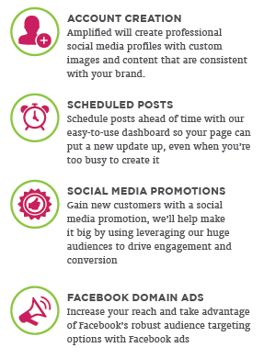
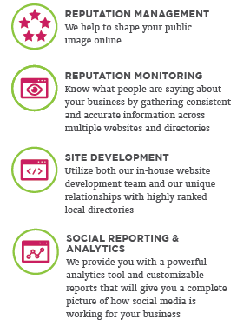
SOCIAL: MARKETING WITH AMPLFIED

Slide 3
SOCIAL MEDIA
Strategy & Execution
A Business’s Virtual Doorway is on Social Media
Measuring the Reach & Frequency of Social Media is much more important than counting number of fans.
GET FANS who are they?
BRAND MESSAGES REACH FANS via news feed
FANS “TALK ABOUT” CONTENT
CONTENT SPREADS TO FRIENDS
GOAL: REACH MAXIMUM ROI
Drive & Create Engagement
Cut Through the Crowd
Amplify Your Message
Notes:
The greatest potential for new fan growth is to reach the FRIENDS OF YOUR FANS!

Slide 4
Why Amplified for Social Media Management
Amplified is dedicated to expanding a customer’s brand online so they can be found
Around 85-90% of posts on business' Facebook pages are not responded to.
Amplified fulfillment will respond and engage with your customers/clients for you and relationships will be built. Social media is called SOCIAL media, right?
Amplified with take the think-work over for the business.
Amplified will create quality content that prompts response. With some direction from the business owner or not, they will shoulder the majority the work.
We do see it as a partnership, so do expect for your customer to participate in some manner.
Multiple social networks require individual approaches
Amplified team remains up-to-date with technological developments in the social world
Analytics with proven results
Most importantly...
It will free up the business owner’s time to do what they need to do - run a business!

Slide 5
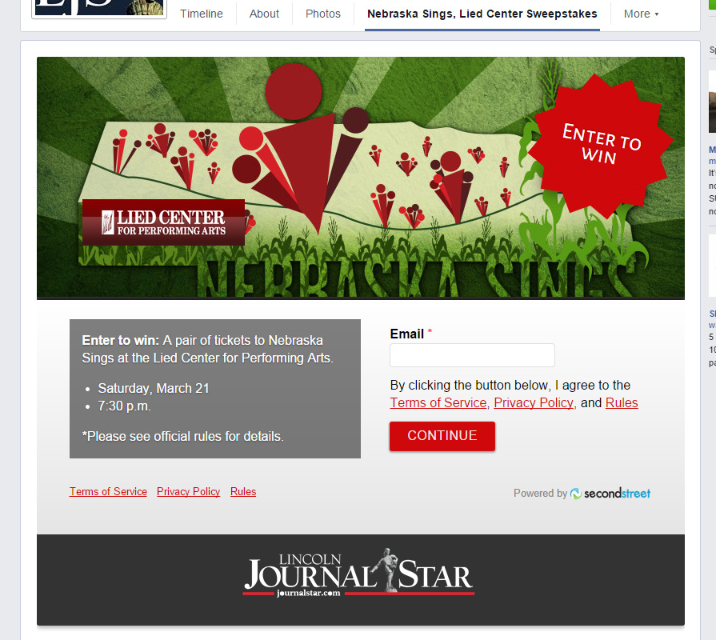
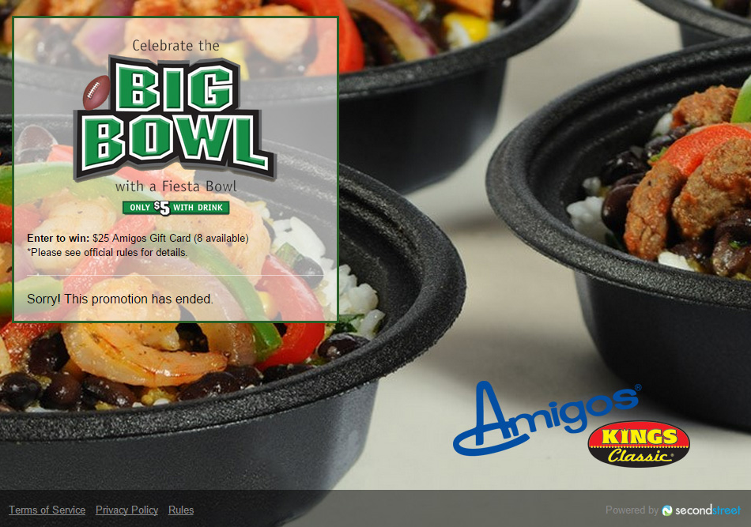
leverage audience to grow fans

Slide 6
Online Reputation

Slide 7
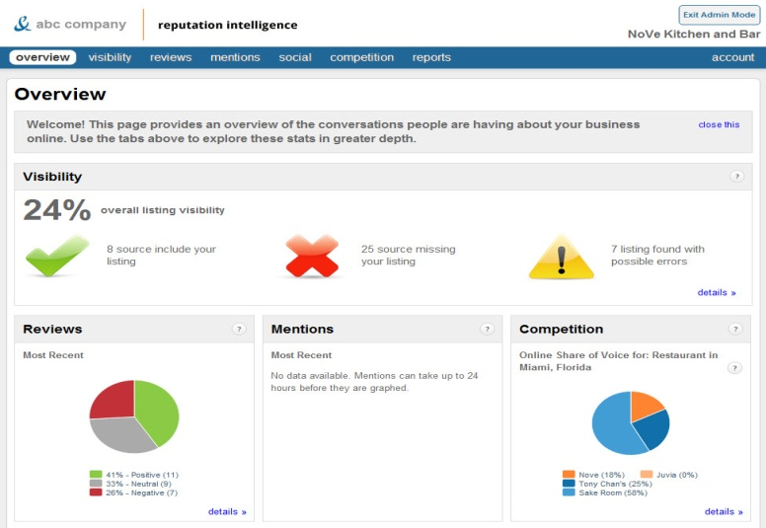
REPUTATION INTELLIGENCE
Monitors your brand and reputation 24 / 7
Receive instant notification when a review is posted about your business
Monitor listings for accuracy
Track share of voice against competition
Track social followers
Monthly reports emailed
Reputation

Slide 8
Why Choose Us for Reputation
No robots or canned responses – we have real social media experts handling your online reputation, ready to work with you to come up with the best solutions
Build your own package – our pricing allows reputation management to be affordable for all business sizes
Pricing by location – the more locations you have, the less you pay per location
We’ve got you covered – we use the most state-of-the-art dashboards to stay on top of every online aspect of your reputation
Transparency – we train and teach our customers on how to use their reputation dashboards so they can see everything we see, what we’ve done, where they’re at, plus more.

Slide 9
Reputation Management Services – (We do it for you)
Setup of Facebook, Twitter and Google+
Scheduled posts including emailed proof process and responding to Tweets or posts to your business Facebook and Google+ pages
Claim, correct, and verify specified listings.
Monitor the listings and social sites for reviews/responses, and work with your team to answer or address any customer feedback
Setup and training of Social and Reputation dashboards
Technical support via phone or email available with a turnaround time of up to 2 days during business hours
Quarterly Social Contests (per contest)
Pinterest Management
All reputation solutions are built around the customers needs

