Slide 1
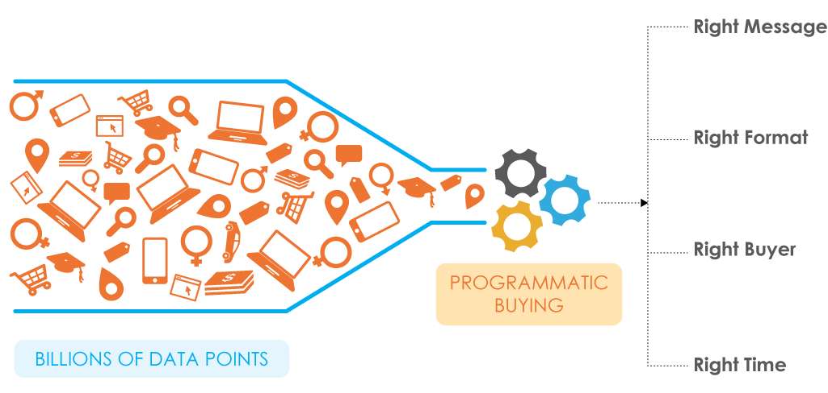
TARGET DISPLAY AUDIENCE

Slide 2
TARGETING OPTIONS ON NEWSPAPER.COM
CHANNEL TARGETING
Choose a section that best fits your advertising message or targeted audience. The most popular content sections on Newspaper.com are:
News
Local News
Business
Sports
BEHAVORIAL TARGETING
Choose from over 100 audience segments based on consumers online habits
and what their purchasing interests are.
The message is only sent to users who have demonstrated
a specific key behavior in the last 30 days that is relevant to the advertiser.

Slide 3
TARGETING OPTIONS ON NEWSPAPER.COM
DEMOGRAPHIC TARGETING
Data is captured from users upon site registration
– segment users and serve ads to them based on demographic information.
Demographic information that can be captured includes gender, age and household income.
DEVICE TARGETING
Target your message by how users are viewing your message
– target by iPad or Smartphone users.
DAYPART TARGETING
Target your ads to only appear during certain hours of the day,
ensuring you reach a quality, engaged audience.
GEOGRAPHIC TARGETING
Tracks users by IP address or registration data to know accurately where they are coming from.
Target down to individual zip code levels. (we recommend zones)

Slide 4
Audience Targeting Options
Extended reach
Search retargeting
Contextual targeting
Category/Topic targeting
Audience targeting (BT)
Mobile RON
Mobile Hyper-local
Tablet
Premium News Network
Video network – Pre-roll
YouTube Video
Face Book
Site Retargeting

Slide 5
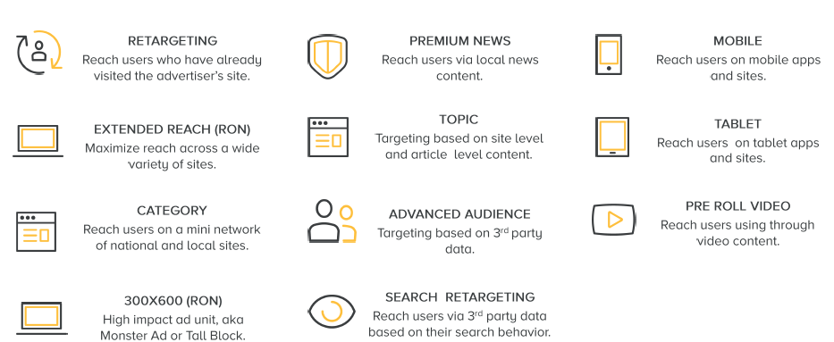
Audience Buying Groups

Slide 6
setting your target
Geographic Targeting
Reach internet users in a specific area
Demographic Targeting
Reach internet users of specific ages, genders, HHI’s, or professions
Demographic Targeting
Category Targeting
Reach internet users with interests in specific categories of information
Behavioral Targeting
Reach internet users with behaviors showing interest in specific products & services
Contextual Targeting
Reach internet users interested in your products or services
Job Title Targeting
Reach internet users interested in a specific field or profession
Search Re-Targeting
Reach internet users who are looking for your services or products and may not know who you are
Site Re-Targeting
Reach Internet Users who already know who you are

Slide 7
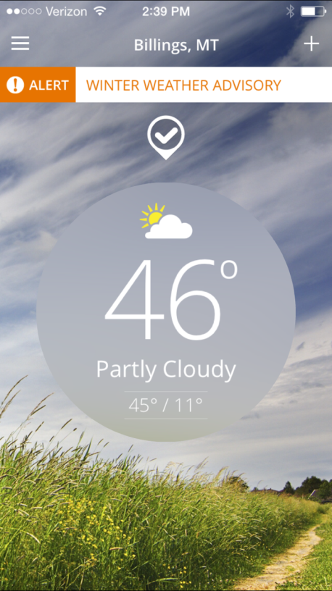
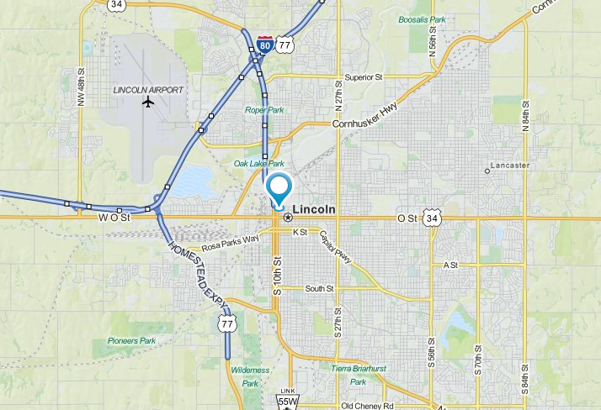
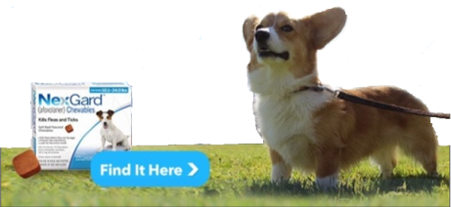
Mobile targeting: geo-fencing
Whether you want to target a 2 mile radius of an event or business, or a city or the entire US
Target hyper-locally, nationally and globally

Slide 8
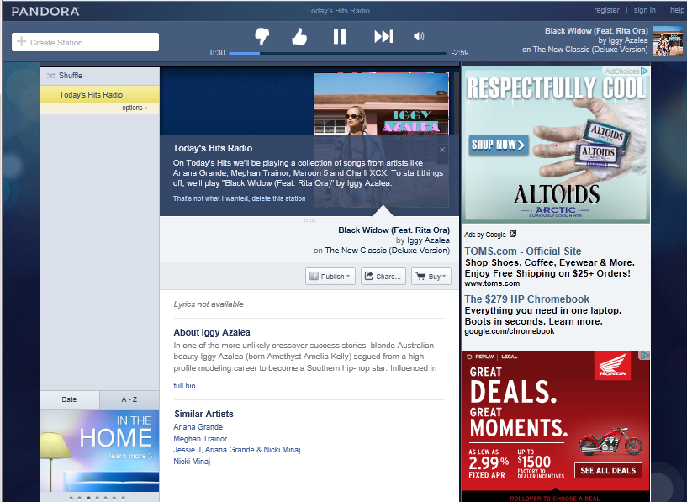
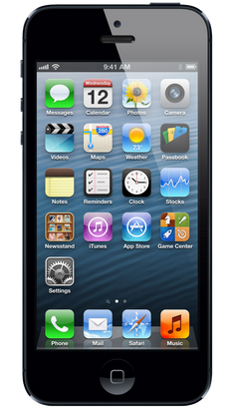
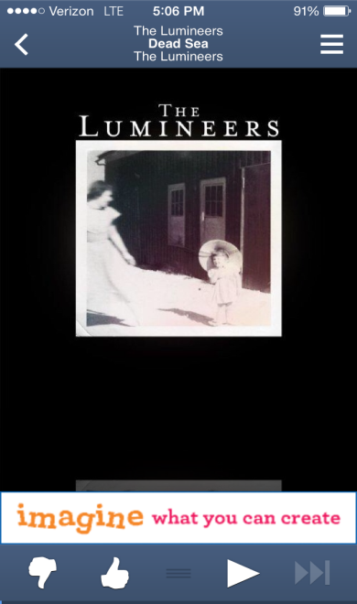
AUDIO TARGETING: PANDORA
Pandora has over 30 million listeners every month

Slide 9
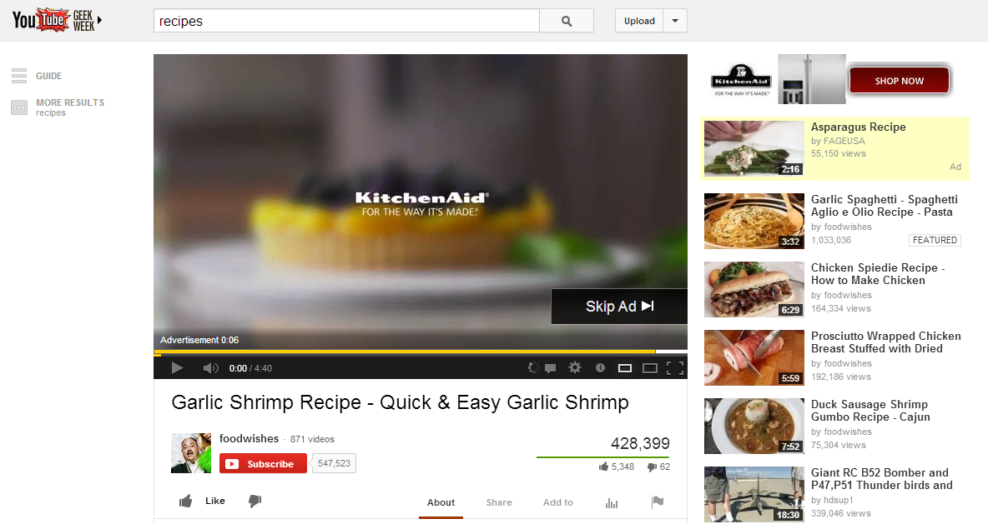
VIDEO TARGETING: YOUTUBE
With or without Companion Banner
Notes:
Streaming Video offerings allow businesses
to run their video-format message in front of video content online.
Selling points
Engage in conversations with clients who have video ads and have Broadcast or Cable budgets.
Video page layouts contain fewer distracting elements and longer page view times, giving advertising messages a less cluttered environment.
CTR is historically higher than a standard web display campaign.
The Fine Print
Pre-Roll Video Network
Pricing model is CPM.
Videos can be :15 or :30 seconds long.
Geo-targeting is available to DMA or US zip codes,.
Other targeting available: Channel or RON, behavior targeting and demo.
Includes a bonus 300x250 companion banner, delivered where available, but not guaranteed.
Inventory is secured through Centro’s programmatic offering.
YouTube.com
After 5 seconds, a “skip video” button appears on the video player.
Pricing model is Cost per completed view (CPV).
YouTube.com pre-roll video audiences are self-selecting and should run ROS unless otherwise recommended.
Geo-targeting is available by US zip codes, DMA, radius, province, or select Canadian cities. Canadian FSA targeting is available for YouTube, RON, and Channel only.
Includes a bonus 300x60 companion tile, delivered where available, but not guaranteed.

Slide 10
Why Amplified for Targeted Display?
Why Choose Lee Enterprises to manage your campaign-
We are performance driven: Partnering with us allows for continuous optimization of performance and results. Our campaigns are not optimized by machines – they are optimized by Lee Enterprise campaign managers who have a stake in each order they set up and continually optimize throughout the duration of the campaign.
We actually invested to have a seat on the ad exchanges. Giving us access to over 50 ad exchanges including Google, Yahoo, Bing which include top media publishers like ESPN, Martha Stewart Living, New York Times, Travel Magazine and thousands of other brand safe websites.
When we manage a campaign for our customers e will move impressions around the platform (ad exchanges) to maximize performance and get the best possible results - so it is not a set and forget it mindset.
There are billions of daily impressions to choose from and what we do for our customers is buy impressions (on the web & mobile) based on the customer’s business goals under various targets and then as it runs, we continually modify for optimal viewabilty, reach and interaction.
Based on the customer’s goals and who their best customer is, we buy targeted impressions for the customer on various sites by setting up audience targets (such as behavior, contextual, search, job title, retargeting, HHI, demographics, etc). We DO NOT SELL TARGETS (such as the aforementioned)… but rather audience based on the needs and goals.
Analytics provided on all digital products for campaign analysis weekly.

Slide 11
Why Amplified for Targeted Display?
Targeted audience to drive activation and ROI
We have tested and vetted many vendors and ad exchanges in this space; running campaigns simultaneously in order to determine the best quality ad sites and exchanges for our customers to drive results.
We can target extended audiences in specific DMA’s wherever they are online with our access to over 50 ad exchanges including Google, Yahoo, Bing which include top media publishers (BH Media, Scripps, McClatchy) and other brand safe websites.
We have access to over 30 billion impressions per day to quality and brand safe websites.
We own the largest and most affluent local audiences in our markets and have access to guaranteed impressions on all of Lee Enterprises’ owned and operated sites (50+); these are well respected and highly read sites within each of Lee’s markets.
Other networks may purchase our sites but the impressions and ad positions are never guaranteed.
We can also target our own audiences within our owned and operated sites.

