Slide 1
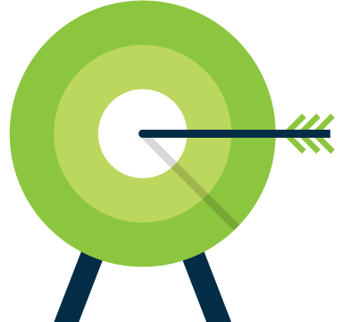
Targeted Display
Reach out to your direct audience with Amplified’s digital targeting solutions

Slide 2


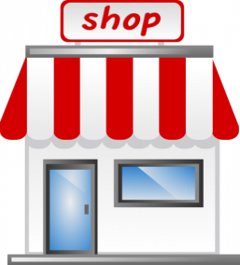
Reaching the Right Audience
The goal of Targeted Display is simple:
to bring your message to exactly the right customers wherever they are online.

Slide 3
Engage the Customer’s buy in…
Ask the business owner about their own internet experience.
Notes:
Start by getting the business owner to tell you about a time when they were retargeted.
What were they shopping for?
Had they visited the website?
Were they doing research?
Were they reading content related to the ads?
Did they buy? If not, why? Was it a relevant ad? An old ad?

Slide 4
Discovering the Need
“IF I COULD SHOW YOU A WAY TO
GET YOUR BUSINESS SEEN BY…
… people who have visited your website, and then left…
… people within your service area who use laptops, desktops, tablets and mobile devices…
… people who are searching for your products and services…
… people who are reading content related to what you sell…
…WOULD THAT BE OF INTEREST TO YOU?”…
Notes:
Transitional questions from Needs Assessment to educating the client about retargeting. LEAD with the solution. THIS is what it is all about.

Slide 5
Identifying the Need
Who is the existing customer base?
    Geography (city, state, zip. . .)
    Age (age span)
    Gender
    What needs is the business fulfilling?
    What life styles do the existing clients have?
    What occupations do they have?
    What do they buy?
    How much do they buy?
    How often do they buy?
Who are the people who should be coming in more?
    What are those people like?

Slide 6

Identifying the Need
Remember the goal of a needs assessment is not about fact finding, it is about FINDING THE NEED
Ask Questions. . .
About their business goals
About their personal goals
About other advertising that they are doing
About their competitors
About their audience
About their best customer
Notes:
The goal of the needs assessment is not about fact finding. It’s about finding the need.
asking questions about their goals can uncover “where they want to be”
Why did you start your business?
What are you trying to accomplish this year? In the next five years?
Why did you agree to talk with me today?
Questions about goals. For our purposes, we’d like the business owner to tell us that they want what we know retargeting can deliver:
More people to search for them by name
More web traffic
Higher quality (more engaged) website visitors.
More sales
Questions about other advertising they are doing. This will help us get an understanding of the kind of advertising they value and their beliefs regarding directional media and creative media.
Creative media “creates” a need for your product. It’s television, radio, billboard, display – anything that informs customers about your product or brand. Directional media captures the lead when they are looking to purchase. The old version of directional media is yellow pages. the new version of directional media is SEARCH ENGINE MARKETING (SEM/PPC). BTW, directional media always improves when paired with creative media.
Questions about competition. Getting the advertiser to talk about his or her competition often uncovers opportunities for conquesting.
Who do you consider your competition?
Who considers you competition?
What kind of advertising do they do?
Questions about their audience/best customer
Who do you feel is your ideal client?
Would you like to learn more about your ideal client?
How do you currently target this audience?
How do they do research before contacting you?
how do they imagine this audience spends time online?

Slide 7
Choose Your Target
home owners
interest
Traveler
HEALTH
Education
age
BUSINESS OWNERS
ENGAGED
JOB TITLES
income
gender
Occupation
kids in the home
AUTO SHOPPERS
pregnant
sports enthusiast

Slide 8
Audience Targeting Options
Extended reach
Search retargeting
Contextual targeting
Category/Topic targeting
Audience targeting (BT)
Mobile RON
Mobile Hyper-local
Tablet
Premium News Network
Video network – Pre-roll
YouTube Video
Face Book
Site Retargeting

Slide 9
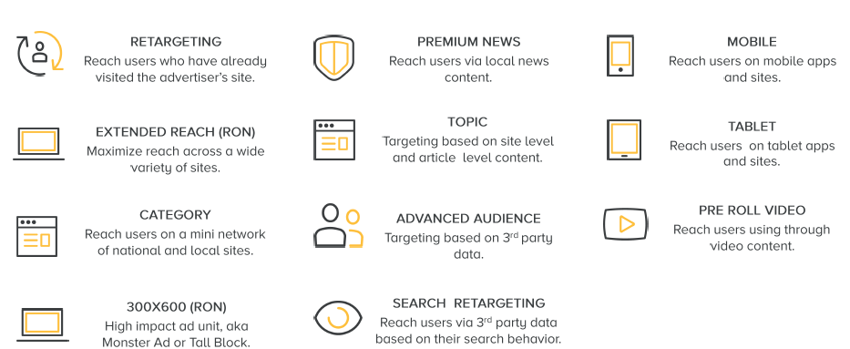
Audience Buying Groups

Slide 10
Targeted Display Opportunities
Geographic Targeting
Geo-Fence Mobile Ads
Run on Local Content
Run as Geo-Targeted
Reach Internet Users
in a Specific Area
Demographic Targeting
Target by Gender or Age
Target by HHI or Job Category
Reach Internet Users of Specific Ages, Genders, HHI’s, or Professions
Category Targeting
Show ads on Sites in a Specific Category
Show Ads on Pages with Specific Topics
Reach Internet Users
with Interests in Specific Categories
of Information
Behavioral Targeting
Show ads that are Interest Based,
to User’s Who Exhibit Those
Behaviors Online.
Reach Internet Users with Behaviors Showing Interest in Specific
Products & Services

Slide 11
Targeted Display Opportunities
Contextual Targeting
Based on Keywords & Phrases
Run though out a network
Run as Geo-Targeted
Reach Internet Users
interested in your products
or services
Search Re-targeting
Show ads on Sites relating to keywords
and phrases
Reach Internet Users who already
know who you are
Site Re-targeting
Show ads to users that have visited your site, but did not take action
Reach Internet Users who are looking for your services or products and may not know you

Slide 12
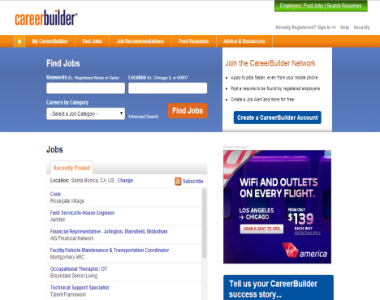
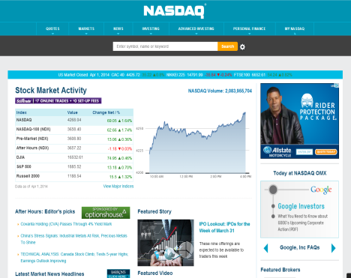
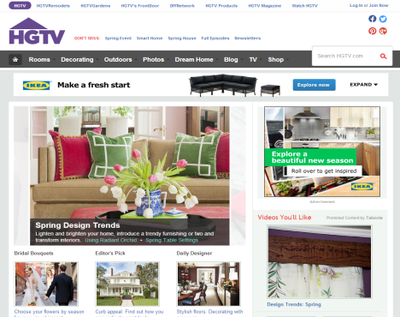
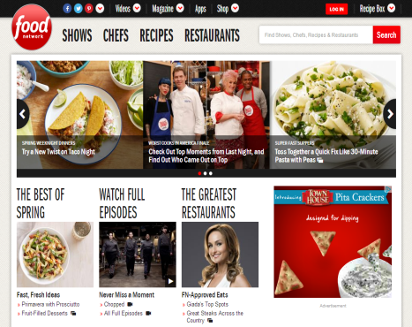

Run of Network
A cost-effective solution that maximizes an advertiser’s presence in market across a curated list of national websites.

Slide 13
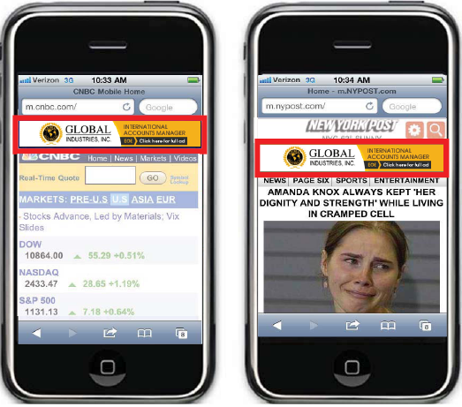
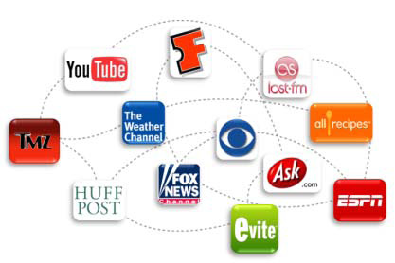
Mobile Network

Slide 14
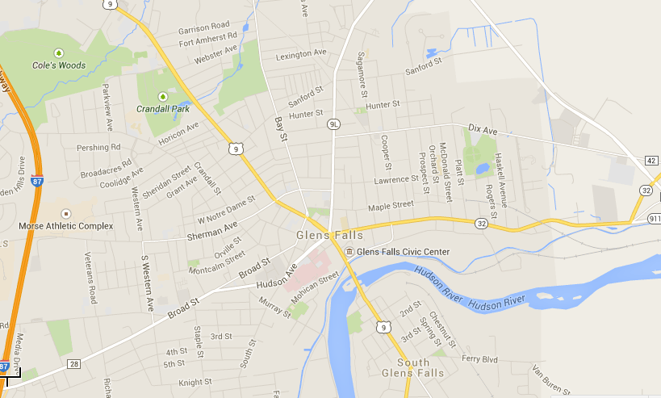

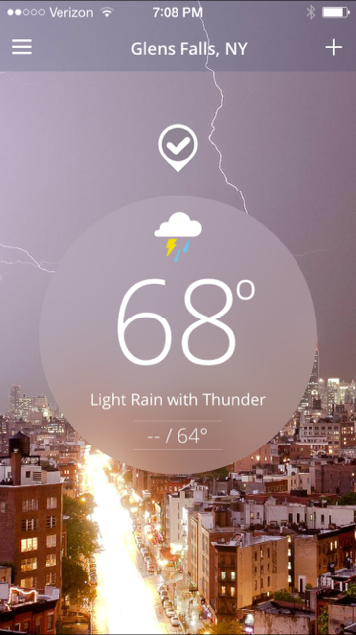
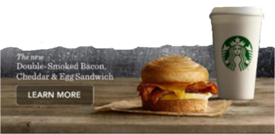
Hyper-Local Mobile Targeting
Whether you want to target a 2 mile radius of an event or business, or a city or the entire US – ONLY ON APPS
Notes:
Runs on apps only
Needs to have a large enough area/radius to deliver impressions
Should be combined with other tactics

Slide 15
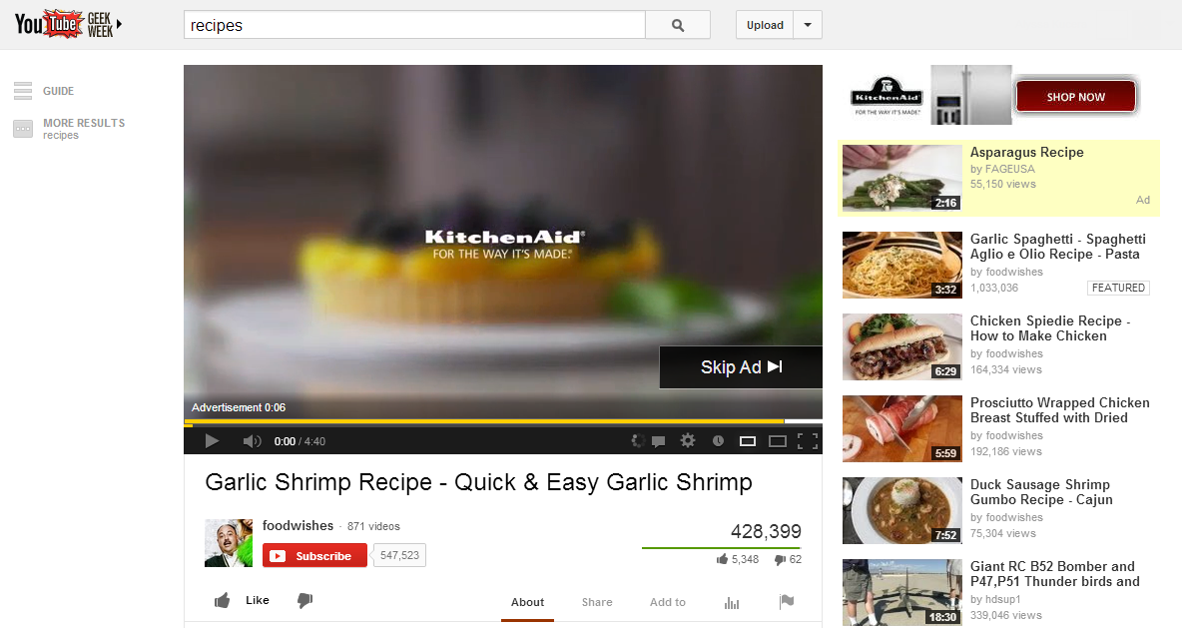
YouTube
YouTube with or without companion banner
Notes:
Streaming Video offerings allow businesses
to run their video-format message in front of video content online.
Selling points
Engage in conversations with clients who have video ads and have Broadcast or Cable budgets.
Video page layouts contain fewer distracting elements and longer page view times, giving advertising messages a less cluttered environment.
CTR is historically higher than a standard web display campaign.
The Fine Print
Pre-Roll Video Network
Pricing model is CPM.
Videos can be :15 or :30 seconds long.
Geo-targeting is available to DMA or US zip codes,.
Other targeting available: Channel or RON, behavior targeting and demo.
Includes a bonus 300x250 companion banner, delivered where available, but not guaranteed.
Inventory is secured through Centro’s programmatic offering.
YouTube.com
After 5 seconds, a “skip video” button appears on the video player.
Pricing model is Cost per completed view (CPV).
YouTube.com pre-roll video audiences are self-selecting and should run ROS unless otherwise recommended.
Geo-targeting is available by US zip codes, DMA, radius, province, or select Canadian cities. Canadian FSA targeting is available for YouTube, RON, and Channel only.
Includes a bonus 300x60 companion tile, delivered where available, but not guaranteed.

Slide 16
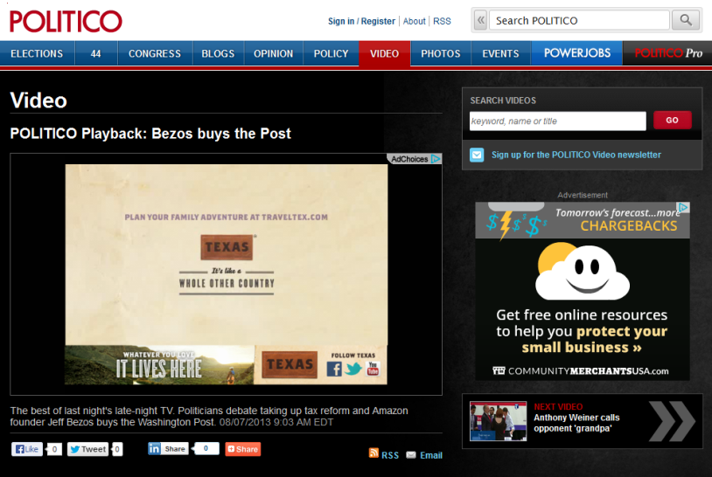
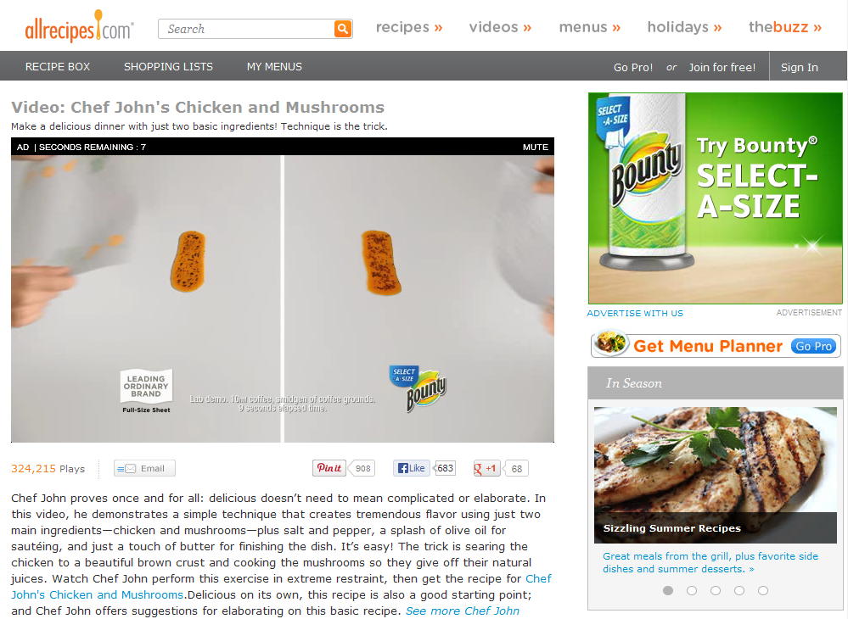
Video Pre-Roll
Targeting Options: RON, Channel, Demo or Behavioral
Pricing Structure: CPM. Video must be watched before user can view video content. There is not a skip button.
Pre-Roll Length Accepted: 15 or 30 seconds
Companion Banner:
Not guaranteed, 300X250
Without Companion Banner
With Companion Banner

Slide 17
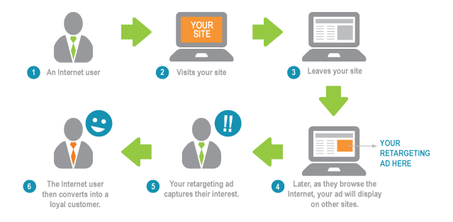
Site Retargeting

Slide 18
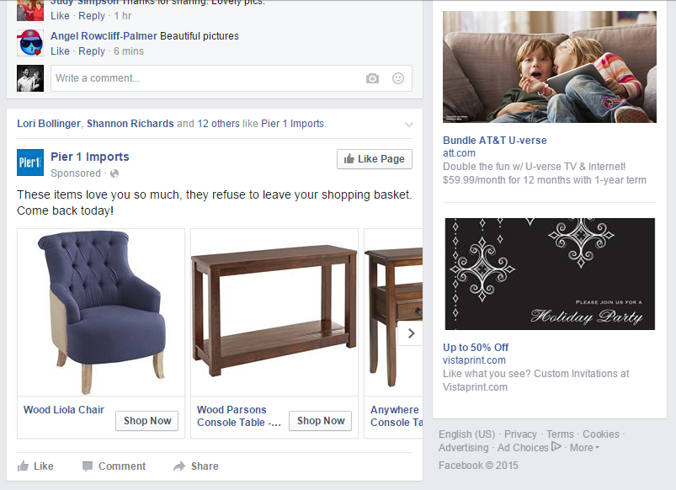
SOCIAL MEDIA MARKETING
FACEBOOK ADS
Targeted to any FB demographics profile info
Right-rail advertising
Newsfeed sponsored posts – must have to have access to customer’s facebook account and logins
Formula for success: checking in with customer on legitimacy of likes, shares and comments

Slide 19

The Formula for Success
Needs Conversation
Matching their “needs” with our solutions
Building a marketing Plan
Present proposal – use supporting research
Determining KPI’s (key performance indicators) to measure
Build effective creative
Review & Share Reporting
Make necessary adjustments

Slide 20


Reaching a Target Market. . .
wherever they are
Genuine furs and high end clothing store.
Display ads to:
Female users
Between 35 – 55 years of age.
With an annual income of $100k or higher
Notes:
Some of our competitors provide lists of websites that the client’s ads would potentially run on. That makes some of our clients request those and if we dig a little bit deeper, we will reach an interesting conclusion… Let’s go back to our very first example.

Slide 21



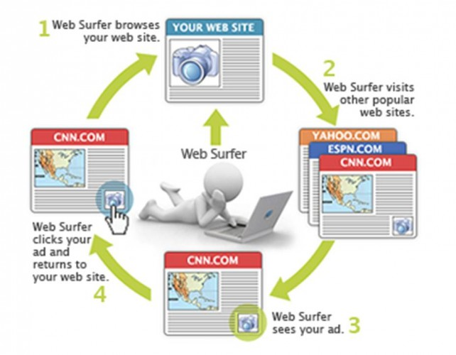
Where is your Target Market
Female user
Age: 37
Annual HHI of $150k
Female user
Age: 40
Annual HHI of $200k
Female user
Age: 48
Annual HHI of $127k
Notes:
Based on this specific example, both users on the screen fit the target he wants to reach. In the first case the consumer is reading Huffington Post, in the second, the lady is selecting what her next luxury car will be. First of all, how could have anyone predicted what either of those consumers would have been reading and secondly and more importantly, which one of the two is more important? Either has the potential to become a client, so why would we limit where the client’s ad can show → adding too many limitation from the very beginning of a campaign would ultimately leads to smaller returns on investment.

Slide 22

Integrated Marketing Plan
LOCAL CORE + TARGETING = MEDIA MIX
Notes:
As part of a media mix, retargeting enhances other kinds of advertising.
Use “part of a balanced breakfast” analogy. It goes like this: If all I get for breakfast is a glass of orange juice (a retargeting campaign), then I’d like it to be a good sized glass of orange juice so that it fills me up and I feel satisfied. However, if I also have eggs and bacon and toast and cereal (other marketing campaigns), then I can get buy with a smaller glass of orange juice.
in other words, it’s perfectly fine to sell a smaller retargeting campaign (< 100,000/mo impressions) when it is combined with other strategies by which it will be measured.
AS A GUIDE… our recommendation is: ___________________ (if sold as stand alone) or ___________ when combined with other media.

Slide 23

Fulfillment
Reporting
& Analytics

Slide 24
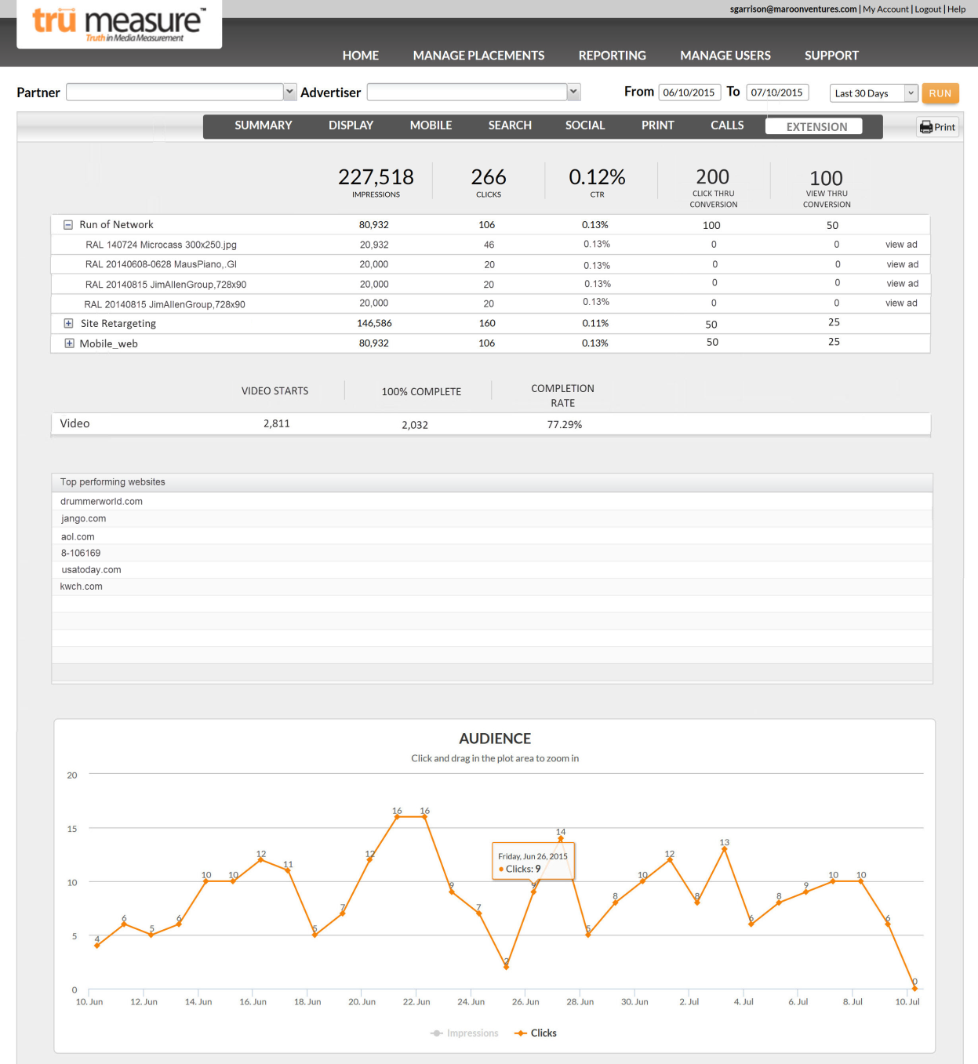
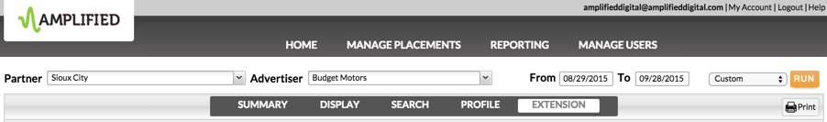
Full Transparency
We provide full transparency to our advertiser’s targeted display results.
Don’t hide from the results…own them

Slide 25

Performance Summary
Data Delivered: Impressions-Clicks-CTR%, Click Thru & View Thru Conversions
Campaign Type (RON, Site Retargeting, Mobile) & Creative Name, breaking out audience metrics
for each. In addition – view the ad creative!

Slide 26

Performance Summary Continued
Video Specific Metrics – Reporting Video Starts, 100% Completed (Sum of all Completed Placements), & Average Completion Rate per Placement
Top Performing Websites: Displayed as top performing sites by CTR
Graph of Total Daily Clicks
Notes:
If activity is not available for a specific section, it should not be shown. For example, if no websites are provided, then the “top performing websites” box would not appear. If video is not provided, then the video section will not appear. The same is true for the Engagement and Action sections.
By default, all Tactics will be collapsed and Creative Names will not be visible upon initial load.

Slide 27
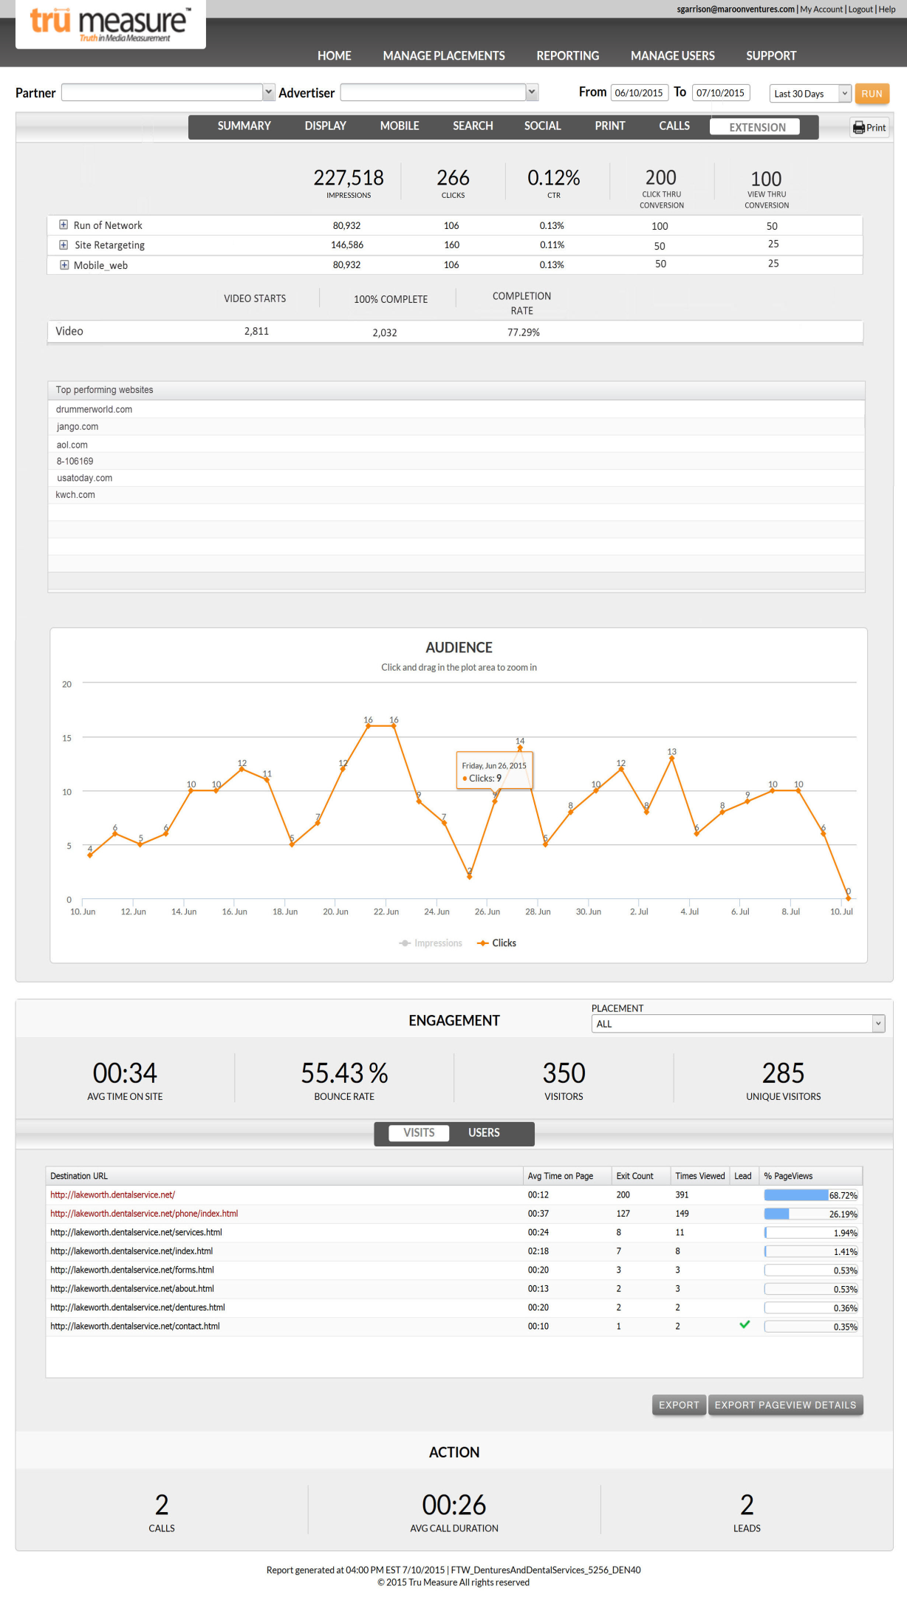
Performance Summary - Engagement
Post Click Activity including:
Average Time on site, bounce rate, visitors, unique visitors, 10 most visited pages and call data along with emails received. Leads are identified by the advertiser and surfaced.

Slide 28
Fulfillment
Fulfillment

Slide 29
Lee’s Audience Extension Philosophy
Vendor Agnostic – best performing inventory at lowest cost
Always bundle owned and operated with audience buys
Remember that audience inventory has a
hard cost – always build in margin!
Central Media Planning Team has access to all vendors and are subject matter experts on what is available and performing well

Slide 30
Campaign Fulfillment Overview
Interest Identified
Sales Rep completes Needs Assessment
Sales Rep submits digital Request for Proposal
Lee Ops returns Quote
Sales Rep confirms buy and submits creative
Campaign goes live
Optimization as needed
Final campaign report sent
Chargeback for wholesale cost

Slide 31
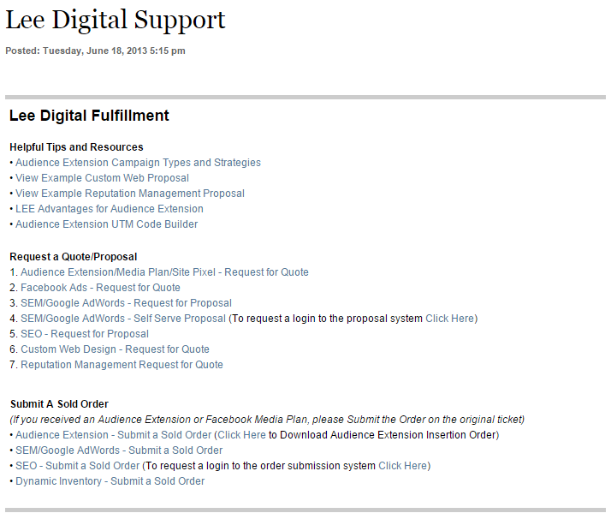
Fulfillment Process Overview - Support Forms
http://intranet.lee.net/online/other/html_2a6fcb16-403f-11e0-870b-001cc4c03286.html

Slide 32
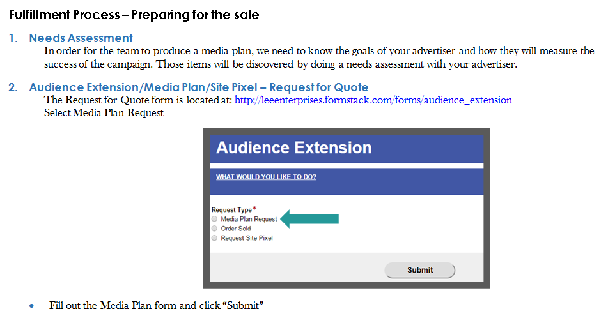
Fulfillment Process Overview – Preparing for the Sale
NOTE: Media plans are completed and returned within 24-48 hours depending upon how complete the information is and the vendors selected.

Slide 33
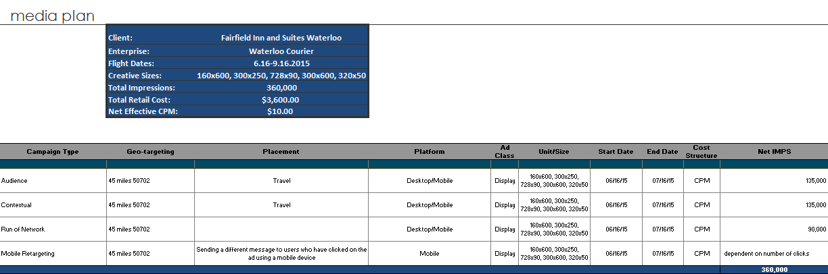
Sample Media Plan

Slide 34
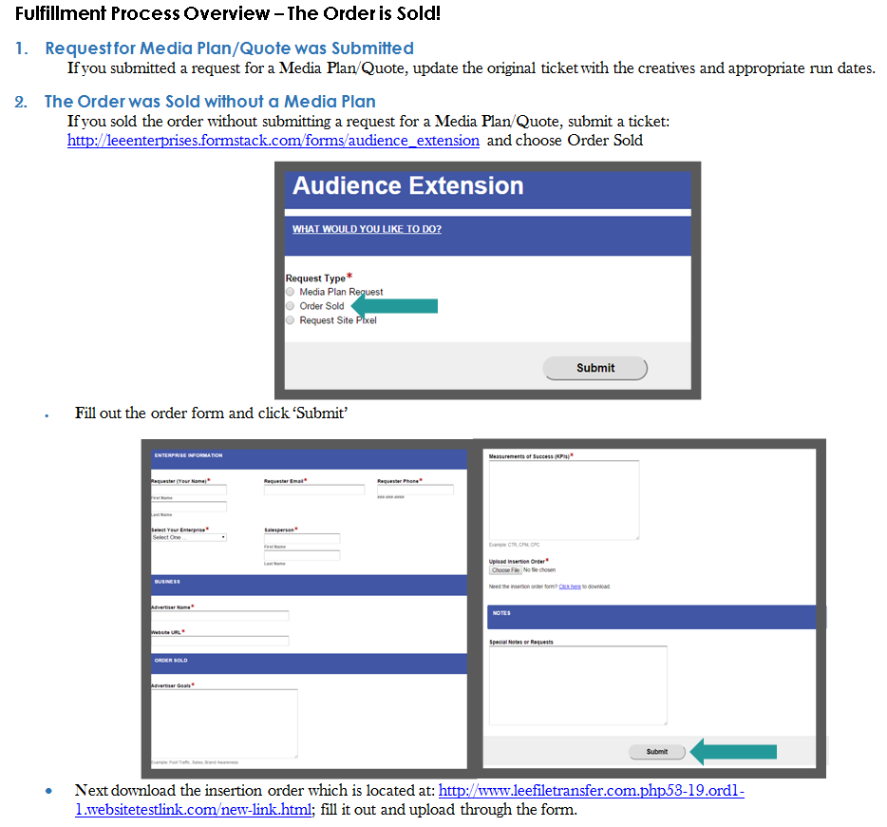
Fulfillment Process Overview – The Order is Sold!

Slide 35
Fulfillment Process Overview – The Order is Sold!
Creatives
Upon close of the sale all creative files need to be submitted. Campaigns cannot be started until creatives are received. Allow a 1-2 day buffer for campaign setup to be completed to allow for the creative review process by the exchanges.
Monitoring and Optimizing Campaigns
Once live - campaigns are monitored constantly. Weekly each line item is checked and optimizations are made based on the advertiser's goals and KPI's.
Reporting
Weekly audit reports are provided by the Media Planning team. Monthly reporting will now be available in the TruMeasure platform and will be pulled by each enterprise.
Monthly Calls
Each enterprise has the option of setting up a monthly call with Media Planning team to go over campaigns in depth and to touch based on any questions or concerns.

Slide 36
Fulfillment Process Overview – FAQ’s
How Should We Sell Audience Extension Campaigns?
Audience Extension campaigns should be sold based on a budget and optimized to achieve an advertiser’s goals. We estimate impressions based on the retail CPM, however, because we purchase impressions in real time the impressions are simply an estimate.
What is the Smallest Monthly Retail Budget?
Campaigns under a $500 monthly retail must have a Manager’s approval.
What Retail CPM’s do you recommend?
Wholesale CPM rates (the hard costs) vary depending on levels of targeting requested. Recommended retail CPM ranges $12-$15.
Why is Audience Extension beneficial for my advertiser?
Audience Extension allows your advertiser to reach their audience far beyond their website with the capability to reach a specific audience that is of major interest to them, in greater numbers and with more frequency.

Slide 37
Fulfillment Process Overview – FAQ’s
How Do I Ensure The Campaign produces great results?
  Clarify your advertiser’s key performance indicators – how do they want to measure the success of the campaign? Make sure the Media Planning team understands both the goals and KPI’s.
  We recommend having the following ad sizes available for desktop campaigns: 160x600, 300x250, 300x600 and 728x90; and for mobile campaigns: 300x250 and 320x50.
  Refresh the creatives periodically for long term campaigns so the message doesn’t get stale.
Why isn’t My Advertiser Seeing Their Ad?
Your ad could appear on literally ANY website that sells their inventory via the Real Time Bidding environment. There are millions of websites and hundreds of exchanges that sell their inventory – they include news sites, celebrity gossip sites, weather sites and gaming sites.
Can we Obtain Tear sheets for our campaigns?
Unfortunately, we are unable to provide tear sheets for audience extension campaigns. This is due to the nature of this type of advertising. Given that the ad could appear on ANY of millions of websites throughout the viewer’s journey on the internet, this is nearly impossible to track. All of our campaigns are geotargeted and the Media Planning team most likely will never see the ads in question.

Slide 38
Google Analytics UTM Link Tagging
Google Link Tagging (UTM code) is a free tool offered by Google. It provides an easy way for your advertiser to track the source of click thrus from digital banner advertising via their Google Analytics dashboard.
This enables the advertiser to see in their Analytics Dashboard what domain the click thru came from and can also identify a specific creative or promotion.
UTM Tags give us credit for the click-thru from a banner on our sites or any display campaign Lee manages; including Targeted Display, FB, SEM, etc.
Available now and currently supported across all Lee properties
Setting expectations with the customer VERY important with UTM Tags.

Slide 39
UTM – URL Builder
URLs must be constructed in a standard format in order for the results to flow into Google Analytics. The URL Builder available at: allows three parameters to be included; source, medium and campaign.
The URL Builder instructions below will walk you through the process for adding UTM parameters to the click thru URLs used in digital campaigns.
In the example below apple.com is the creative’s click thru landing page. The URL Builder supplied the new URL including the UTM parameters. This URL replaces the original click thru URL.]
Step 1:
Obtain the click thru URL for the advertiser’s campaign.
Step 2:
Access the URL builder at: https://leeenterprises.formstack.com/forms/utm_url and paste in the campaign’s click thru URL.
Click ‘submit’ to obtain the final click thru URL with the UTM parameters:
http://www.apple.com?utm_source=journalstar.com&utm_medium=display&utm_campaign=iPhone6promotion
If your advertiser’s URL already has a ‘?’, instead of adding another “?’ replace with ‘&’ as outlined below:
http://www.apple.com? NavID=50&utm_source=journalstar.com&utm_medium=display&utm_campaign=iPhone6promotion
Bitly URLs can also be supported although this adds another layer of tracking that may cause reporting discrepancies.
Step 3:
Use this URL as the click thru URL for the campaign and remind your advertiser to check their Google Analytics for results.

Slide 40
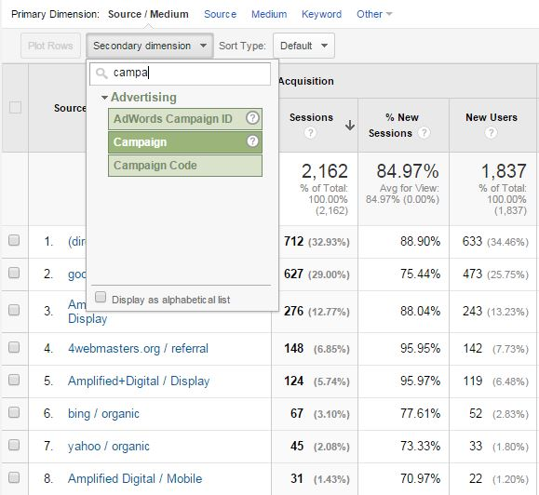
Tracking UTM Codes
Google Analytics and custom UTM codes help advertisers better understand the behavior of their website visitors. But how do you track them?
Tracking specific campaigns within Google Analytics is as simple as following these steps:
Click on Acquisition>All Traffic>Source/Medium
  This page allows you to view combined traffic from the site or agency the ads originated, plus the way they run (i.e. banner, mobile, social, Facebook, etc.)
Select Secondary Dimension, and type in “Campaign”
  This will allow you to break down traffic by the Campaign Name field entered in the URL Builder, including ad sizes (if used in the URL).

Slide 41
Why choose us?
Why Choose Lee Enterprises to manage your campaign-
We are performance driven: Partnering with us allows for continuous optimization of performance and results. Our campaigns are not optimized by machines – they are optimized by Lee Ent. campaign managers who have a stake in each order they set up and continually optimize throughout the duration of the campaign.
  We actually invested to have a seat on the ad exchanges. Giving us access to over 50 ad exchanges including Google, Yahoo, Bing which include top media publishers like ESPN, Martha Stewart Living, New York Times, Travel Magazine and thousands of other brand safe websites.
  When we manage a campaign for our customers e will move impressions around the platform (ad exchanges) to maximize performance and get the best possible results - so it is not a set and forget it mindset.
  There are billions of daily impressions to choose from and what we do for our customers is buy impressions (on the web & mobile) based on the customer’s business goals under various targets and then as it runs, we continually modify for optimal viewabilty, reach and interaction.
  Based on the customer’s goals and who their best customer is, we buy targeted impressions for the customer on various sites by setting up audience targets (such as behavior, contextual, search, job title, retargeting, HHI, demographics, etc). We DO NOT SELL TARGETS (such as the aforementioned)… but rather audience based on the needs and goals.
  Analytics provided on all digital products for campaign analysis weekly.

Slide 42
Why choose us?
Targeted audience to drive activation and ROI
  We have tested and vetted many vendors and ad exchanges in this space; running campaigns simultaneously in order to determine the best quality ad sites and exchanges for our customers to drive results.
  We can target extended audiences in specific DMA’s wherever they are online with our access to over 50 ad exchanges including Google, Yahoo, Bing which include top media publishers (BH Media, Scripps, McClatchy) and other brand safe websites.
  We have access to over 30 billion impressions per day to quality and brand safe websites.
  We own the largest and most affluent local audiences in our markets and have access to guaranteed impressions on all of Lee Enterprises’ owned and operated sites (50+); these are well respected and highly read sites within each of Lee’s markets.
    Other networks may purchase our sites but the impressions and ad positions are never guaranteed.
    We can also target our own audiences within our owned and operated sites.

Slide 43

Questions?
Thank you!

