Slide 1
Training Deck – Video Production

Slide 2
INTEGRATING VIDEO INTO TURN-KEY SOLUTIONS
Exciting new capability to bring to your clients
Allows us to further our agency/consultative approach
Video can be used to enhance current campaigns or build out new strategies
Think BIG PITCTURE – how can video translate to an integrated marketing plan?
Video will be a huge differentiator for us in our markets
Production Strategy
Distribution Strategy
Notes:
We’re very excited to bring these great new video production capabilities to our markets. Integrating video into our already robust digital portfolio will allow us to further our agency and consultative approach with our clients.
Video is such a versatile marketing tool – it can be used to enhance current campaigns or build out new strategies and should always be built into an integrated marketing plan.
Video will be a huge differentiator for us in our markets. By offering video production to our clients, we bring the one, two punch with production and distribution strategy.

Slide 3
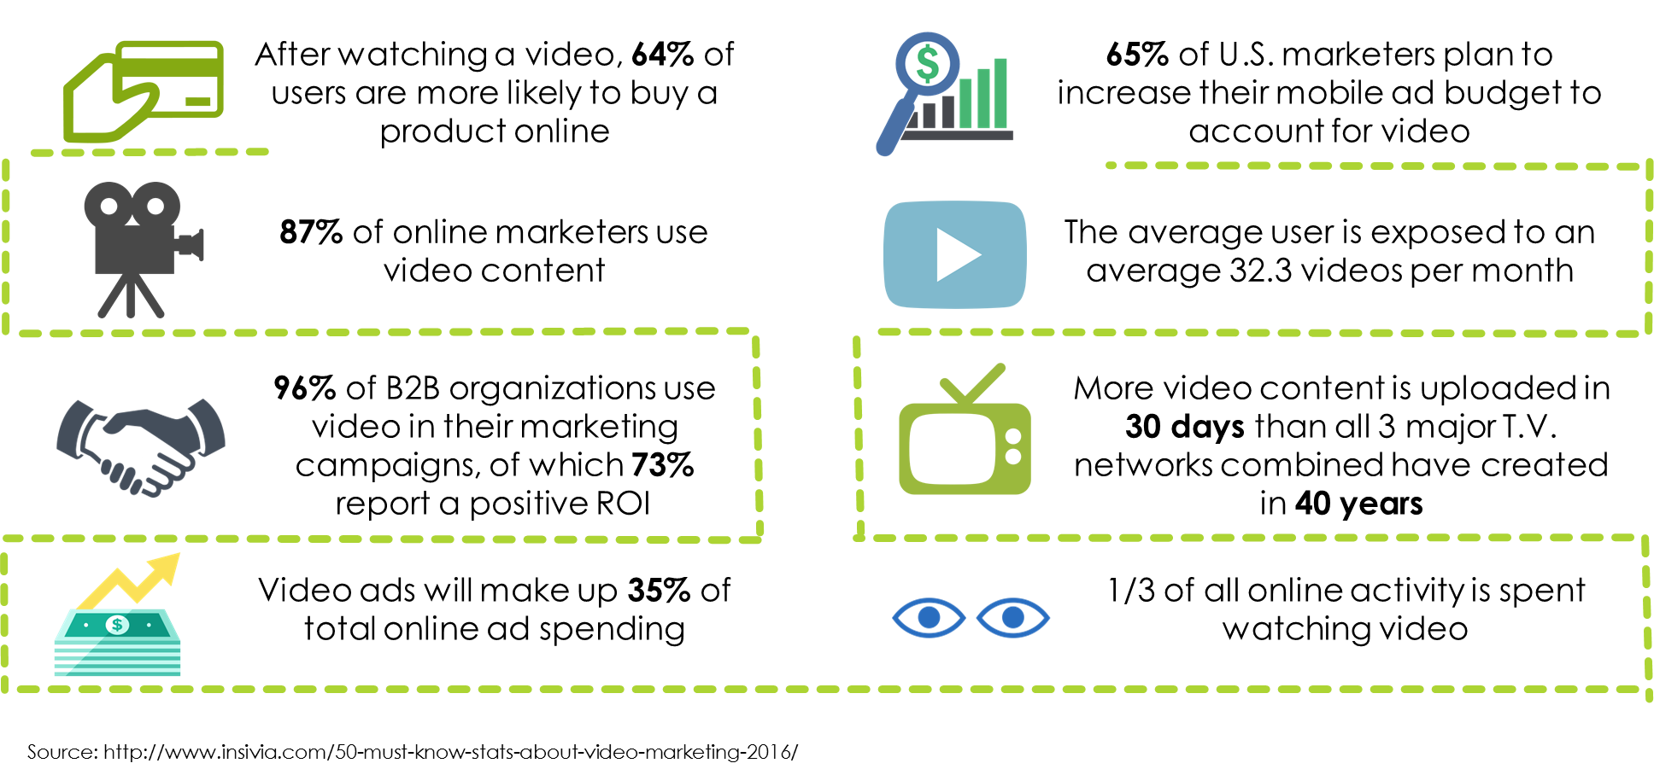
WHY IS VIDEO ESSENTIAL TODAY?

Slide 4
VIDEO IS POPULAR
Notes:
https://techcrunch.com/2016/01/27/facebook-grows/

Slide 5
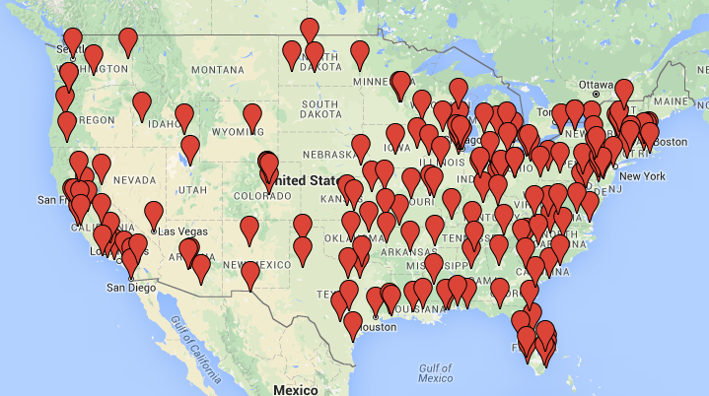
OUR VIDEO PARTNER
5,000 Videographers & Crews
All 50 States
Internal Producers & Editors
Unmatched coverage, quality, capability and service

Slide 6
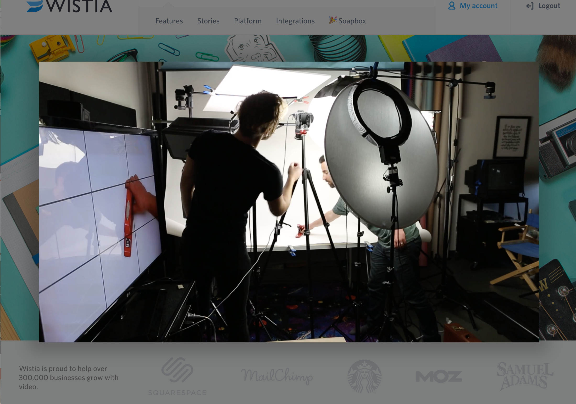
WHERE IS VIDEO?
Landing Pages:
60-90 seconds
Informative & Broad
May link to other videos

Slide 7
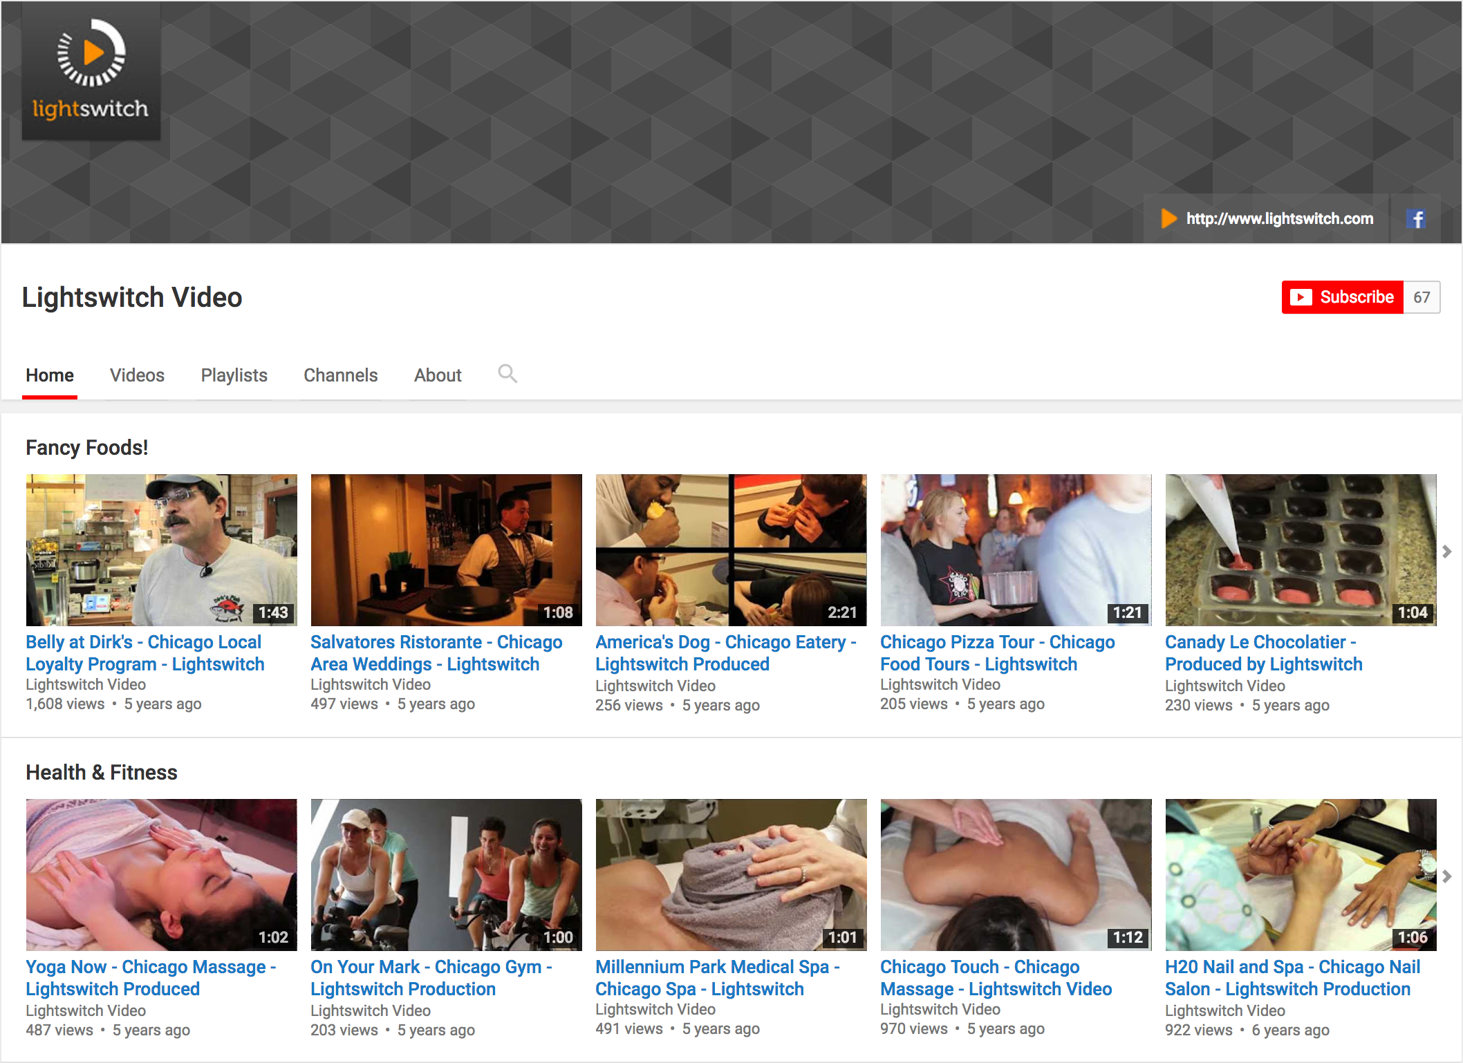
WHERE IS VIDEO?
Video-Centric Sites:
All lengths
All video types
Need descriptions, tags, and links back to landing pages

Slide 8
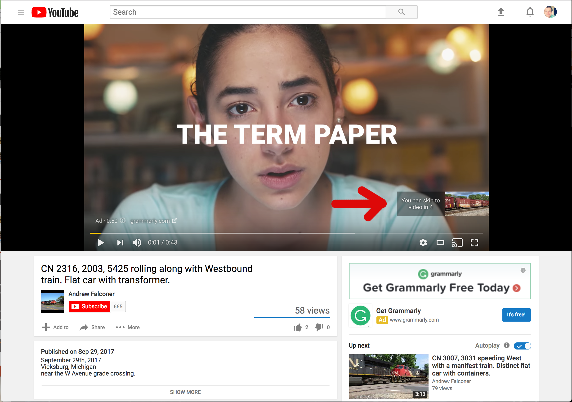
WHERE IS VIDEO?
Pre-roll:
SHORT
Often skippable
Placed or programmatic

Slide 9
WHERE IS VIDEO?
Rich Media:
SHORT
Text on screen
Often silent

Slide 10
IDENTIFYING GOOD PROSPECTS
Pre-Call Questions to Ask Yourself
Is the client already producing video?
Are they just starting to build an online presence?
Are they new to their market?
Do they have very similar competitors and need to differentiate themselves?
Is the business owner’s/employees’ personality an important selling point
Is their business inherently visual
Ex. interior design, real estate, autos, furniture etc.
Do they need to educate their customers on their offering?
Do they need to establish credibility and build trust?

Slide 11
WHAT DO WE NEED TO KNOW?
Message – what do they need to say?
Don’t overthink it!
Audience – who do they need to say it to?
Venue – where will they say it?
Facebook, Pre-roll, Rich Media, Youtube, In-Banner, Native, Television, Programmatic, Native, VHS, etc

Slide 12
PRODUCTION
Step 1: Contact us
Sales@lightswitch.com
bryce@lightswitch.com
(312) 999-5860
Notes:
Discuss costs

Slide 13
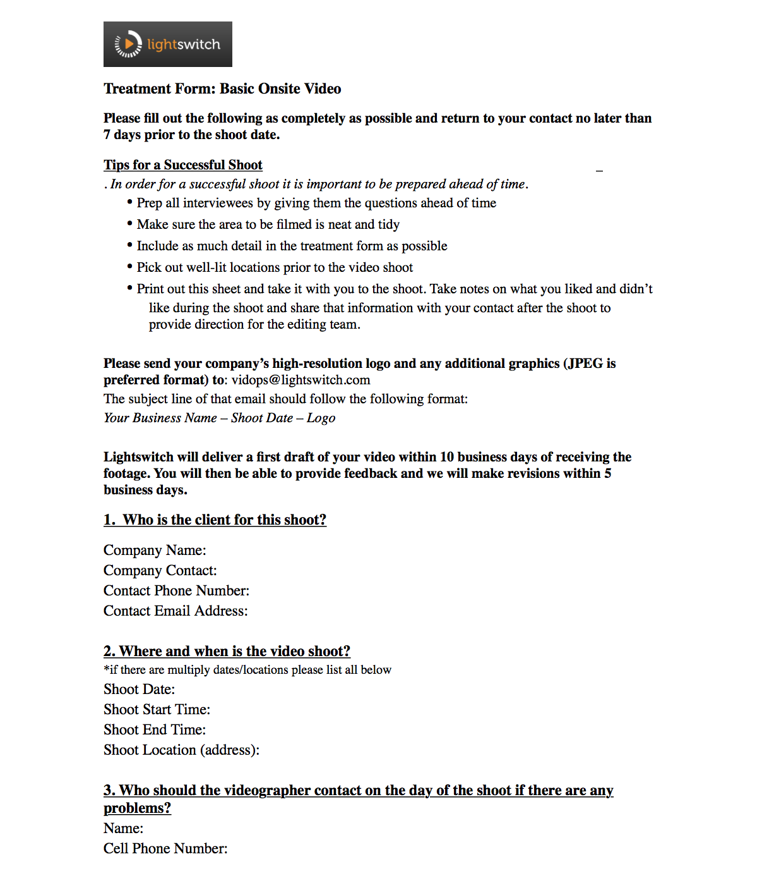
Scope of Work
Length of Shoot
Size of Crew
# of edits
Length of Edits
Extras
Aerial?
Motion Graphics?
Teleprompter?

Slide 14
PRICING & PACKAGES

Slide 15
PRICING & PACKAGES
Other Production Costs | Wholesale
First hour on site video capturs/Reshoots | $350.00
Additional hour on site for footage capture | $250.00
Additional length to final video | $150.00
Additional rounds of revisions | $150.00
60s video created from footage previously captured by Lightswitch | $350.00
30s video created from footage previously captured by Lightswitch | $250.00
15s video created from footage previously captured by Lightswitch | $175.00
Raw footage file (transferred via FTP) | $350.00
Rush Order (Scheduled shoot date in fewer than 10 business days)* | $300.00
Rush Edit (First edit delivered in fewer than 10 business days)** | $300.00
Additional 15 second edit using previously captured footage or provided material | $175.00
Google Business View Tour - up to 30 Panos | $845.00
Aerial footage - hourly | $425.00
Half Day Hair & Makeup | $550.00
Half Day Audio Engineer | $625.00
Half Day Producer | $875.00
Half Day Videographer DP | $875.00
Full Day Hair and Makeup | $900.00
Full Day Audio Engineer | $1,000.00
Full Day Producer | $1,300.00
Full Day Videographer/DP | $1,495.00
15 to 60 second voiceover | $200.00
60 second edit from provided material - standalone video | $375.00
30 second edit from provided material - standalone video | $325.00
15 second edit from provided material - standalone video | $275.00

Slide 16
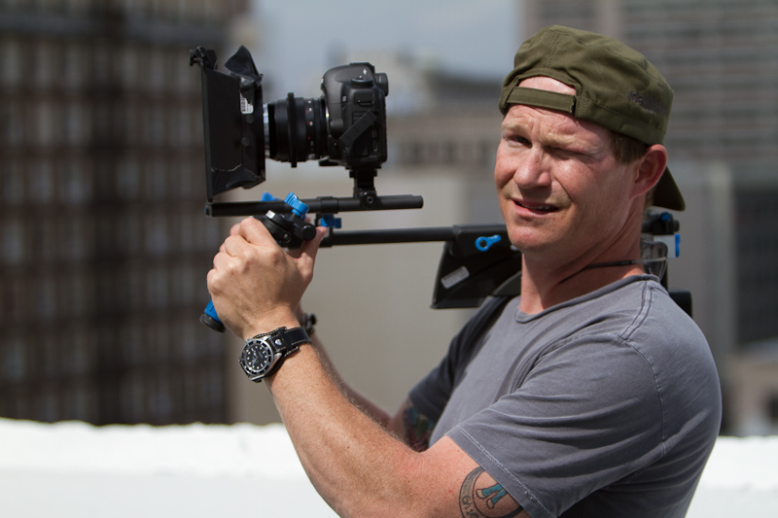
THE VIDEO SHOOT
Videographer will arrive 30-60 minutes prior to shoot to set up
You do not have to attend the shoot but are welcome to

Slide 17
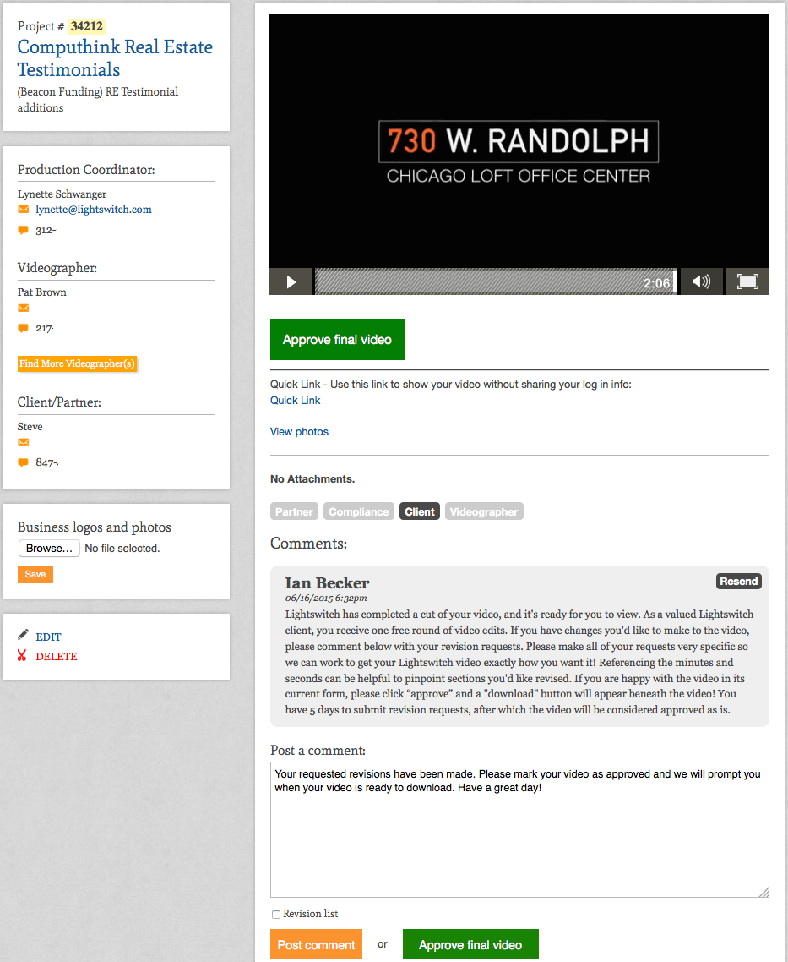
Review & Approval
First draft in 10 days
Revisions made in 5 days
Video can be shared, approved & downloaded

Slide 18
REVIEW
5 business days to schedule
10 days until first version
Client owns the file
Reach out to sales@lightswitch.com for help

Slide 19
EXAMPLE VIDEOS
RESOURCES
www.examplevideos.com/amplified
www.lightswitch.com/partner/amplified

Slide 20
QUESTIONS? Contact Adriane Morris Adriane.morris@lee.net 563-383-2127

