Slide 1
Webinar Training Series
Profile Reporting

Slide 2
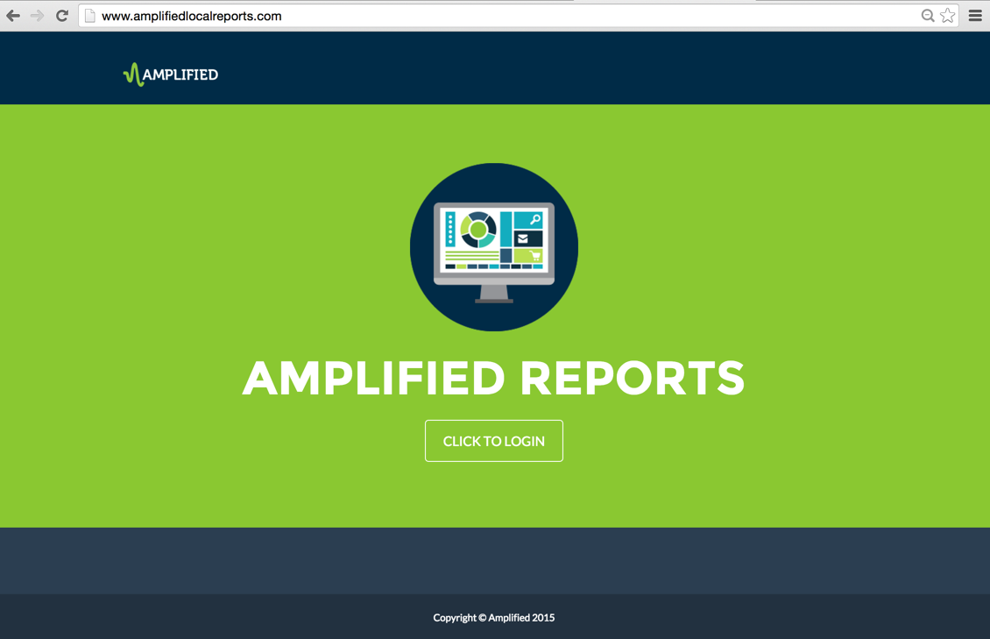
Notes:
The focus of this training session is the Amplified Analytics Dashboard data page for the Business Directory program.

Slide 3
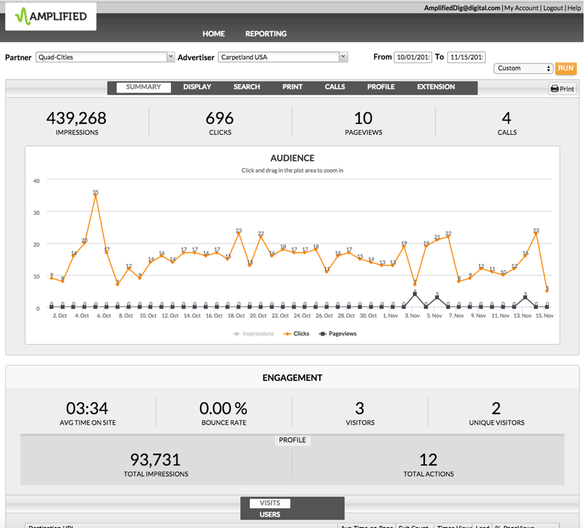
Notes:
From the performance summary page if the particular advertiser is participating in the Business Directory program you will see an overview of Total Impressions and total actions in the Profile Section directly under Engagement. Using the tabs across the top, click the profile tab to drill down into details of the business directory or profile section.

Slide 4
Notes:
On the left you will see the Impressions Summary. This is the total number of impressions the business profile page received under the Local Businesses header on the newspaper website and in the Local Search Directory plus the total number of times the business’s offer(s) appeared under the Deals, Offers and Events header and in the Classifieds search results.
Directly below is detail on those impressions. First is Featured Business Impressions which represents the total number of impressions the business profile page received under the Local Businesses header on the newspaper website. The second item is the Local Offers Impressions. This is the total number of times the business’s offer(s) appeared under the Deals, Offers and Events header on the newspaper website. The third section details the offer search impression. This number tells you the total number of times business’s offer(s) appeared in the Classifieds search results. And finally the Profile Search Impressions numbers are the total number of times business’s profile page appeared in the Local Search Directory search results.
On the right hand side is the Actions Summary, a total number of page views the business profile received, plus the total number of page views the business’s offer(s) received. The two categories below are Profile Views and Local Offers Clicks. Profile views are the total number of times the business profile page was clicked on from under Local Businesses. In addition it will contain a count of the Local Search Directory search results and how many clicks were received as the page was viewed. Last, the Local Offers Clicks section tells us the total number of times the business’s offers were clicked from under Deals, Offers and Events or when the Classifieds search results were viewed.
Should the advertiser choose to purchase a call tracking number for their campaigns, a number should be set up in the Services tab, by creating a new tracking order. (create new tracking, new tracking order). The tracking type would be Call Tracking Only and Placement should be Directory.
Please note: this section will contain no data if a tracking number has not been ordered.
When this section is populated it contains total calls and Average Call Duration. The calls are the number of interactions made to the call-tracking phone number used on the profile page. The average call duration provides the average time engaged with that tracking number.

Slide 5
Notes:
This concludes the Business Directory Profile data page training, within the Amplified Analytics dashboard.

