Slide 1
Webinar Training Series
#2 – Calls Reporting

Slide 2
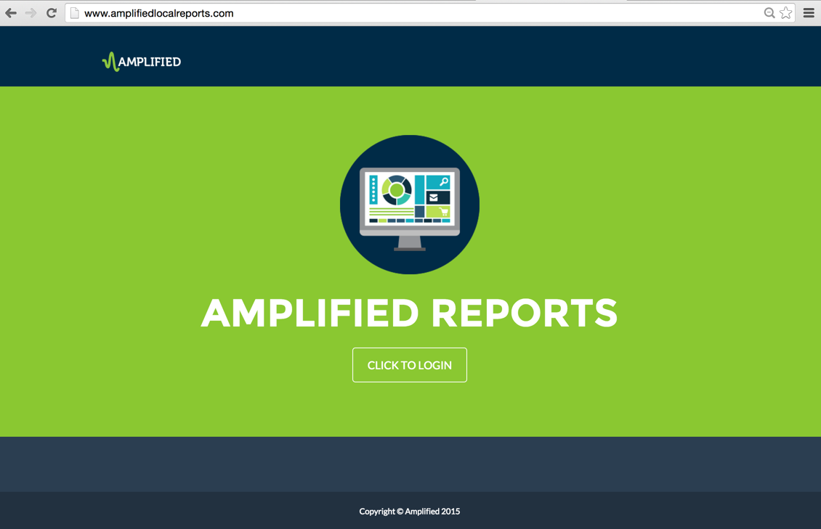
Notes:
The focus of this training session is the Calls data page in the Amplified Analytics dashboard.

Slide 3
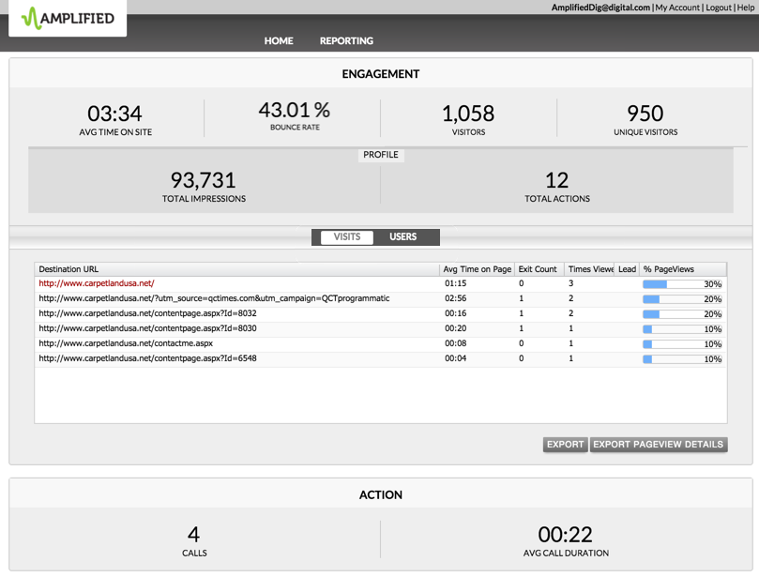
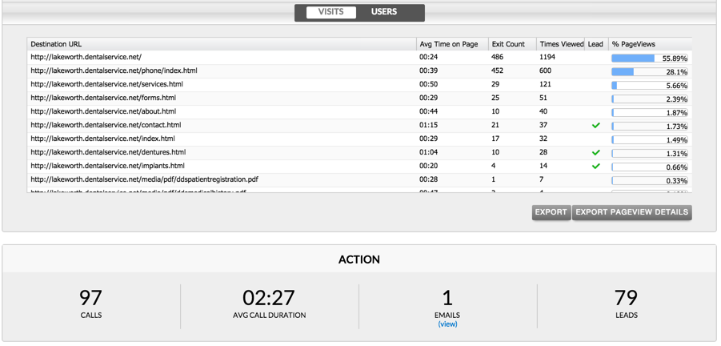
Notes:
Let’s quickly recap on how we are able to capture actions, including calls, within the dashboard. In order to see the engagement and action metrics, you will need to have your customer’s website and advertising campaign tracked thru a mirror-site set up thru your ad operations and fulfillment team. In addition, by including a call tracking number, we can see the data both under action section, as well as within the calls report. Let’s take a look!

Slide 4
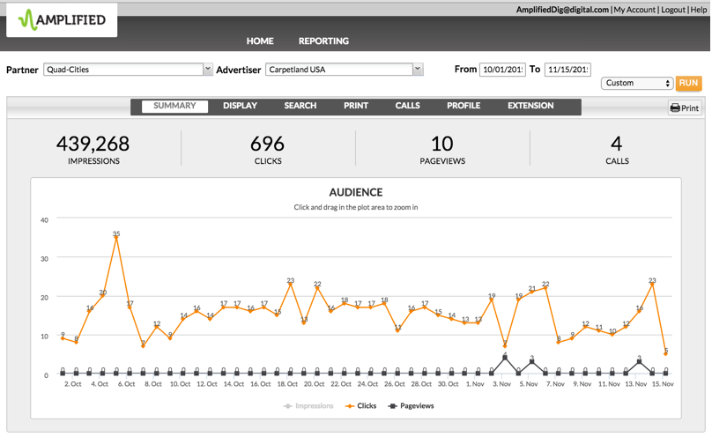
Notes:
From the performance summary page, using the tabs across the top, click the calls tab to drill down into the metrics behind the phone calls.

Slide 5
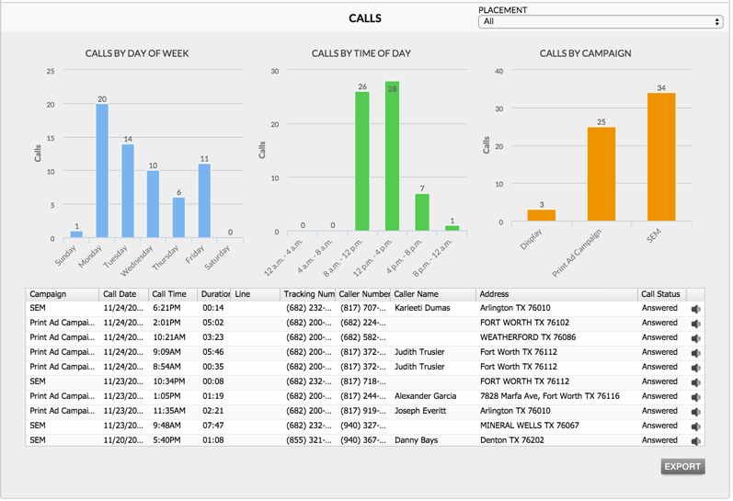
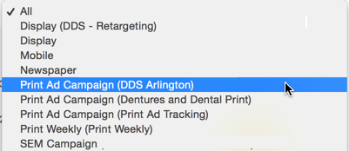
Notes:
The report starts with calls by day of the week and time of the day. This can be very eye-opening to an advertiser and can provide data that can, in some cases, uncover issues that may be affecting their business. They can determine if their business is set up adequately to make sure they aren't missing any calls. Are there certain days or times they're understaffed or do they need more phone lines? This detailed call information can be very powerful and can be an indirect way to increase business as a result of the information you are giving them as a marketing consultant.
You can also see the call breakdown by campaign. For this advertiser, the SEM campaign is leading in call generation, followed by print. If you would like to drill down even further into the call metrics by a specific campaign, click on the placement drop-down menu and choose a campaign you would like to measure.
This section lets you drill down deeper into the details on the actual calls made. Filtering options on all the tabs allow you to sort the data to find exactly what you're looking for, whether it be all the calls from a specific campaign, calls from one particular day, or even all the calls from a particular caller. By knowing the name of the caller, you can see if it is a current customer or a potential new lead.
In addition to proving the ROI of advertising campaigns, the call status and ability to listen to the calls is a great tool to help your advertisers in the customer service arena. You have the ability to see how many calls were answered, as well as how many were missed.
Listening to the calls within the dashboard provides another insight into their business, as you can hear how the phones are being answered and how customers are being treated. As a business owner, you trust the front line answering the phones are professional and courteous to your customers. Listening can be very enlightening to your advertiser and can greatly help them in the customer service area. In addition, you can find out what people are asking for when they call. Maybe it's a product or service the advertiser doesn't offer. Once again, this can be an indirect way of growing sales. Not only knowing their phones are being answered but how they're being answered, how their customers are being treated and maybe products and services callers are asking for, comes from the data you provided as a marketing consultant. Call recordings are available for 30 days after the call was received. You can also export the call details into an Excel document by selecting the export button – the audio does not export into the excel.

Slide 6
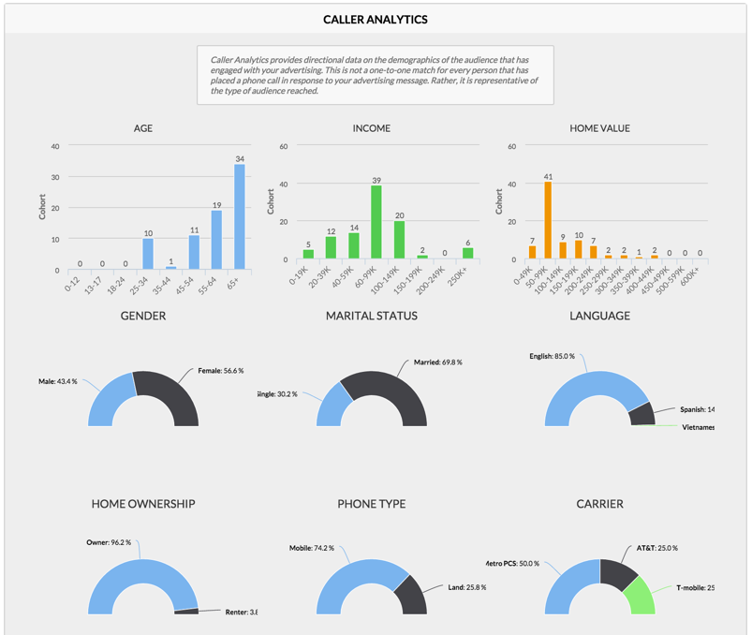
Notes:
The caller analytics section really digs into the demographics of the callers. It's a representation of the audience reached. For advertisers who want to know more about who they're reaching, this section providers about everything they would want to know: Age, income, home value, gender, marital status, the caller's language, home ownership, phone type and phone carrier. It's a lot of information that some advertisers may be interested in knowing and vet against leads and sales.

Slide 7
Notes:
This concludes the training on the Amplified Analytics call data page training

