Slide 1
Webinar Training Series
#2 – Print Reporting

Slide 2
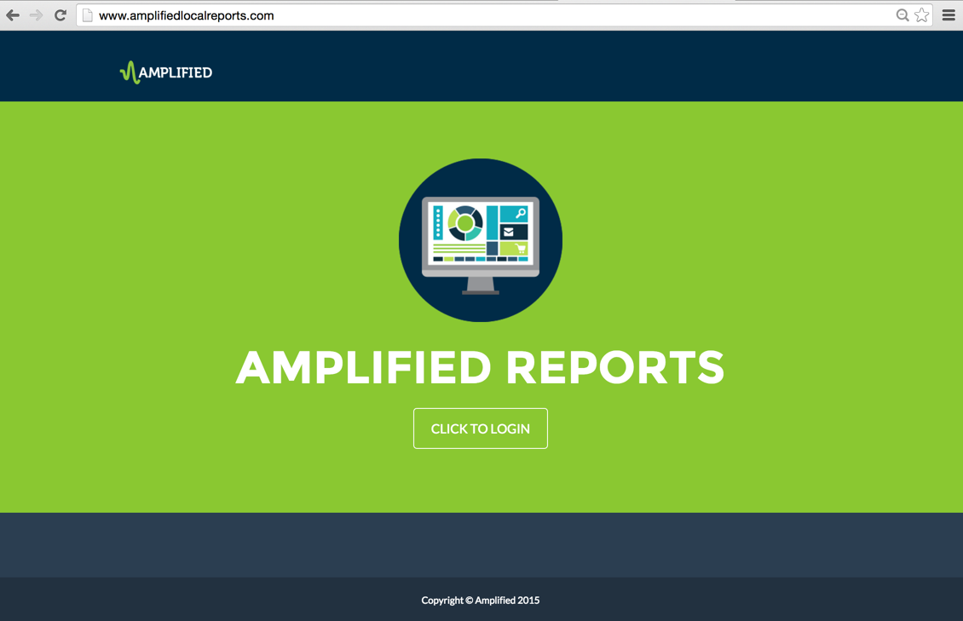
Notes:
The focus of this training session is the Amplified Analytics Dashboard Print Data Page.

Slide 3
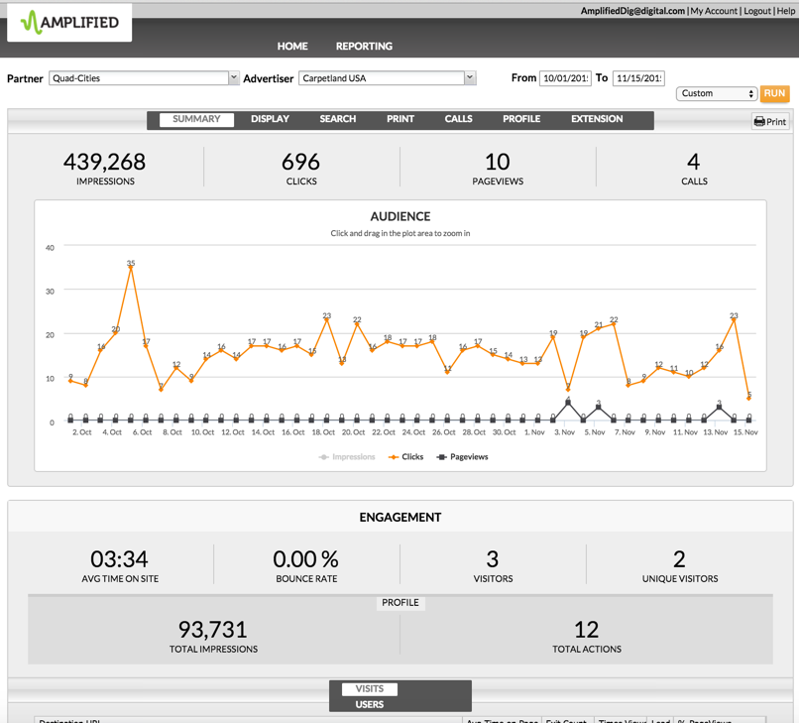
Notes:
From the Performance Summary Page, using the tabs across the top, click the Print tab to drill down into the print data.

Slide 4
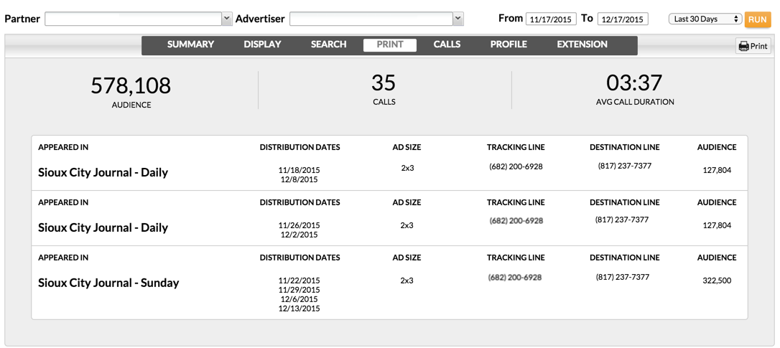
Notes:
The metrics for print look a little different than the other product pages. Let's take a closer look.
The Summary section for print shows the audience reached, calls generated, and average call duration. Below the summary, you'll find the data showing where the ad appeared, the day the ad ran, the ad size, tracking line or phone number used in the ad, destination line; which is the business line the tracking number forwards to, and audience. The audience numbers are pre-populated for most daily publications for each market, using readership numbers (2.4 x circulation for Daily and 2.7 x circulation for Sunday). In addition, you can include special sections or any additional publications manually to capture and present the strength of those unique sections and their reach.
In order to see the calls received, you will need to include a unique call tracking line for any of your print ads. This should be set up by your local ad operations team. Typically, advertisers will want to use the same number in all print ads to keep the consistency, like they've done here. However, if they wanted to track specific ads, publications or publication dates, they could do so by using different call-tracking numbers. Remember, with the inclusion of the call tracking numbers, we're able to leverage all our products together. By demonstrating the power of print, and marrying print readership with digital impressions, creates an all-inclusive multimedia campaign.
If you do not include a call tracking number, you can still add your print campaigns into the dashboard in order to show the audience reached.

Slide 5
Notes:
Has your advertiser ever wondered how well their other offline marketing tactics are working for them? Are they planning on executing a billboard or direct mail campaign? You also have the ability to track outside media, such as billboards and radio for your customers. All you would need to do is procure a call tracking number to provide your client to publish on the outside media in order to track the performance inside the amplified analytics dashboard.

Slide 6
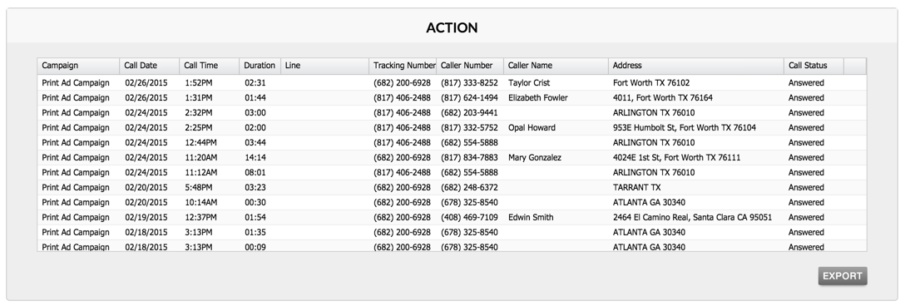
Notes:
When a call tracking number is used, you'll find the details of the calls generated in the Action section.
The data includes: the campaign generating the call, date of the call, time of day the call came in, duration of the call, the tracking number, the phone number of the caller, and when available; the caller's name, and address (which provides your client with valuable lead information). And finally, the call status. Was it answered or missed? Another great feature is the ability to listen to the actual call. By clicking the Recording icon, a pop-up will generate for you to listen to the audio of the call. Remember, the calls are available to listen to and download for 30 days from when the call was received. You can also export the call details into an Excel document by selecting the export button – the audio does not export into report. As a reminder, you can view deeper call data, including caller analytics from the Calls data page.

Slide 7
Notes:
The Print Data Page is very powerful, as it illustrates the strength and value of our print products, and analytics dashboard. This completes The Print Data Page Training.

