Slide 1
Webinar Training Series
Search Data Page

Slide 2
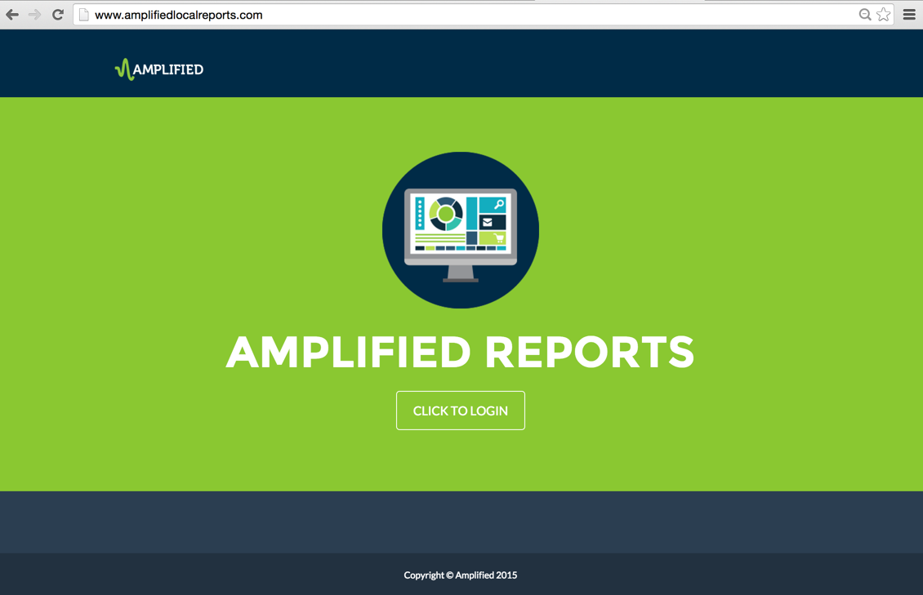
Notes:
The focus of this training session is the Amplified Analytics Dashboard Search data page.

Slide 3
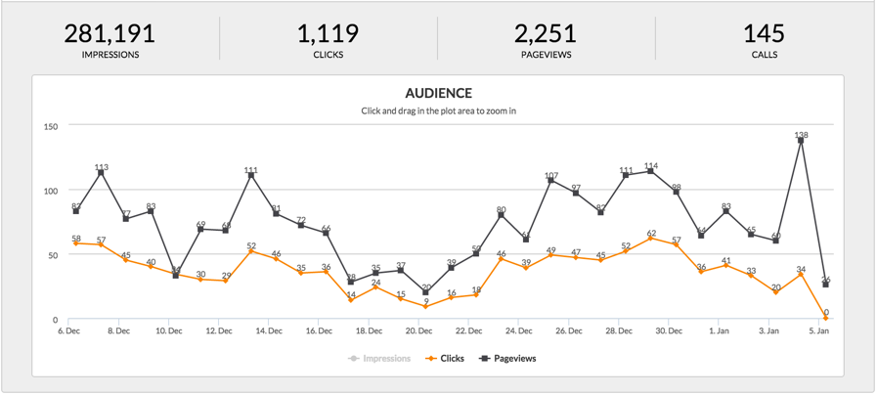
Notes:
From the performance summary page, using the tabs across the top, click the search tab to drill down into the search data.
The metrics of each product roll up into the summary page so you'll notice the overall data, layout and page navigation will be the same as the summary page, reflecting the metrics driven by each campaign, and the search data includes more drill down options. Let's review the search data.

Slide 4
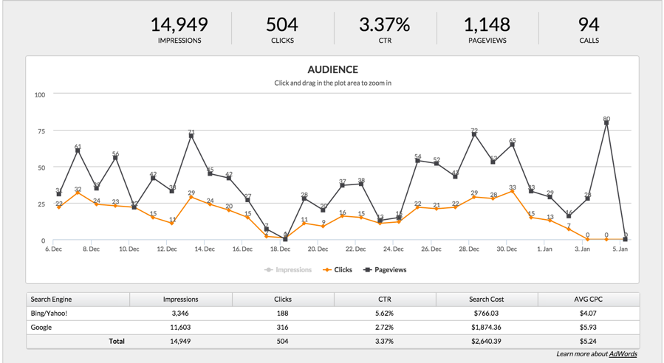
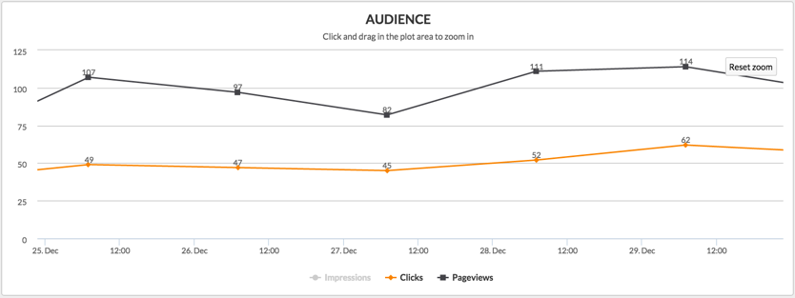
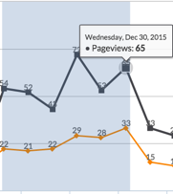
Notes:
The at-a-glance summary section for search includes the metrics on impressions, clicks, click through rate, page views and calls. An audience graph includes the ability to zoom in on a particular time frame and reset with the reset button.
Digging deeper into the specific audience, you can see the performance and not only impressions, clicks and click through rates but also search costs and average costs per click. Note, the search costs do not reflect management fees.
Drilling even deeper into the search data, you can see performance by keywords giving you the information you need to make adjustments to the campaign. The sorting ability lets you filter the data for a quick glance at what you're looking for. Maybe you'd like to see which keywords received the most impressions, drove the most clicks, have the highest or lowest click through rate, search costs or average cost per click. All the information you need to know what is working and what is not. You can also download the keyword data details into an Excel document by selecting the export button.
Based on the data we see here, the high click through rate for search indicates the keywords and creative running for this campaign are reaching the right target audience.

Slide 5
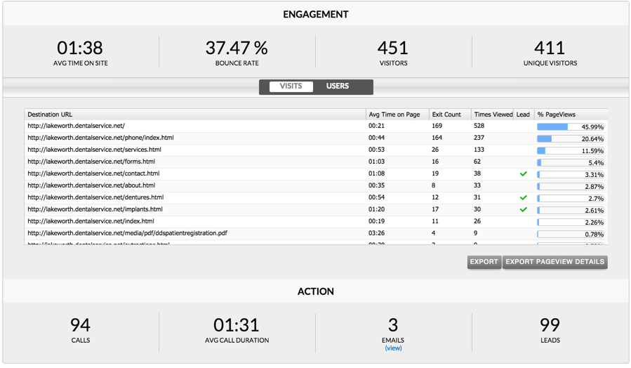
Notes:
The next section shows the user engagement and actions. Remember, in order to see the engagement and action metrics, you will need to have your customer’s website and advertising campaign tracked thru a mirror-site set up thru your ad operations and fulfillment team. In addition, by including a call tracking number, we can see the data both under the action section, as well as within the specific calls report.
The engagement section mirrors the summary page with the following metrics:
Average time spent on the website. This metric can vary depending on the industry and content on the site. A longer duration could mean your visitors are engaged with the site and want to stay. A much shorter duration could mean they are struggling to understand your navigation scheme or to find meaningful content. In general, though, a longer time means you're successfully engaging your visitors.
The Bounce Rate, which is the percent of consumers who clicked on your ad and went no further into the site than the click-to page. Average bounce rates tend to be around 40-60%. If the bounce rate is lower than the average, you’ve attracted consumers who are engaged and interested in learning more about your business. If the bounce rate is higher, don’t assume that is a negative. If consumers can quickly find what they are looking for on the landing page, they don’t need to stay longer on your site. However, if the message in the creative does not lead them to the page on your site that contains that product, service or offer, you will see a higher bounce rate and you may want to consider modifying your campaign.
Visitors are the total number of consumers that visited your website or landing page as a result of clicking on an ad or returning to the site after first clicking on the ad. This number could include return visits by the same consumer.
And finally, Unique visitors which is a sub-set of total visitors. A unique visitor measures the number of distinct individuals who visited your website or landing page in any given time period, regardless of how many times they visit.
Now let’s take a look at the Users tab: (next slide)

Slide 6
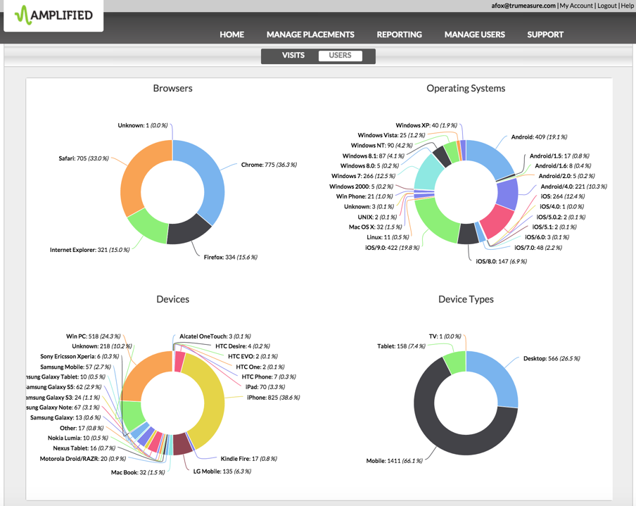
Notes:
The user tab provides insight into the users behind the visits. As a reminder, the only way to get this information is if there is a mirror site set up for your advertiser.
The information within this section is used to determine where user traffic is coming from. It is very helpful for a business owner, as well as programmers, to identify any necessary changes needing to made with their website to make sure they are optimized correctly to give a friendly user experience within different browsers or devices. As shown in this example, this customer would want to make sure they have responsive website, since they have a large amount of their traffic coming from mobile devices and tablets.

Slide 7
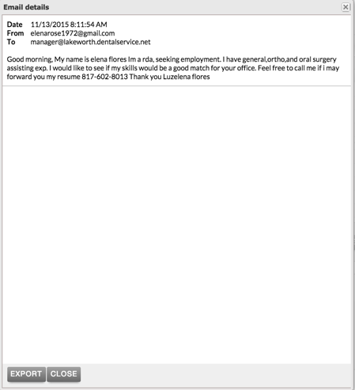
Notes:
Under the actions section, you will see the total calls delivered, and the average call duration. We can also view the emails generated, and the total leads. Remember, the leads are defined by your client by tagging the pages that potential customers would visit as part of their decision to do business with them. There's also a view link under the email metric that when clicked will display the contents of the email.
When we look at the total campaign metrics from the summary page, we can see that with search driving 94 of the 145 total calls, all 3 of the total emails, and 99 of the total 101 website leads, search is certainly doing its part to drive awareness and engagement.

Slide 8
Notes:
This completes the Amplified Analytics search data page training.

