Slide 1
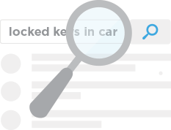
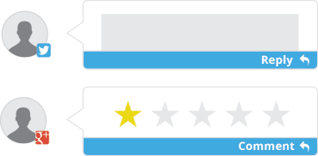
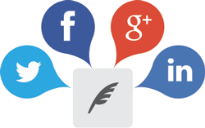
SOCIAL MARKETING
GROW YOUR BUSINESS WITH
SOCIAL MEDIA
Social media marketing is successful when you are constantly posting updates and having real-time interactions with your customers. But really, who has enough time for that?
To make things easier, we offer a tool that streamlines all of your social media marketing needs. Social Marketing helps you publish content, find real-time leads and interact with your online audience. Finally, you can build loyal followers (and revenue) without wasting valuable time.
90%
of shoppers trust recommendations on social media, while only 14% trust ads.¹
Generate new leads and customers
Build a loyal following and fan base
Respond to customer feedback
Compose posts to popular social channels
Find leads based on social activity in your area and engage them with the click of a button! Discovery Marketing is the fastest way to find red-hot business opportunities through social media. | Thinking up new things to say on social media can be difficult. Social Marketing helps local businesses create compelling social posts that people want to tune into. | Stay up to date with your social activity and see what people are saying about you—all from one dashboard. Hear the latest buzz and respond directly to customers from one place. | Compose and post content across all of your platforms from one location. Plan and compose future posts, too, then sit back and watch as we take care of them for you.
1http://webbiquity.com/social-media-marketing/106-more-amazing-social-media-and-marketing-statistics-for-2014-and-2015/

Slide 2
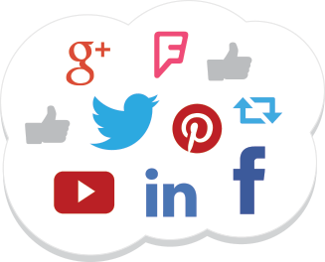
SOCIAL MARKETING
BENEFITS
Interact directly with new customers to expand your audience
Discover content and republish it to engage with your audience
Respond to clients on multiple social platforms from one place
Monitor Facebook, Twitter, Google, LinkedIn and Foursquare accounts from one easy-to-use location
Compose and post content to all of your social channels, as well as schedule content to publish at a later date
85%
of fans of brands on Facebook recommend brands to others, compared to just 60% of average users. ²
Customer
Service
Generating
Leads
Building
Fans
Monitor, manage and build your online reputation today!
² http://www.syncapse.com/value-of-a-facebook-fan-2013/#.U9gcRPldV8F

