Slide 1
Training Deck – Facebook Ads

Slide 2
FACEBOOK ADS
FACEBOOK ADS ARE GREAT FOR LEAD GENERATION AND AWARENESS
AWARENESS
HUNDREDS OF TARGETING OPTIONS AVAIABLE
BRANDING
CONSIDERATION
GREAT LEAD GENERATION, AWARENESS AND LIKE GENERATION
PREFERENCE
LEAD GEN
PURCHASE
RIGHT RAIL, IN FEED, INSTAGRAM AND AUDIENCE EXTENSION PLACEMENTS
LOYALTY
ADVOCACY
CPC (COST PER CLICK) OR CPM (COST PER THOUSAND) PRICING MODEL AVAILABLE - $500/MONTH MINIMUM

Slide 3
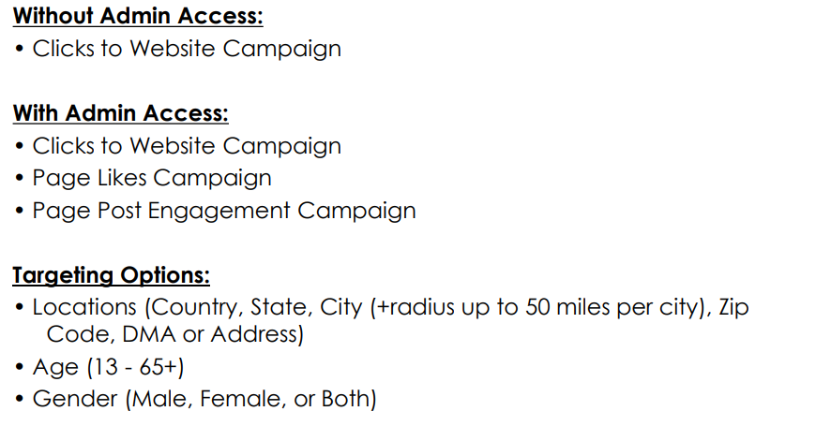
WHAT WE CAN DO

Slide 4
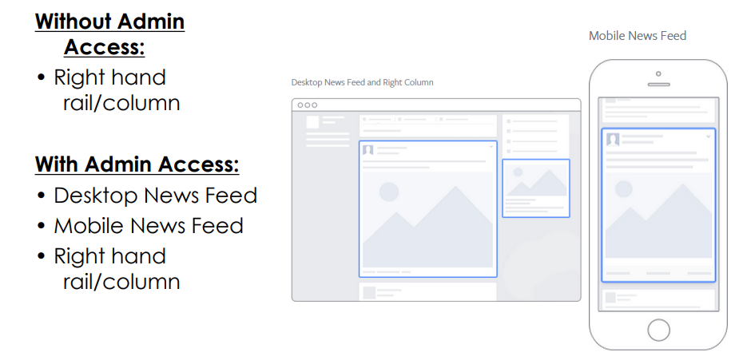
FACEBOOK ADS
WHERE DO THEY APPEAR?

Slide 5
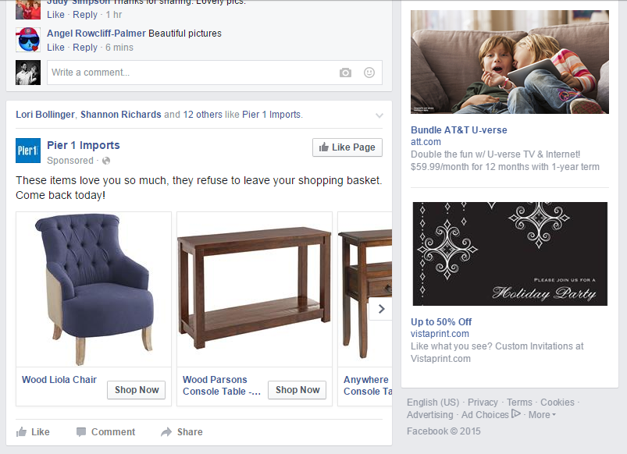
SOCIAL MEDIA MARKETING
FACEBOOK ADS
3 TYPES OF CAMPAIGNS TO RUN
PAGE POST ENGAGMENT
CLICKS TO WEBSITE
Page likes

Slide 6
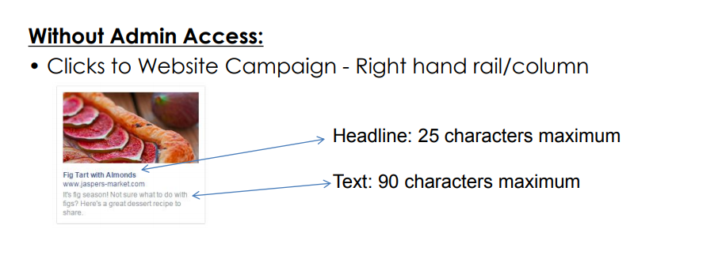
CLICKS TO WEBSITE CAMPAIGN
FACEBOOK ADS

Slide 7
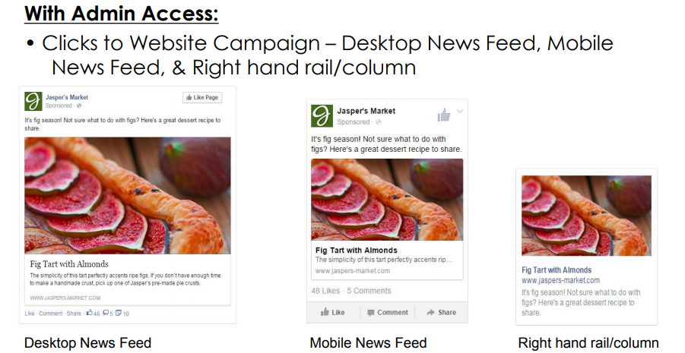
CLICKS TO WEBSITE CAMPAIGN
FACEBOOK ADS

Slide 8
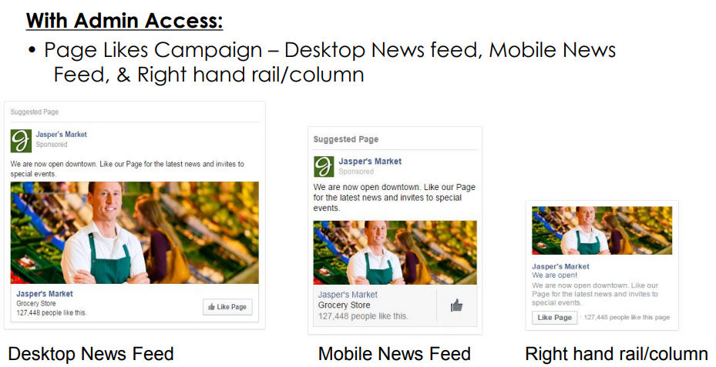
PAGE LIKES CAMPAIGN
FACEBOOK ADS

Slide 9
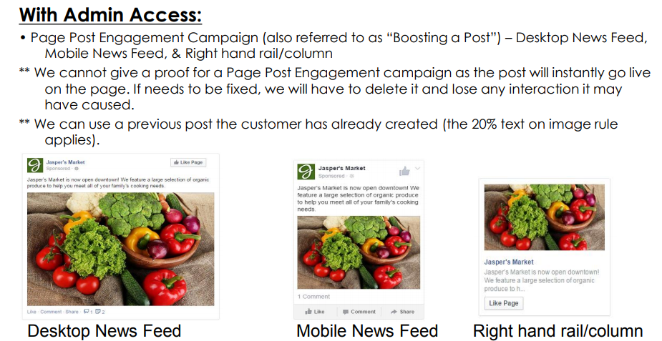
PAGE POST ENGAGEMENT (BOOST) CAMPAIGN
FACEBOOK ADS

Slide 10
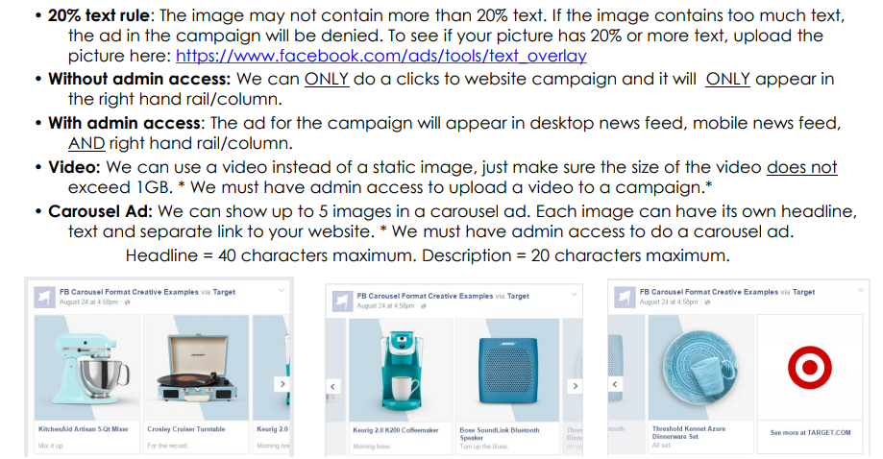
THINGS TO KEEP IN MIND

Slide 11
FACEBOOK AD CAMPAIGN FULFILLMENT – OVERVIEW OF PROCESS
Identify an interest from the advertiser - Have a conversation about their needs
SUBMIT A request for quote or sold order at (minimums apply see handout) http://leeenterprises.formstack.com/forms/smm
CAMPAIGN SETUP AND GO LIVE (Centralized team)
Campaign is monitored to ensure that it is spending correctly and adjustments made to keyword bids as needed
REPORTING CAN BE FOUND IN AMPLIFIED LOCAL REPORTING SUITE
FINAL COSTS ARE CHARGED BACK TO ENTERPRISE

Slide 12
QUESTIONS? Sales: Contact Adriane Morris Adriane.morris@lee.net 563-383-2127 Fulfillment: Contact Eddi Umphrey edwina.umphrey@lee.net 563.383.2502

