Slide 1
Training Deck – Overview of Lee

Slide 2
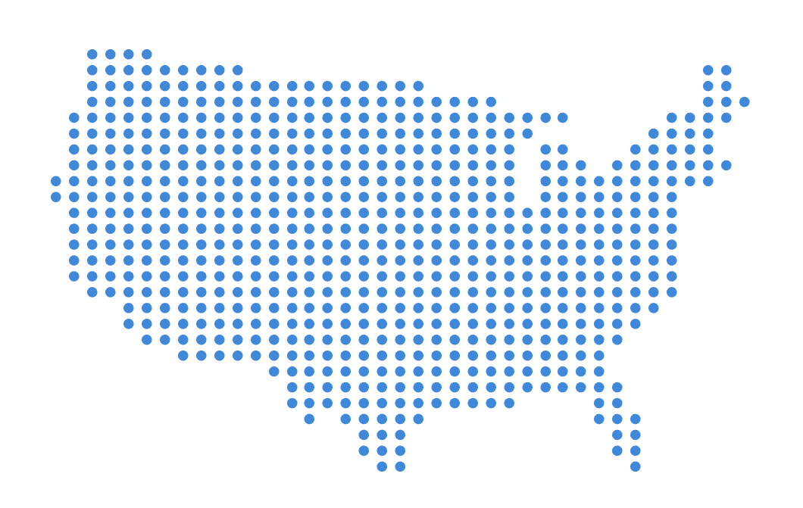
LEE ENTERPRISES
AT A GLANCE
Huge audiences – print and digital
Attractive midsize to small markets with a strong sense of community
Little print competition
Daily community newspapers
About 0.9 million daily print circulation
More than 1.2 million Sunday print circulation
Nearly 3 million readers
Digital products and services
#1 local web and mobile sites
More than 26 million digital unique visitors per month
TownNews provides content management and digital services for more than 1,600 news sites
Nearly 300 niche publications
Including both print publications and digital sites
Weekly community newspapers
Large group of agricultural newspapers
LARGE AUDIENCES IN MID-SIZED COMMUNITIES
Notes:
Our newspapers are located in 50 markets in 21 states. We focus on solid, mid-sized communities where we are the dominate provider of local news, information and advertising in both digital and print — places like Madison, Wisconsin; Billings, Montana; Davenport, Iowa; and Lincoln, Nebraska — to name a few.
Our printed newspapers reach about 900,000 households daily and more than 1.2 million on Sunday, totaling nearly three million readers. Our web and mobile sites are the number one digital local news source in most of our markets, reaching more than 26 million unique visitors each month.
Additionally, our fast growing subsidiary, TownNews.com, provides digital and content management services to more than 1,600 newspapers and broadcast entities across the country.
We also cover our markets with nearly 300 other publications — most with additional digital platforms — to further expand our local audiences and market penetration.

Slide 3
STRONG LOCAL MARKETS
Leading provider of HIGHLY-VALUED local news, information and advertising
Dominant Source Of Local News, Information And Advertising
Produce Content Highly Relevant And Desirable To The Communities We Serve
Well Established Brands With Deep Community Roots
Notes:
Most Lee markets are midsize, regional hubs where our digital and print media are the dominant sources of local news, information and advertising with very little, if any, print competition. Our brands are well established and have deep community roots. We publish breaking news and updates around the clock on all of our digital platforms. In our markets, we have more reporters, photographers and sales people on the street than all of our competitors combined. We are — by far — the leading media in the communities we serve.

Slide 4
LOCAL AUDIENCE STRENGTH
LEE AUDIENCE SPANS ALL AGE GROUPS
Audience by age group
74% of all adults interact with us over a 7-day period
80%
73%
73%
11%
66%
17%
Total Digital
Users: 36%
19%
Total Print
Readers: 46%
27%
Lee Enterprises Audience Report, Thoroughbred Research, January-June 2016.
Markets: Billings, MT; Bloomington, IL; Davenport, IA; Lincoln, NE; Madison, WI; Northwest Indiana; La Crosse, WI/Winona, MN; St. Louis, MO; Sioux City, IA; Waterloo, IA; Tucson, AZ. Margins of error: All Adults +/-1.1 % points; ages 18-29 +/-6.4 % points; ages 30-39 +/-4.9% points; ages 40-59 +/-2.2% points; ages 60-plus +/-1.6 % points.
Notes:
We deliver huge audiences in our markets with strength across all age groups.
The column at the left shows our seven-day reach in our largest markets. We reach 75 percent of adults. Of those, 46 percent are print readers and 36 percent access our digital products. Twelve percent say they “use” the newspaper for such information as advertising, entertainment listings and sports scores.
We are highly relevant to all age groups and reach 66 percent of millennials. Although this age group is more likely to use our digital products, 32 percent read our printed newspapers; 40 percent access us using websites and apps; and, 11 percent use us for such things as advertising, sports scores and entertainment listings.

Slide 5
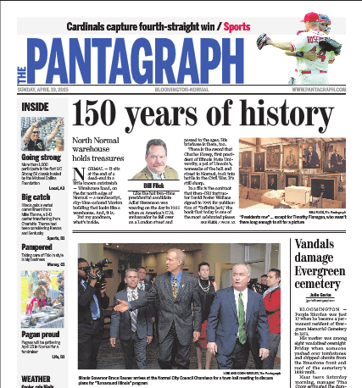
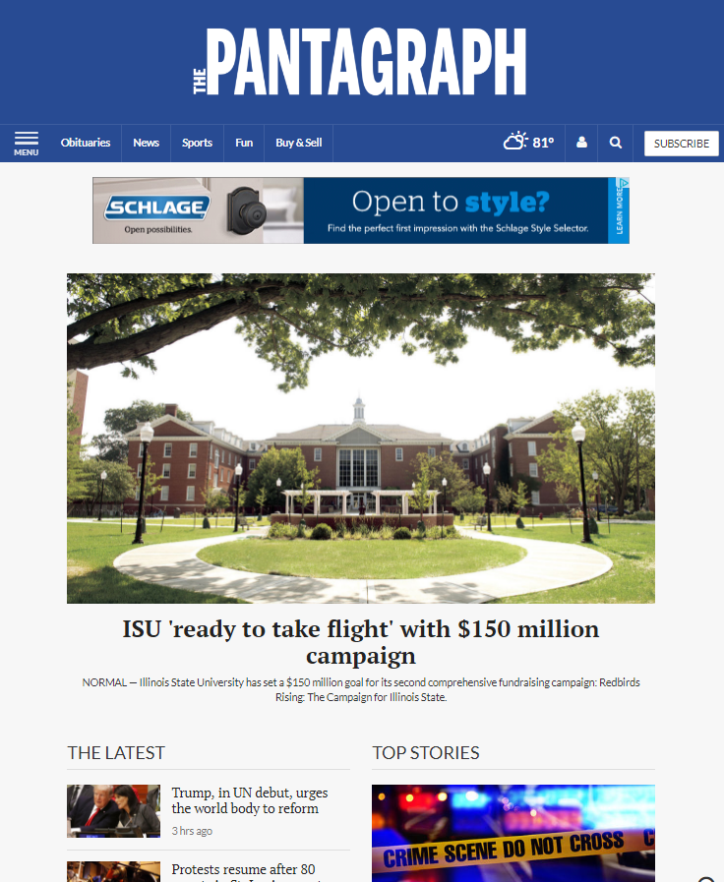
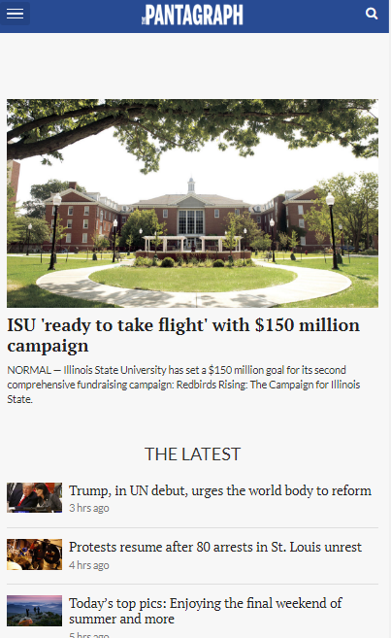
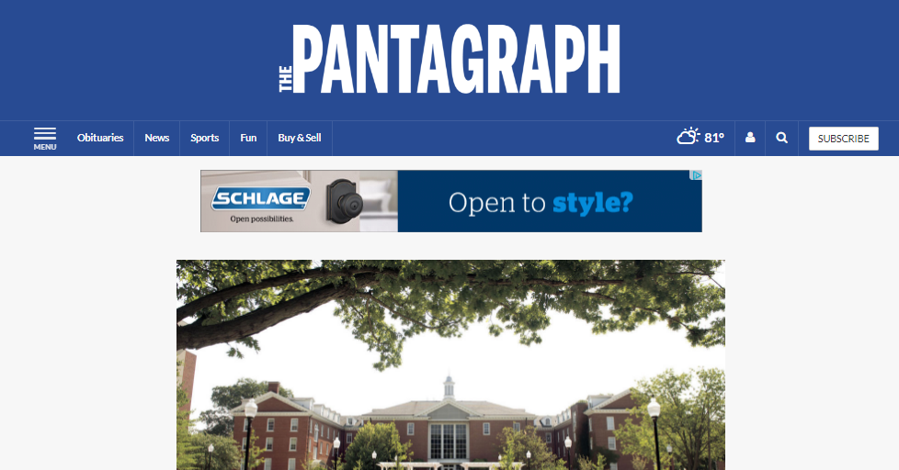
WHY US?
WE ARE LOCAL, PROVEN & TRUSTED
Delivering local audiences and results for customers since 1890.
We are the largest publisher of content in the markets we serve; no one knows more about the market than we do.
We have more top talent and feet on the street than our competition.
We leverage national scale to understand trends to be applied at the local level.
Notes:
Our local sales forces are one of our core strengths. We have strong relationships with businesses in our markets and offer a wide array of products to deliver the advertisers’ message.

Slide 6
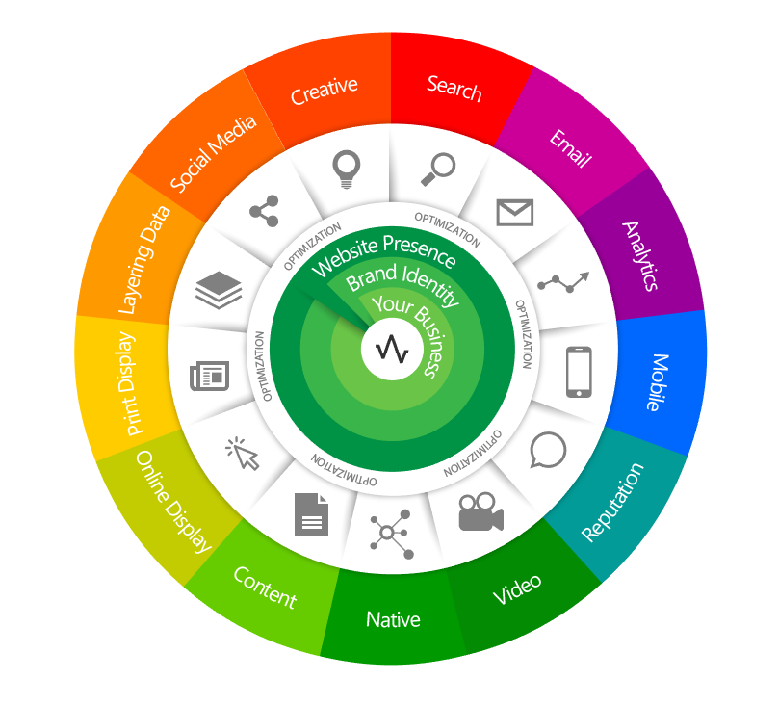
WHY US?
We are more than just a newspaper company. We can offer our clients turn-key integrated marketing strategies.
Data is key. We help our clients understand the data to build greater results and stronger ROI’s.
Our full service agency approach delivers high-quality, engaging creative for our clients.
We aren’t set it and forget it. We operate with a very “hands on” approach, ensuring optimal delivery.
WE ARE FULL SERVICE AND DATA FOCUSED
Integrated marketing ecosystem

Slide 7
ROBUST DIGITAL AUDIENCES

Slide 10
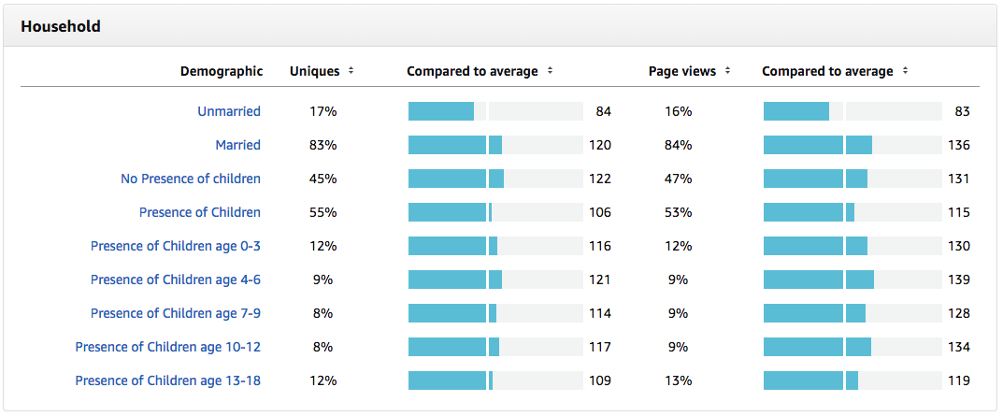

Slide 11
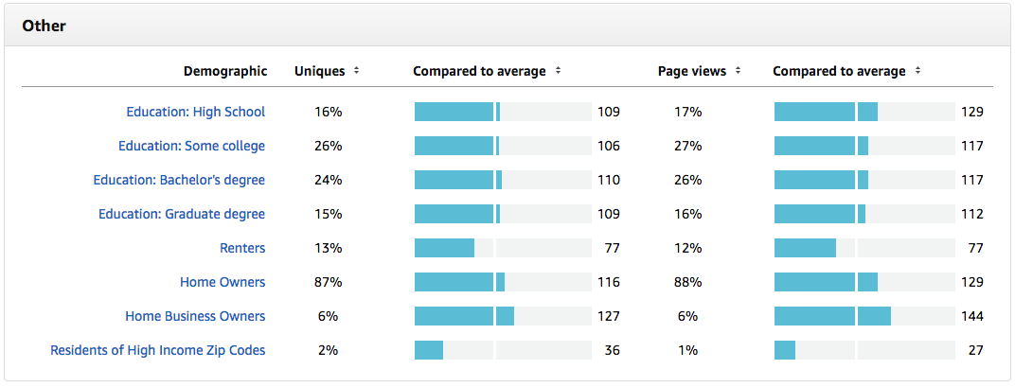

Slide 12
QUESTIONS? Contact Adriane Morris Adriane.morris@lee.net 563-383-2127

