Slide 1
Training Deck – SEO

Slide 2
THERE ARE 6,586,013,574 SEARCHES BEING DONE A DAY WORLDWIDE
http://www.smartinsights.com/search-engine-marketing/search-engine-statistics/

Slide 3
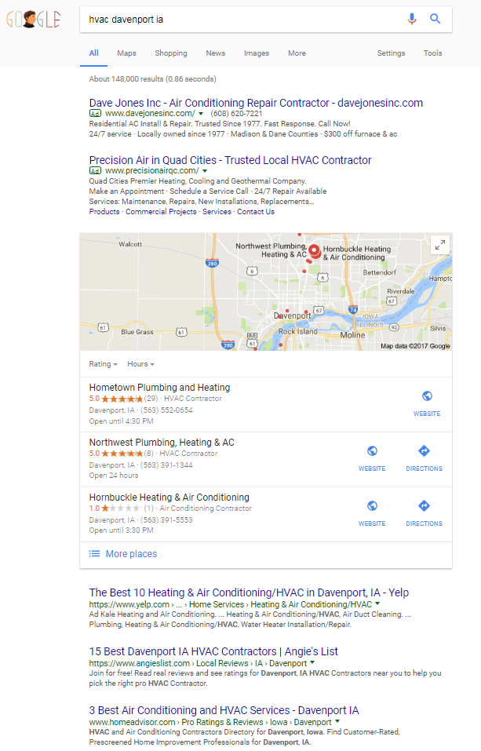
SEARCH
VISUAL OVERVIEW
PAID SEARCH
SEM (SEARCH ENGINE MARKETING)
PPC (PAY PER CLICK)
GOOGLE ADWORDS
MAPS LISTINGS
LOCATION BASED
CLAIMING GOOGLE LISITNGS
SEARCH ENGINE RESULTS PAGE
ORGANIC SEARCH
SEO (SEARCH ENGINE OPTIMIZATION)

Slide 4
SEO (SEARCH ENGINE OPTIMIZATION)
SEO IS GREAT FOR AWARENESS AND LEAD GENERATION
AWARENESS
“MARATHON CAMPAIGN”
BRANDING
CONSIDERATION
ALL ABOUT RELEVANCY WITH THE SEARCH ENGINES
PREFERENCE
REACH CONSUMERS TOP AND MID FUNNEL
LEAD GEN
PURCHASE
TWO PRONGED APPROACH
ON-SITE
OFF-SITE
LOYALTY
ADVOCACY

Slide 5
WHY IS SEO IMPORTANT?
70% Search Online Before Buying
Prospective buyers begin their search online. By the time they visit your site, 60% of the purchasing process is already complete.
70

Slide 6
HOW DOES SEO WORK?
TWO PRONGED APPROACH
ON-SITE OPTIMIZATION
OFF-SITE OPTIMIZATION
SEO
Indexability
Trust
User Experience
Relevance
Authority

Slide 7
SEARCH ENGINE OPTIMIZATION
HOW DOES IT WORK?
Indexability
Are your individual pages able to be viewed and categorized by the search engines? Are there certain elements of your website that disallow Google from understanding the content?
Relevance
Does the information on your website accurately describe exactly what you do? Can the search engines clearly understand your content?
SEO
Authority/TRUST
Are other websites linking to your site, referring their unique traffic to your website?
User Experience
Once someone has visited your website, are there defined elements that entice them into taking the next step? Is your phone number prominently advertised? Do you have a clear “Contact us!” procedure laid out?

Slide 8
ON-SITE OPTIMIZATION
EXISTING CONTENT
META INFORMATION
KEYWORDS
<title tag>
</a>
What people can read
on your site
Title tags, meta descriptions
Placing the right
keywords within your
content

Slide 9
OFF-SITE OPTIMIZATION
Industry-Specific Links
Dedicated Content Team
Quality content created by a dedicated content team.
Linking Pizza Hut to an HVAC contractor makes no sense. Google penalizes unnatural link behavior.
Blogs
Algorithm-Friendly Content
No cutting corners. Only the highest quality content is posted on your client’s behalf.
Extensive relationships with blogs all over the country

Slide 10
ADDITIONAL SEO DETIALS
MINIMUM MONTHLY SPEND IS $500
SEO IS A MARATHON, NOT A SPRINT. 6 MONTH MINIMUM CAMPAIGN LENGTH TO START SEEING RESULTS. ANNUAL CAMPAIGNS ARE STRONGLY RECOMMENDED.
SEO IS AN ESSENTIAL ELEMENT TO ANY NEW WEBSITE BUILD; GREAT ADD ON
SEO AND SEM WORK GREAT TOGETHER FOR TOTAL SEARCH ENGINE DOMINATION

Slide 11
SEO CAMPAIGN FULFILLMENT TIMELINE
1
1. Verify interest and submit request for proposal
2
2. Proposal returned within 24 hours
3
3. Sale Closed and order entered into Launchpad
4
4. Welcome Call Scheduled with Client
3
5
5. Ongoing monthly check-in call with Client

Slide 12
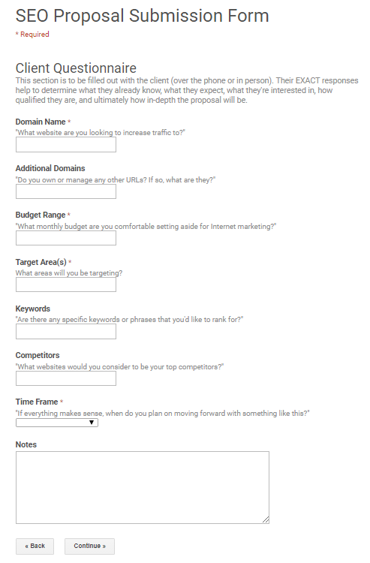
FULFILLMENT
REQUEST FOR PROPOSAL
SEO PROPOSAL IS RETURNED WITHIN 24-48 HOURS
SEO PROPOSAL SUBMISSION FORM

Slide 13
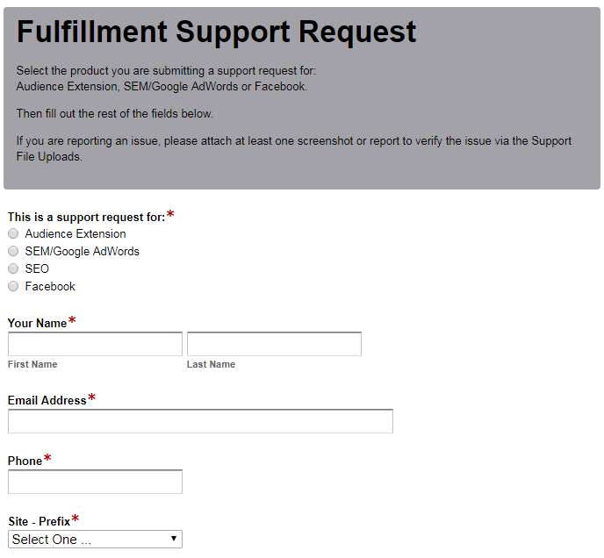
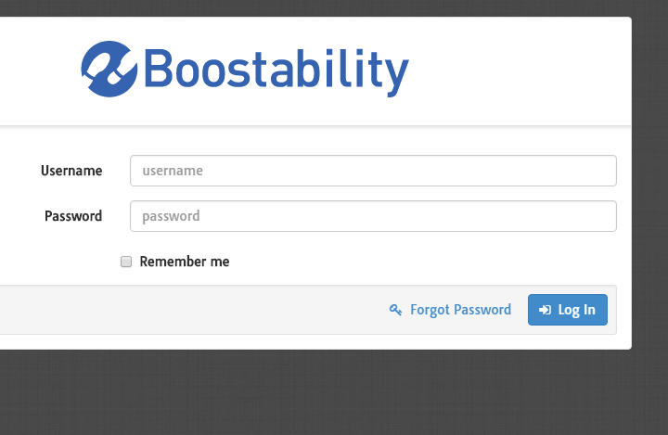
FULFILLMENT
SUBMIT A SOLD ORDER
SUBMIT SOLD ORDER HERE
- ALREADY HAVE LOGIN
SUBMIT SOLD ORDER HERE
- NEED A LOGIN

Slide 14
QUESTIONS? Sales: Contact Adriane Morris Adriane.morris@lee.net 563-383-2127 Fulfillment: Contact Eddi Umphrey edwina.umphrey@lee.net 563.383.2502

